Slide 1
CHAPTER 4 – NETWORKSAND EFFECTS OF USING THEM

Slide 2
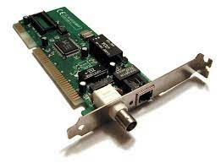

Slide 3
NIC – NETWROK INTERFACE CARD

Slide 4
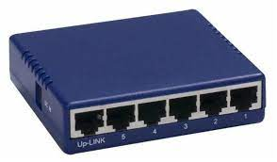

Slide 5
HUB

Slide 6
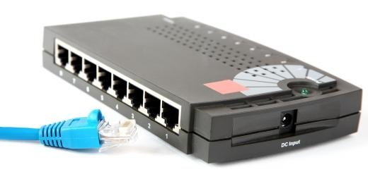

Slide 7
BRIDGES

Slide 8
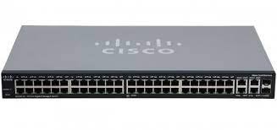

Slide 9
SWITCHES

Slide 10
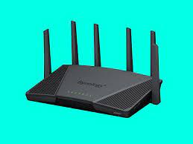

Slide 11
ROUTER

