Slide 1
Topic CPU, its components, von Neumann architecture, and buses.
Computer science
Year 8

Slide 2
Microprocessor

Slide 3
https://www.youtube.com/watch?v=OWCaYfPcaoI

Slide 7
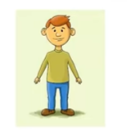
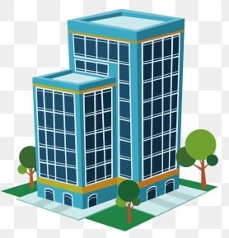
Architecture?
Every object has its own structure
Similarly computer has its own structure

Slide 8
Computer Architecture
The most famous computer architecture is von Neuman architecture

Slide 9
Von Neumann architecture

Slide 10
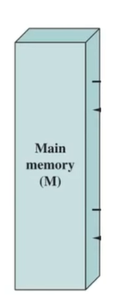
Von Neumann architecture

Slide 11
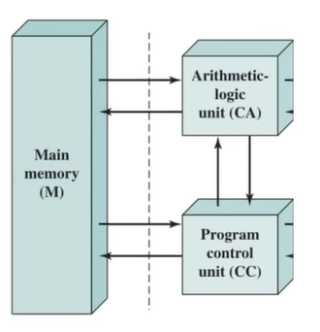
Von Neumann architecture

Slide 12
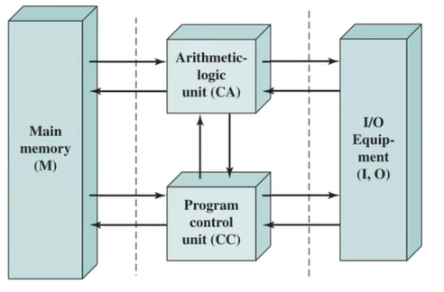
Von Neumann architecture

Slide 13
Components of Von Neumann architecture
CPU
Arithmetic and logic unit
Control unit
Registers
Buses
Memory unit
I/O Unit

Slide 14
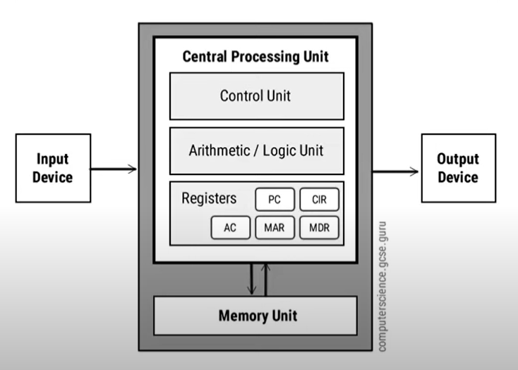
Von Neumann architecture

Slide 16
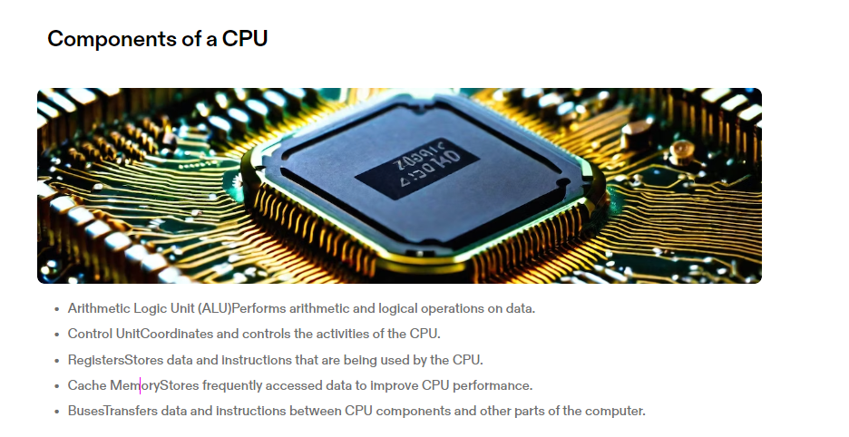

Slide 18
Thank You!

