Slide 1
Be a Storyteller
T2 Wk 2 D2

Slide 2
Lesson Objective
By the end of the lesson, learners will be able to To change code to get the right result.

Slide 3
Hook Activity-Pair Activity (10 mins)

Slide 4
Main Activity– Pair Work (20 mins) (pg 101)
Extension task:
Early finishers will do challenge task on pg 102.

Slide 5
Extension task: Early finishers will do challenge task on pg 102.

Slide 6
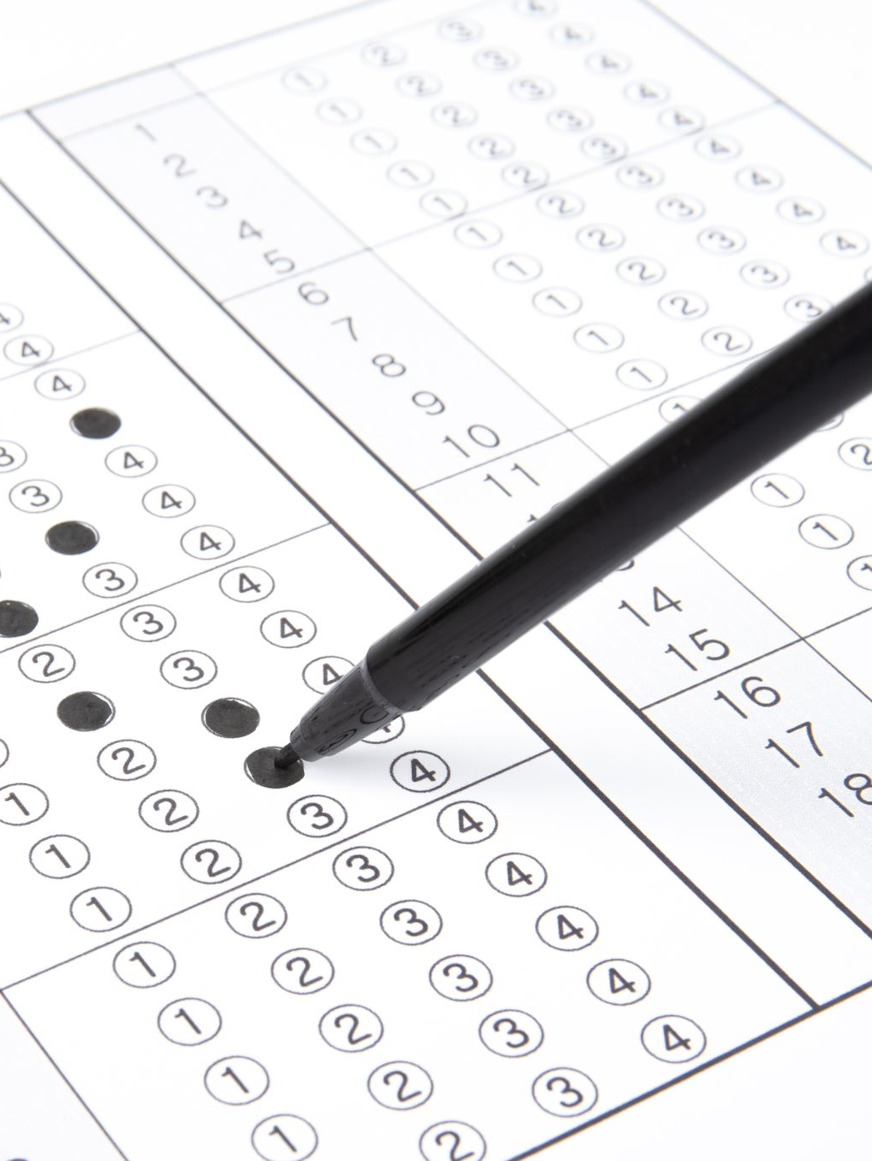
Exit Ticket
Do the following Quiz on Quizlet.
https://quizlet.com/862000281/match
Quiz 1

