Slide 1
Science - Year 3/4B Summer 2
Electricity
Electric Personalities
Session 3
Game PowerPoint
© Original resource copyright Hamilton Trust, who give permission for it to be adapted as wished by individual users.
We refer you to our warning, at the foot of the block overview, about links to other websites.

Slide 2
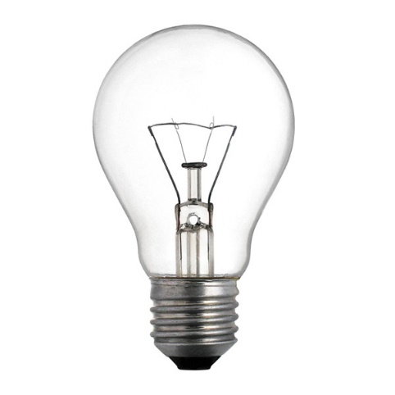
This game is called
Top Score Wins!
On each slide there is a sentence with 3 possible endings. One is low, one is in the middle and the other is high. Your team should discuss the sentence and agree on the ending that you think is correct or gives the best explanation.
If you think the lowest one is correct, crouch with your hands touching the floor. If you think the middle one is correct, stand with your hands held straight out in front of you. If you think the highest one is correct, reach your hands high up into the air.

Slide 3
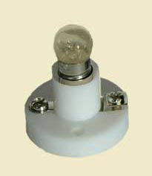
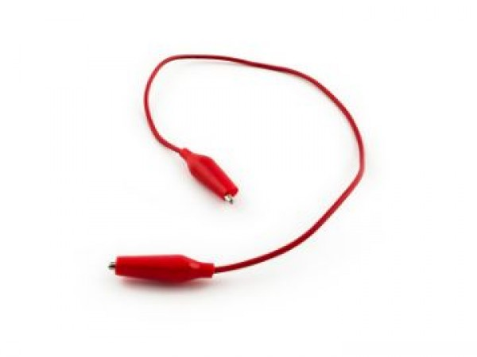
When all the teams have made their choice your teacher will click to reveal the answer. The teams that have picked the correct answer win a cube. The team with the most cubes at the end is the winner.
Good Luck!

Slide 4
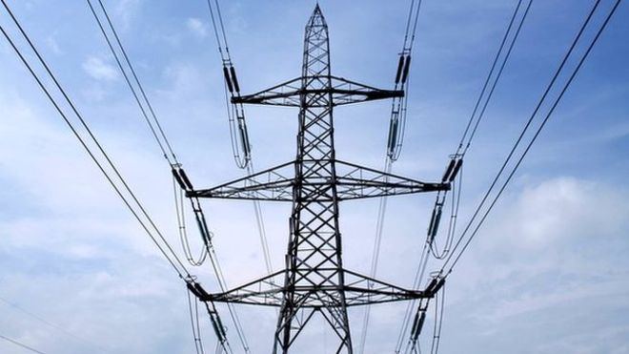
1. The flow of electricity is called …
a current
a raisin
a currant

Slide 5
2. Electricity must flow in a continuous loop which is called a ….
a circus
a circle
a circuit

Slide 6
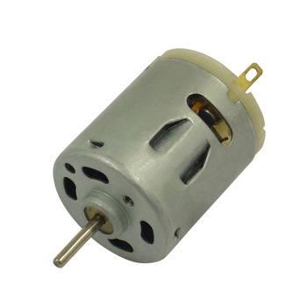
3. To make a circuit you must have …
a bulb
a motor
a power source

Slide 7
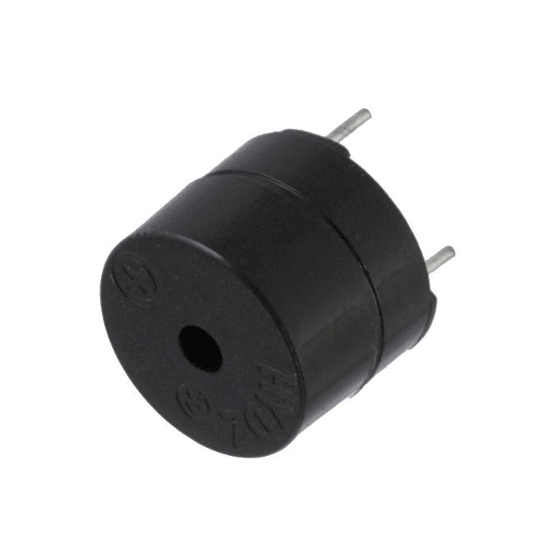
4. The parts that make up an electrical circuit are called …
items
components
appliances

Slide 8
5. A single unit that converts chemical energy into electrical energy is called …
a battery
a cell
a cylinder

Slide 9
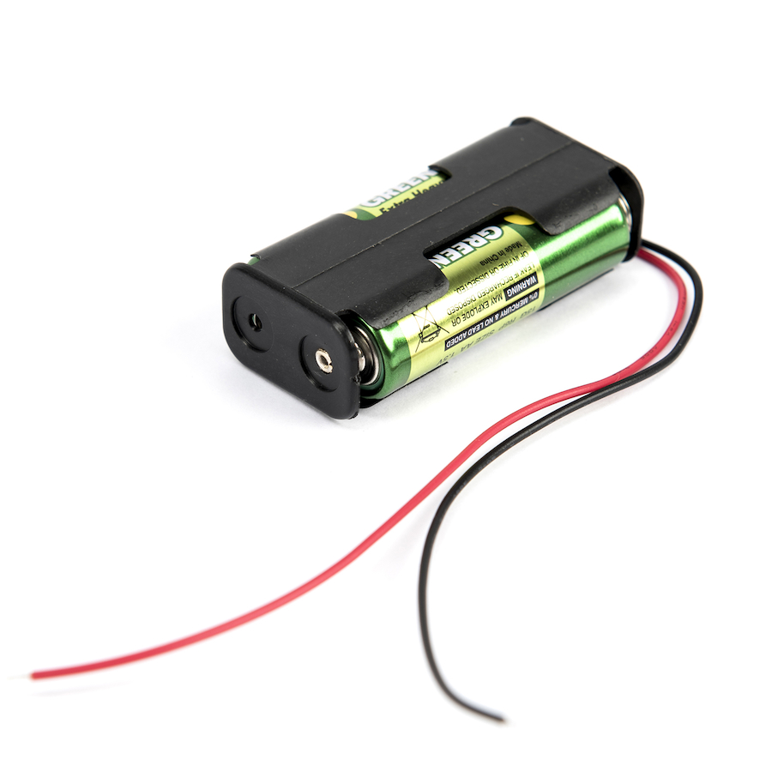
6. A group of 2 or more cells is called …
a battery
a collection
a power box

Slide 10
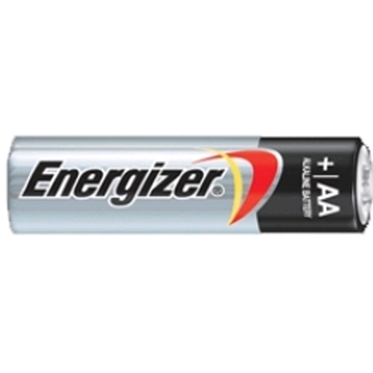
7. All cells have two …
points
terminals
bumps

Slide 11
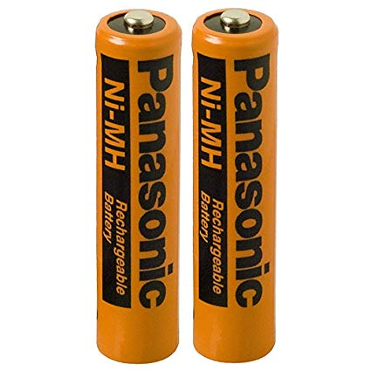
8. The terminals are marked …
0 and 1
✓ and X
+ and -

Slide 12
9. This bulb will not light up because …
There is no power source
Both the leads are joined to the same terminal
The cell has no power left

Slide 13
10. Which bulb will be brightest?
The bulb in circuit A
A
The bulb in circuit B
B
Neither - both bulbs will be equally bright

Slide 14
11. There are recognised symbols for electrical components to make it easier to draw circuits. This is the symbol for a …
bulb
buzzer
motor

Slide 15
12. This diagram shows a circuit with a bulb in it. The arrow points to the symbol for a …
cell
buzzer
motor

Slide 16
13. Here the arrow is pointing at the symbol for a …
battery
motor
buzzer

Slide 17
15. This circuit diagram shows a …
Cell and a motor
battery and a buzzer
motor and a battery

Slide 18
16. Which of these symbols are labelled correctly?
All of them
Cell
Battery
Motor
All except the switch
Buzzer
Switch
Bulb
All except the battery

Slide 19
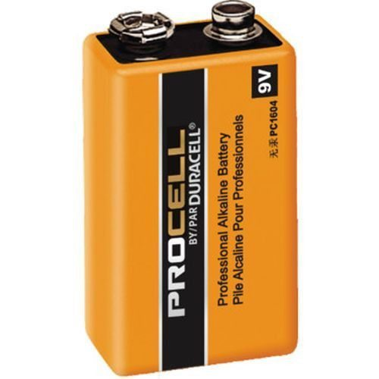
End of Game!
Congratulations to the winning team!

