Slide 1
Multiplication and division
Division of big numbers using vertical layout
Objectives
Day 1
Use a written method to divide numbers above the times tables.
Day 2
Use a written method to divide numbers above the times tables; Round up or down after division according to the context.
Day 3
Use a written method to divide numbers above the times tables; Choose a mental or written method to solve division.
Notes:
Before teaching, be aware that:
On Day 1 - 3 children will need mini-whiteboards and pens.

Slide 2
Multiplication and division
Division of big numbers using vertical layout
Starters
Day 1 Multiplication and division facts (pre-requisite skills)
Day 2 Place 5-digit numbers on a human number line (simmering skills)
Day 3 Convert between units of time (simmering skills)
Notes:
Choose starters that suit your class by dragging and dropping the relevant slide or slides below to the start of the teaching for each day.

Slide 3
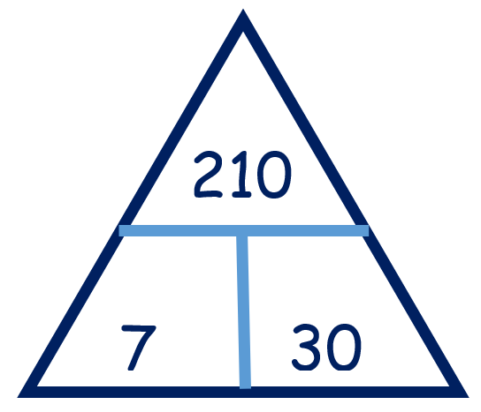
Multiplication and division
Division of big numbers using vertical layout
Starter Multiplication and division facts
Notes:
Pre-requisite skills – to use this starter, drag this slide to the start of Day 1
Ask children to work in pairs to write four number sentences that use all three numbers: two multiplications and two divisions, i.e. 7 x 30 = 210, 30 x 7 = 210, 210 ÷ 7 = 30 and 210 ÷ 30 = 7. Repeat for other triangles, e.g. 420, 6 and 70; 320, 40 and 8; 560, 7 and 80.

Slide 4
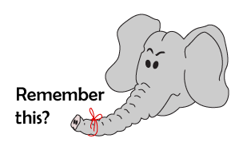
Multiplication and division
Division of big numbers using vertical layout
Starter
Place 5-digit numbers on a human number line
Notes:
Simmering skills – to use this starter, drag this slide to the start of Day 2
Ask two chn to hold 0 and 100,000 cards at either end of the front of the classroom. Secretly give a child the number 42,842 and ask them to stand roughly where they think this number lies between 0 and 100,000. Ask each group to suggest a number. The child says whether the mystery number is more or less. Say chn can now zoom in on the line between neighbouring multiples of 10,000. Which would they like? Change the end numbers to 40,000 and 50,000. The child stands at roughly the right place between them. Take a guess from each group. Afterwards they choose multiples of 1000 to go at each end of the line. Zoom in again so the child stands between 42,800 and 42,900. Each group agree and show a guess at the same time. The nearest wins.

Slide 5
Multiplication and division
Division of big numbers using vertical layout
Starter
Convert between units of time
Converting time units
Notes:
Simmering skills – to use this starter, drag this slide to the start of Day 3
Play ‘Converting time units’ at http://mrnussbaum.com/stdut/ . Show each of the 12 questions one at a time. Chn write A, B, C or D on their whiteboards to answer. Click on the letter with the most votes. Can you score more than 10 as a class?

Slide 6
Multiplication and division
Division of big numbers using vertical layout
Objectives
Day 1
Use a written method to divide numbers above the times tables.

Slide 7
Day 1: Use a written method to divide numbers above the times tables.
196 ÷ 6
Roughly how many 6s do you think are in 196?
30 × 6 = 180 and 40 × 6 = 240, so the answer should be between 30 and 40, and closer to 30 than 40.
We can draw jumps on an empty number line to help find the answer.
How much is left?
How many 6s in 16?
30 x 6
0
180
196

Slide 8
Day 1: Use a written method to divide numbers above the times tables.
196 ÷ 6
= 32 r 4
Does this answer seem about right?
Roughly how many 6s do you think are in 196?
30 × 6 = 180 and 40 × 6 = 240, so the answer should be between 30 and 40, and closer to 30 than 40.
We can draw jumps on the empty number line to help find the answer.
So how many are in 196?
How much is left?
r4
30 x 6
2 x 6
0
180
192
196
Notes:
Agree that the answer seems about right, because it is between 30 and 40, and closer to 30 as the original estimation suggested.

Slide 9
Day 1: Use a written method to divide numbers above the times tables.
196 ÷ 6
We can use a vertical layout of chunking. Think of the division as a ‘multiplication with a hole’.
□ × 6 = 196 How many 6s are in 196?
30 × 6 = 180 30 x 6 = 180. How much left?
16 How many 6s are in 16?
2 × 6 = 12 2 x 6 = 12. How much left?
4
196 ÷ 6 = 32 r 4

Slide 10
Day 1: Use a written method to divide numbers above the times tables.
113 ÷ 3
Roughly how many 3s do you think are in 113?
To use chunking on the number line, what do we do first?
Have a go!
How big is our first jump?
Notes:
Ask children to make an estimate first and then helping you with each stage of the division on the board.
Today would be a great day to use a problem-solving investigation – Revision Rules from NRICH – as the group activity, which you can find in this unit’s IN-DEPTH INVESTIGATION box on Hamilton’s website.
Alternatively, children can now go on to do differentiated GROUP ACTIVITIES. You can find Hamilton’s group activities in this unit’s TEACHING AND GROUP ACTIVITIES download.
WT: Use both empty number lines and vertical layouts, then choose a preference.
ARE: Use the vertical layout of chunking. Make an estimate between two multiples of 10 first.
GD: Come up with divisions by 6, 7, 8 and 9 with answers within given ranges. Check using vertical layout.

Slide 11
Notes:
The Practice Sheet on this slide is suitable for most children.
Differentiated PRACTICE WORKSHEETS are available on Hamilton’s website in this unit’s PROCEDURAL FLUENCY box.
WT: Practise using division (answers between 10 and 30).
ARE: Practise using division (answers between 20 and 30).
GD: Practise using division (answers between 30 and 70).

Slide 12
Multiplication and division
Division of big numbers using vertical layout
Objectives
Day 2
Use a written method to divide numbers above the times tables; Round up or down after division according to the context.

Slide 13
Day 2: Use a written method to divide numbers; Round up or down after division according to context.
A hotel is preparing for a wedding. There are 124 guests who will sit at tables of eight. How many tables are needed?
Discuss in pairs what calculation is needed and work together on your whiteboards to solve it.
How many tables are needed? Did we need to round the answer up or down?
124 ÷ 8 =15 r 4
Does this answer the problem?
Notes:
Discuss how 124 ÷ 8 = 15 r 4, and so 16 tables will be needed, rather than 15, otherwise four people would have nowhere to sit.

Slide 14
Day 2: Use a written method to divide numbers; Round up or down after division according to context.
A packer for an internet company is gift wrapping remote control sand buggies. It takes 3m of paper to wrap each sand buggy. There is 86m of wrap left.
How many buggies can he wrap before he needs to go to the warehouse to get more paper?
Discuss in pairs what calculation is needed and work together on your whiteboards to solve it.
Then work out the answer to the problem.
Did you need to round the answer up or down?
86 ÷ 3 =28 r 2
Notes:
Children can now go on to do differentiated GROUP ACTIVITIES. You can find Hamilton’s group activities in this unit’s TEACHING AND GROUP ACTIVITIES download.
WT: Make sketches to help solve word problems.
ARE: Solve word problems, then check answer to division with multiplication.
GD: Solve a multi-step division problem.

Slide 15
Notes:
The Practice Sheet on this slide is suitable for most children.
Downloadable PRACTICE WORKSHEETS are available on Hamilton’s website in this unit’s PROCEDURAL FLUENCY box.
WT/ARE/GD: Solve division word problems; round up or down.

Slide 16
Multiplication and division
Division of big numbers using vertical layout
Objectives
Day 3
Use a written method to divide numbers above the times tables; Choose a mental or written method to solve division.

Slide 17
Day 3: Use a written method to divide numbers; Choose a mental or written method to solve division.
127 ÷ 6 119 ÷ 4 123 ÷ 5 128 ÷ 7
Discuss in pairs which might have the greatest and smallest answers, and why.
Write the divisions in order from the smallest answer to the greatest.
128 ÷ 7 127 ÷ 6 123 ÷ 5 119 ÷ 4
Notes:
Draw out children’s reasoning, e.g. thirty 4s are 120 so 119 ÷ 4 will be just under 30.

Slide 18
Day 3: Use a written method to divide numbers; Choose a mental or written method to solve division.
246 ÷ 6 148 ÷ 4 148 ÷ 5 246 ÷ 5 148 ÷ 3 246 ÷ 7
Discuss in pairs which of these divisions you would work out mentally.
Roughly how many 3s do you think are in 148?
Examples of mental strategies
We can work out 148 ÷ 4 by halving twice.
246 ÷ 6 is quite easy because 240 is a multiple of 6, and there is another 6.
246 ÷ 8: 240 is a multiple of 8, and then there is 6 left over.
Chunking: vertical layout
□ × 3 = 148
40 × 3 = 120
28
9 × 3 = 27
1
148 ÷ 3 = 49 r 1
Notes:
Children can now go on to do differentiated GROUP ACTIVITIES. You can find Hamilton’s group activities in this unit’s TEACHING AND GROUP ACTIVITIES download.
WT: Identify which divisions can be done mentally and why.
ARE: Spot divisions with the same answer, and write others with the same answer.
GD: Find answers to divisions, writing the answers as mixed numbers.

Slide 19
Notes:
The Practice Sheet on this slide is suitable for most children.
Downloadable PRACTICE WORKSHEETS are available on Hamilton’s website in this unit’s PROCEDURAL FLUENCY box.
WT: Start at question 1 and do as many as they can.
ARE: Start at question 5 and do as many as they can.
GD: Complete whole sheet.

Slide 20
Multiplication and division
Division of big numbers using vertical layout
Well Done! You’ve completed this unit.
Objectives
Day 1
Use a written method to divide numbers above the times tables.
Day 2
Use a written method to divide numbers above the times tables; Round up or down after division according to the context.
Day 3
Use a written method to divide numbers above the times tables; Choose a mental or written method to solve division.
Notes:
You can now use the Mastery: Reasoning and Problem-Solving questions to assess children’s success across this unit. Go to the next slide.

Slide 21
Multiplication and Division
Problem solving and reasoning questions
Explain how each of these three divisions could be efficiently done mentally.
• 250 ÷ 5 =
• 180 ÷ 6 =
• 210 ÷ 3 =
So now explain how you would do these three.
• 255 ÷ 5 =
• 186 ÷ 6 =
• 213 ÷ 3 =
Divide 456 by 8 using just 2 hops along a number line. Show the same division using vertical layout.
Use vertical layout to find the answer to 234 divided by 6 and say why it is possibly less straightforward than 244 ÷ 6.
Write a division of a 3-digit number by a 1-digit number where the remainder is 5.

Slide 22
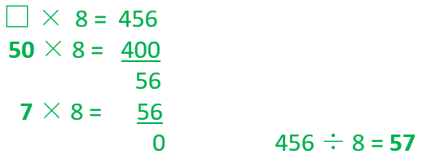
Problem solving and reasoning answers
Explain how each of these three divisions could be efficiently done mentally.
• 250 ÷ 5 = 50 since 25 ÷ 5 = 5
• 180 ÷ 6 = 30 since 18 ÷ 6 = 3
• 210 ÷ 3 = 70 since 21 ÷ 3 = 7
So now explain how you would do these three.
• 255 ÷ 5 = 51 since 255 is 5 more than 250
• 186 ÷ 6 = 31 since 186 is 6 more than 180
• 213 ÷ 3 = 71 since 213 is 3 more than 210
Divide 456 by 8 using just 2 hops along a number line. Show the same division using vertical layout. Hop 1: Fifty 8s (to 400), then Hop 2: Seven 8s to 456 = 57
Continued…

Slide 23
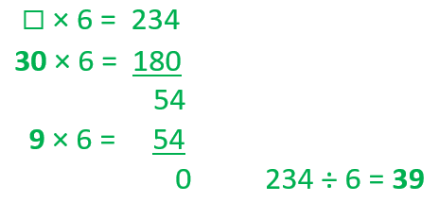
Problem solving and reasoning answers continued
Use vertical layout to find the answer to 234 divided by 6 and say why it is possibly less straightforward than 244 ÷ 6.
244 ÷ 6 is just 4 more than 240 ÷ 6 – which we should be able to complete mentally using a tables fact (24 ÷ 6) and place value knowledge (x10).
Write a division of a 3-digit number by a 1-digit number where the remainder is 5. Various – check. Note that the divisor must be at least 6 for there to be a remainder of 5.

