Slide 1
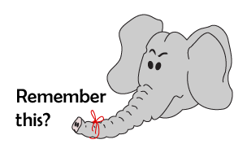
Addition and Subtraction
Number bonds to 10
Starter
Ordering numbers to 100
Notes:
Simmering skills – to use this starter, drag this slide to the start of Day 1
Cover up 10 numbers on a 1–100 grid with sticky notes (or grey out squares on ITP Number grid). Point to each in turn. Children write the missing number on their whiteboards. Reveal to check.

Slide 2
Addition and Subtraction
Number bonds to 10
Objectives
Day 1
Partition 10 into pairs. Write addition sentences.

Slide 3
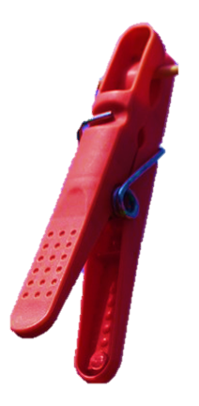
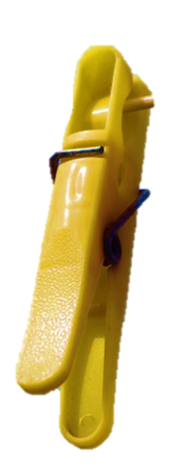
Day 1: Partition 10 into pairs; Write addition sentences.
How many pegs?
10
Notes:
Split the pegs into 9 and 1.

Slide 4
Day 1: Partition 10 into pairs; Write addition sentences.
There are 9 on this side.
And 1 here.
9 + 1 = 10

Slide 5
Day 1: Partition 10 into pairs; Write addition sentences.
What could we write now?
1 + 9 = 10
Notes:
Split 10 into other pairs and repeat.

Slide 6
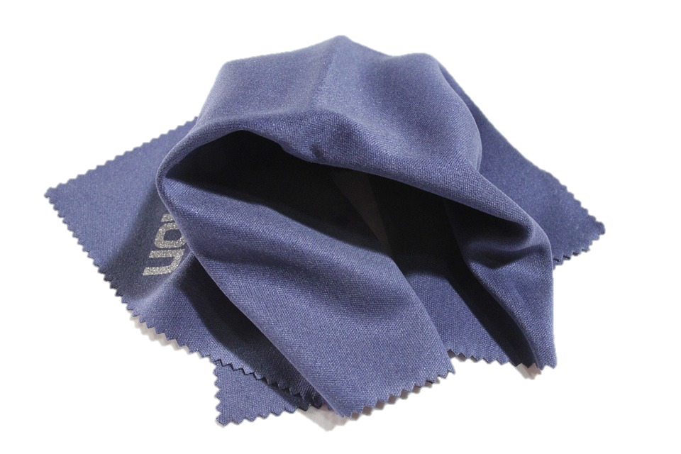
Day 1: Partition 10 into pairs; Write addition sentences.
Ask children to close their eyes while you hide some pegs under a cloth…
Talk to your partner.
How many pegs are hidden?
1
Notes:
Ask children how they know it is 1 peg that is hidden.

Slide 7
Day 1: Partition 10 into pairs; Write addition sentences.
Ask children to close their eyes…
How many pegs are hidden?
2
Notes:
Repeat, covering 2 pegs.

Slide 8
Day 1: Partition 10 into pairs; Write addition sentences.
Ask children to close their eyes…
How many pegs are hidden?
3
Notes:
Repeat, covering 3 pegs.

Slide 9
Day 1: Partition 10 into pairs; Write addition sentences.
Ask children to close their eyes…
How many pegs are hidden?
4
Notes:
Repeat, covering 4 pegs.

Slide 10
Day 1: Partition 10 into pairs; Write addition sentences.
Ask children to close their eyes…
How many pegs are hidden?
5
Notes:
Repeat covering 5.

Slide 11
Day 1: Partition 10 into pairs; Write addition sentences.
What is left if we take two pegs away?

Slide 12
Day 1: Partition 10 into pairs; Write addition sentences.
Talk to your partner.
What subtraction would we write?
10 – 2 = 8

Slide 13
Day 1: Partition 10 into pairs; Write addition sentences.
What if we took the 8 off instead?

Slide 14
Day 1: Partition 10 into pairs; Write addition sentences.
What subtraction would we write?
10 – 8 = 2

Slide 15
Day 1: Partition 10 into pairs; Write addition sentences.
What is left if we take 3 pegs away?

Slide 16
Day 1: Partition 10 into pairs; Write addition sentences.
What subtraction would we write?
10 – 3 = 7

Slide 17
Day 1: Partition 10 into pairs; Write addition sentences.
What if we took the 7 off instead?

Slide 18
Day 1: Partition 10 into pairs; Write addition sentences.
What subtraction would we write?
10 – 7 = 3
Notes:
Today would be a great day to use a problem-solving investigation – Square Tens – as the group activity, which you can find in this unit’s IN-DEPTH INVESTIGATION box on Hamilton’s website.
Alternatively, children can now go on to do differentiated GROUP ACTIVITIES. You can find Hamilton’s group activities in this unit’s TEACHING AND GROUP ACTIVITIES download.
WT/ARE/GD: Finding missing number bond numbers!

Slide 19
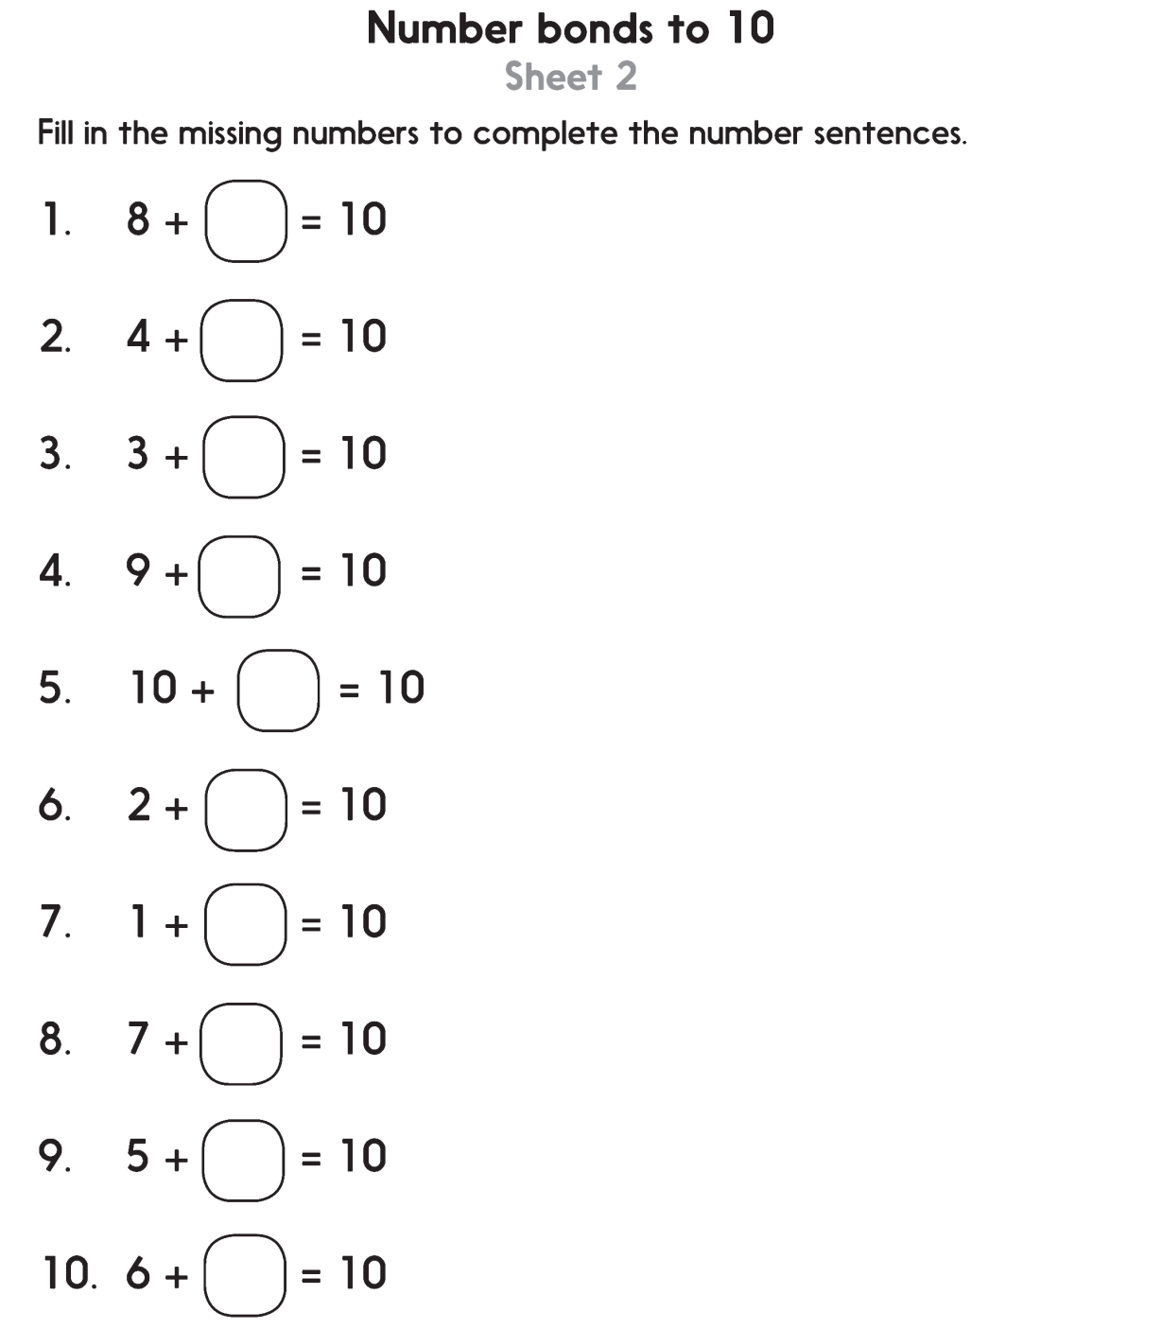
Challenge
Notes:
The Practice Sheet on this slide is suitable for most children.
Differentiated PRACTICE WORKSHEETS are available on Hamilton’s website in this unit’s PROCEDURAL FLUENCY box.
WT: Splitting 10 Sheet 1
ARE/GD: Number bonds to 10 Sheet 2

Slide 20
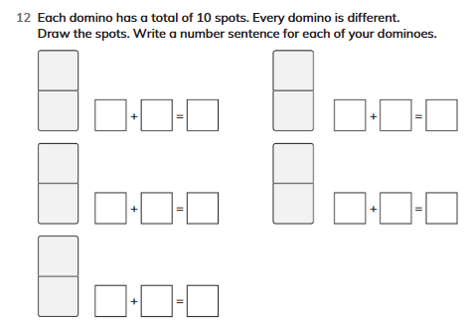
BOOK EXIT
Complete Workbook page 62 no. 12

