Slide 1
Place Value and Fractions
Ordinal numbers, Place value
Properties of 2-digit numbers, Rounding
Objectives
Day 1
Use ordinal numbers in context up to 10th and beyond.
Day 2
Compare numbers using the symbols < and >.
Day 3
Round 2-digit numbers to nearest multiple of 10.
Day 4
Round 2-digit numbers to nearest multiple of 10.
Notes:
Before teaching, be aware that:
On Day 1 you will need a selection of age birthday cards (to include 1st, 2nd, 3rd, 6th, 9th; children will need mini-whiteboards and pens.
On Day 2 you will need 0-100 landmarked line (see resources), black card strips and fasteners to make <, and > signs, cubes, card, 0-9 cards.
On Day 3 you would be best-served by using a 0-100-bead bar and tags; children will need mini-whiteboards and pens.
On Day 4 you will need items for sale with price labels [17p, 25p, 32p, 49p, 55p, 63p, 74p, 86p and 99p], a 0-100 landmarked line (see resources).

Slide 2
Place Value and Fractions
Ordinal numbers, Place value
Properties of 2-digit numbers, Rounding
Starters
Day 1
1 more/1 less (pre-requisite skills)
Day 2
Order 2-digit numbers (pre-requisite skills)
Day 3
Place value (simmering skills)
Day 4
Rounding (simmering skills)
Notes:
Choose starters that suit your class by dragging and dropping the relevant slide or slides below to the start of the teaching for each day.

Slide 3
Place Value and Fractions
Ordinal numbers, Place value
Properties of 2-digit numbers, Rounding
Starter
1 more/1 less
Notes:
Pre-requisite skills – to use this starter, drag this slide to the start of Day 1
Ask children to write a number on their whiteboards between 10 and 50. Choose a child to stand up and show their number. Draw 3 boxes next to each other on IWB. Write that number in the middle box. Choose children to come up and write the number one more on the right side and the number that is one less on the left. Repeat with other numbers. As children get used to the activity, simply point at the boxes and have children call out/ show you with a number fan the numbers 1 more and 1 less

Slide 4
Place Value and Fractions
Ordinal numbers, Place value
Properties of 2-digit numbers, Rounding
Starter
Order 2-digit numbers
Notes:
Pre-requisite skills – to use this starter, drag this slide to the start of Day 2
Put children in groups of 4. They each write a 2-digit number on a whiteboard and then work together to put them in order from the smallest to largest. Show a 1-100 grid (see resources) for them to check. Repeat then ask 2 groups of 4 to combine and order all 8 on whiteboards.

Slide 5
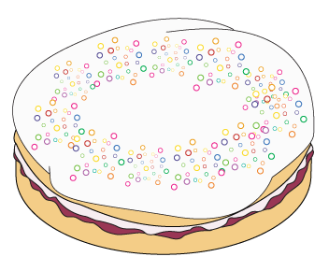
Day 4: Round 2-digit numbers to nearest multiple of 10.
49p
Let’s round each price to the nearest 10p.
63p
55p
74p
32p
86p
17p
99p

Slide 6
Day 4: Round 2-digit numbers to nearest multiple of 10.
17p
If we want to add these prices quickly, to know roughly how much they will be in total, it is much easier to round them first.
49p
63p
Add, 20p, 60p and 50p…
20p
50p
60p
What are your strategies for adding multiples of 10?
Notes:
What are the children’s strategies for adding multiples of 10? Are they using number facts to help, e.g. 30 + 40 by using 3 + 4? Or do they use ‘Spider’ to add 10s on the 100-square?
Children can now go on to do differentiated GROUP ACTIVITIES. You can find Hamilton’s group activities in this unit’s TEACHING AND GROUP ACTIVITIES download.
WT/ ARE: Identify numbers that will round to a given 10, using landmarked or penny number lines.
ARE/ GD: Round prices to the nearest 10p to keep a running total; use a calculator to find exact totals.

Slide 7
Task 1 – Pair/Group Work
Pick two prices that round down to 20p (e.g., 24p and 21p).
Pick two prices that round up to 20p (e.g., 15p and 19p).
Mark them on a number line from 0 to £1, with 10p intervals.
Repeat for 30p, 40p, 50p... up to £1.
Pick two prices that round down to 20p (e.g., 24p and 21p).
Pick two prices that round up to 20p (e.g., 15p and 19p).
Mark them on a number line (one that has pennies) from 0 to £1, with 10p intervals.
Repeat for 30p, 40p, 50p... up to £1.
Write two prices that round to 20p.
Write one price less than 20p and two prices more than 20p.
Record as number sentences, e.g., 18p < 20p.
Repeat for 30p, 40p… up to £1.

Slide 8
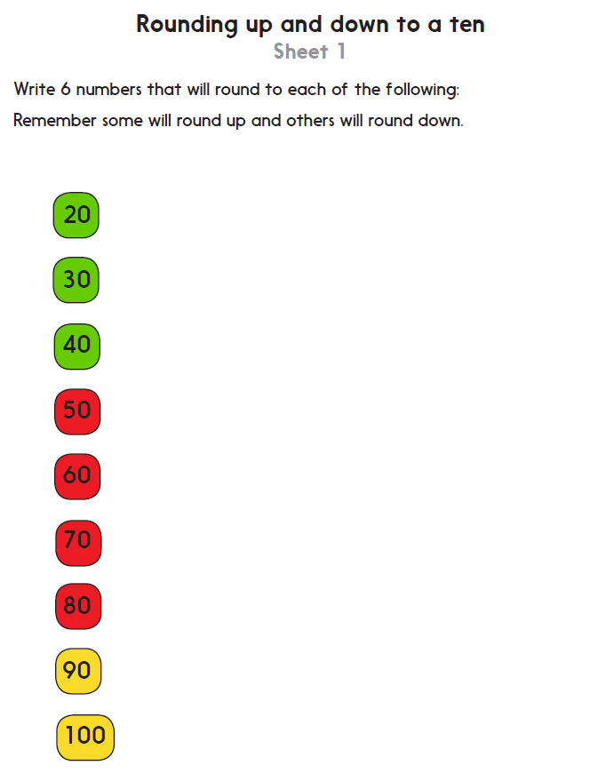
Task 2 – Independent Work
Challenge
Notes:
The Practice Sheet on this slide is suitable for most children.
Differentiated PRACTICE WORKSHEETS are available on Hamilton’s website in this unit’s PROCEDURAL FLUENCY box.
WT/ ARE/ GD: Write numbers that will round up and down to each multiple of 10, from 20 to 100.

Slide 9
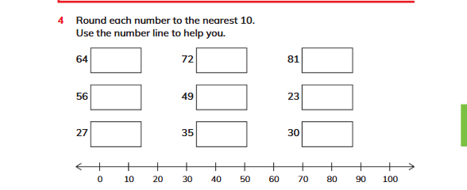
Plenary
Solve Q4 on page 120, Learners book.

Slide 10
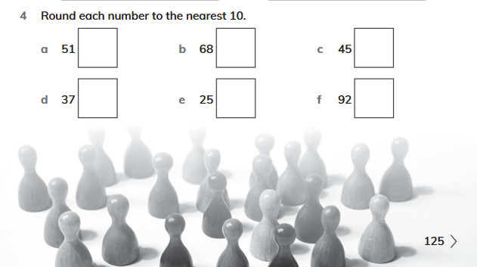
Homework
Solve Q4 on page 125 workbook.

