Slide 1
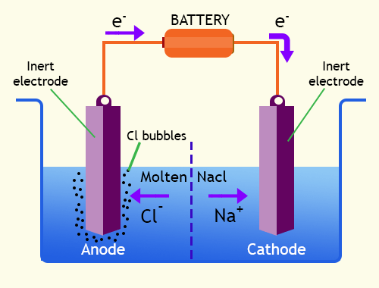
ELECTROLYSIS
https://chemistry.tutorvista.com/physical-chemistry/electrolytic-cell.html

Slide 2
Key points
Cathode Negative | Anode Positive
Positive ions attracted | Negative ions attracted
REDUCTION (RED CAT) happens here (positive ions gain electrons) | OXIDATION (AN OX) happens here (negative ions lose electrons

Slide 3
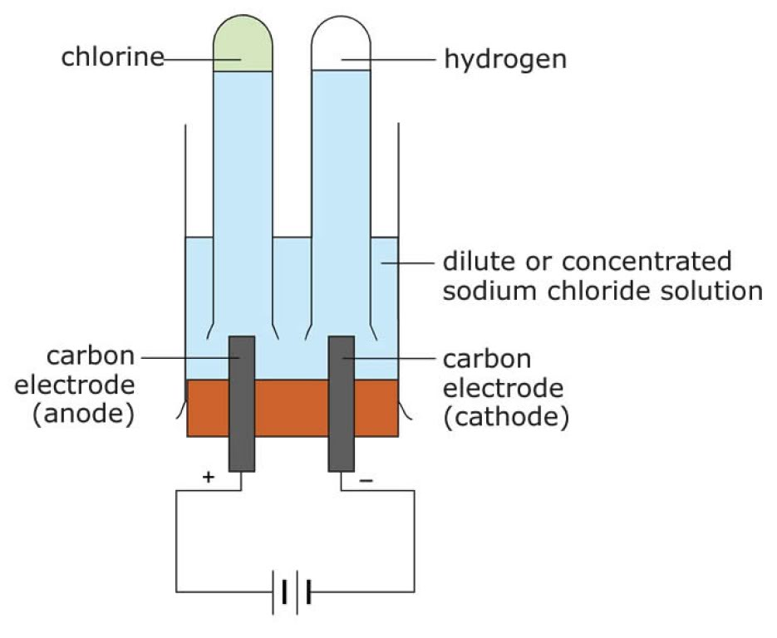
Electrolysis of Aqueous Solutions NaCl solution
https://mind42.com/mindmap/b7803c9d-2688-4933-9a5a-37ea05a708b2?rel=pmb

Slide 4
Present Ions
From NaCl | Na⁺ | Cl⁻
From H₂O | H⁺ | OH⁻

Slide 5
Redox Reactions
Reduction - Cathode (RED CAT)
2H⁺_{(aq)} +2e⁻ H₂
* Because Na is more reactive than H
Anode – Oxidation (AN OX)
2Cl⁻ Cl₂ + 2 e⁻
*because there are many chloride ions present than hydroxide from water

Slide 6
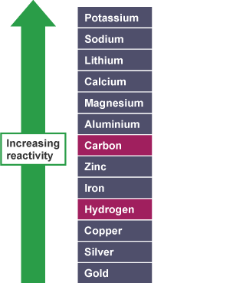
Reactivity Series
https://www.bbc.co.uk/education/guides/zqjsgk7/revision

Slide 7
Remaining Ions
From NaCl | Na⁺ | Cl⁻
From H₂O | H⁺ | OH⁻
* Left with sodium hydroxide solution (NaOH), alkaline

Slide 8
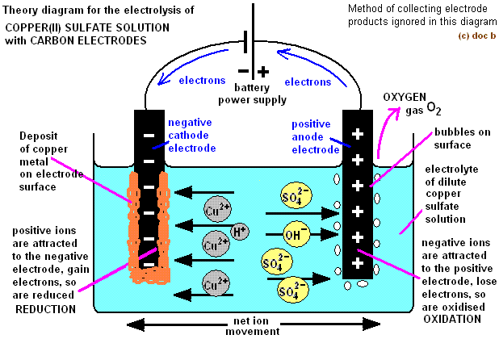
Electrolysis of Copper (II) Sulfate Solution with inert electrodes
http://www.docbrown.info/page01/ExIndChem/electrochemistry04.htm

Slide 9
Present Ions
From CuSO₄ | Cu²⁺ | SO₄²⁻
From H₂O | H⁺ | OH⁻

Slide 10
Redox Reactions
Reduction - Cathode (RED CAT)
Cu²⁺_{(aq)} +2e⁻ Cu_{(s)}
* pink-brown copper formed
* Because H is more reactive than Cu
Anode – Oxidation (AN OX)
4OH⁻_{(aq)} 2H₂O_{(l)} + O_{2(g)} + 4e⁻
* Because SO₄²⁻ not easy to oxidised

Slide 11
Remaining Ions
From CuSO₄ | Cu²⁺ | SO₄²⁻
From H₂O | H⁺ | OH⁻
* Left with dilute sulfuric acid (H₂SO₄)

Slide 12
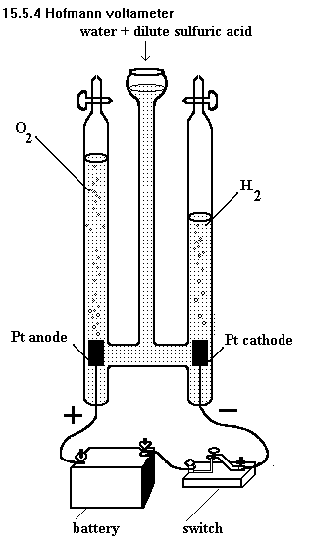
Electrolysis of Dilute Sulfuric Acid (H₂SO₄) with Inert Electrodes
https://sites.google.com/site/internationalgcsechemistry/year-10-topics/chemical-formulae-chemical-equations/2---finding-the-formula-of-water

Slide 13
Present Ions
From H₂SO₄ | H⁺ | SO₄²⁻
From H₂O | H⁺ | OH⁻

Slide 14
Redox Reactions
Reduction - Cathode (RED CAT)
2H⁺_{(aq)} +2e⁻ H_{2(g)}
* only hydrogen ions from acid and water
Anode – Oxidation (AN OX)
4OH⁻_{(aq)} 2H₂O_{(l)} + O_{2(g)} + 4e⁻
* Because SO₄²⁻ not easy to oxidised

Slide 15
Reactivity Series
If metal is high in the RS, you get hydrogen at the cathode
If metal is below hydrogen in the RS, you get metal at the cathode
If you have solutions of halides (chlorides, bromides, iodides), you obtain the halogen (chlorine, bromine and iodine) at the anode.
With other common negative ions (sulfate, nitrate, hydroxide), you get oxygen at the anode
https://www.bbc.co.uk/education/guides/zqjsgk7/revision

Slide 16
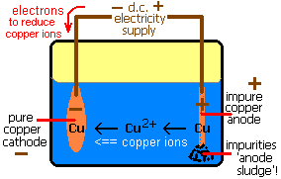
Electrolysis of Copper (II) Sulfate Solution with Copper electrode
http://www.docbrown.info/page04/Mextractc.htm

Slide 17
Redox Reactions
Reduction - Cathode (RED CAT)
Cu²⁺_{(aq)} +2e⁻ Cu_{(s)}
* pink-brown copper formed
* Because H is more reactive than Cu
Anode – Oxidation (AN OX)
Cu_{(s)} Cu²⁺_{(aq)} +2e⁻
* The colour of the solution do not change

Slide 18
Electroplating
Used to coat one metal to another
Basic Rule:
The object must be at the cathode
The electrolyte must be a solution of a salt of metal M
The anode is made of a strip of metal M

Slide 19
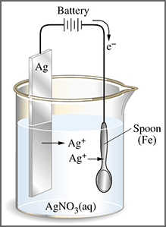
Electroplating with Silver
http://projects.nfstc.org/firearms/module04/fir_m04_t08_02.htm

Slide 20
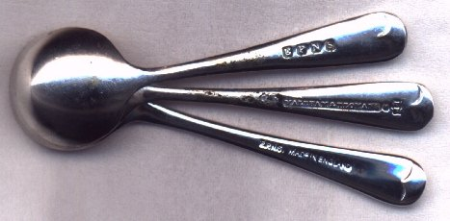
EPNS-Electroplated Nickel Silver
- Made up of copper, zinc and nickel, no silver
http://www.bexfield.co.uk/article1.htm

Slide 21
Sources: Edexcel IGCSE Chemistry (Pearson)
Cambridge IGCSE Chemistry Coursebook
Images from Google

