Slide 1
Revision Lesson
Wk 7 YR 3 D1

Slide 2
Unit 6 – Be a Story Teller

Slide 3
Key Vocabulary
Logical Thinking – to understand a problem and come up with a solution that makes sense
Algorithm – we use logical thinking to break the tasks into steps.

Slide 4
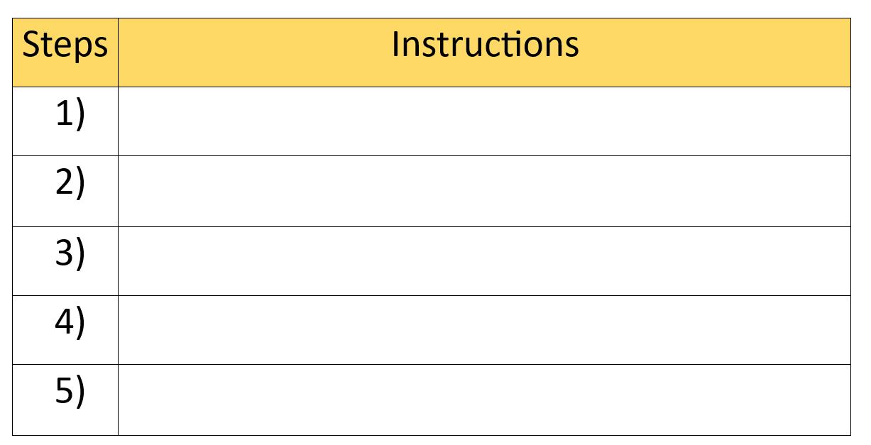
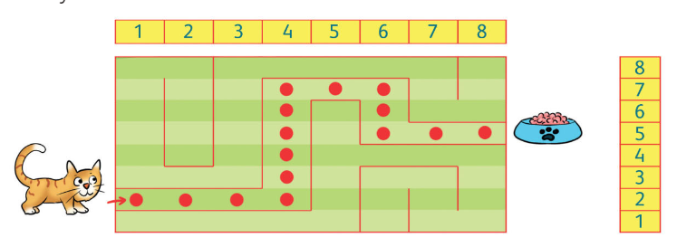
Hook Activity

Slide 5
How Logical thinking can be helpful for making Algorithm?
Notes:
In our activity with the cat and the food, logical thinking is all about figuring out the best way for the cat to get to its yummy meal. We need to think logically, to plan out each move carefully. The algorithm is like our master plan! It's the sequence of steps we create to lead the cat straight to its food.

Slide 6
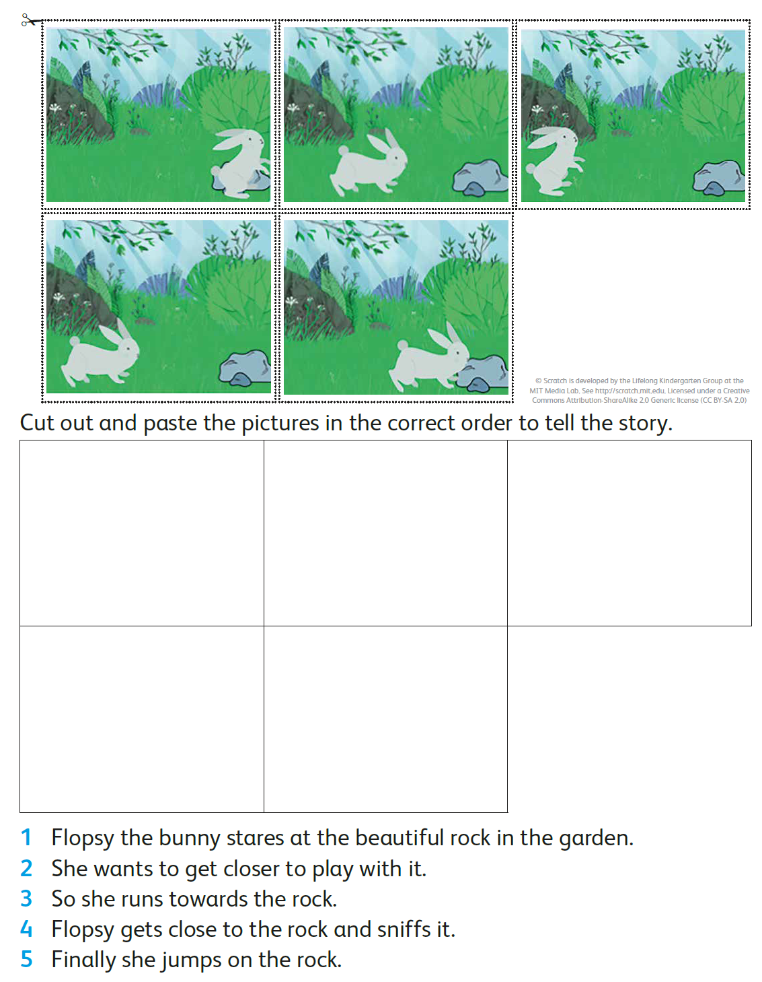
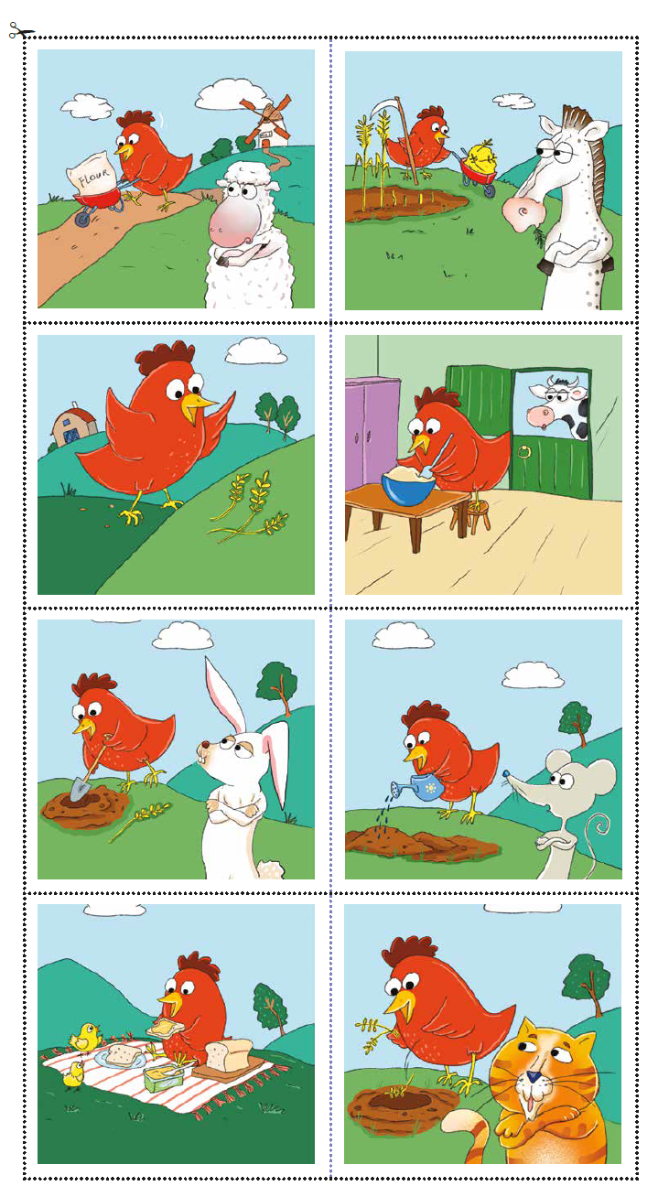
Main Activity 1– Be a Story teller
Group 1 | Group 2
Read the given story and then arrange the pictures by pasting it in the correct order. | Arrange the pictures and create story.

Slide 7
Unit 7 – Computer and robots

Slide 8
Mini Plenary
Plickers
www.plickers.com/shomaila/CS-Term-2-30269

Slide 9
Computer and Robots
Computer Controlled Devices: a machine that inputs data, and perform a specific task.
Internet of things: these are Smart devices that are connected to internet.
Files: it is on a computer are stored on the computer's hard drive. Just like paper documents, files on a computer are stored in folders. These folders have different names. Different folders can be in different places on the hard drive. Each file has its own name so it can be easily found. There many different types of files on a computer. These file types include:
Text, Audio, Image, Video and Games.

Slide 10
Sorting Activity

Slide 11
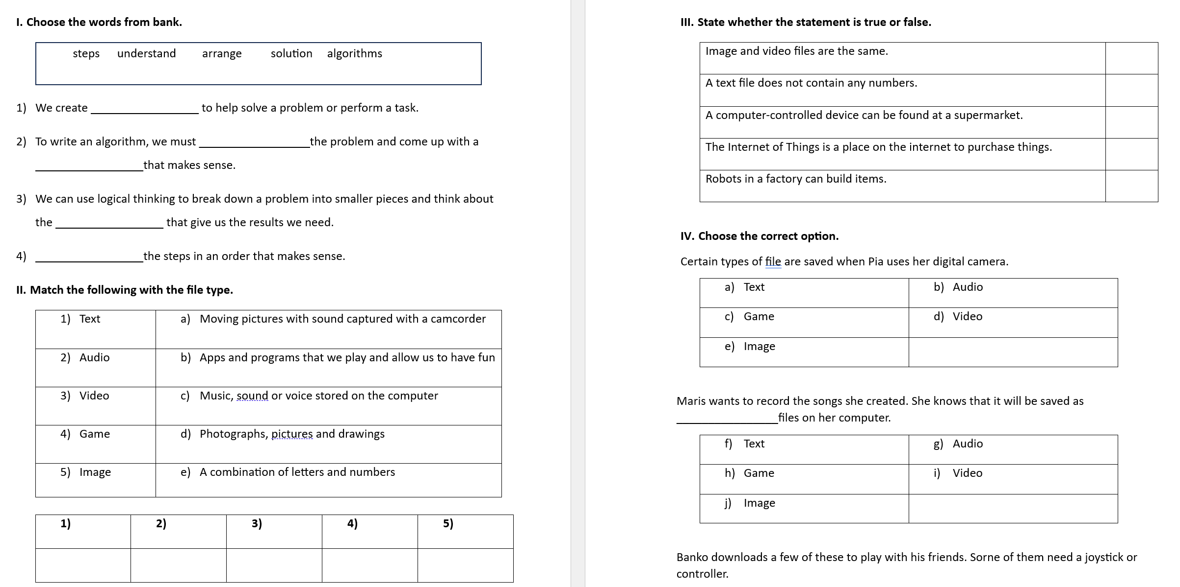
Revision Worksheet – Extension Task

Slide 12
Plenary
Plickers www.plickers.com/shomaila/CS-Term-2-Unit-7--Computers-and-robots-30476

