Slide 1
Unit 4-Be a designer
Year 3 Day 2 Wk 14

Slide 2
Lesson Objective
By the end of the lesson, learners will be able to revise by doing revision worksheet on
Make coding with multiple algorithms.
Identify steps that are repeated in tasks.

Slide 3
Key Vocabulary
Repetitive, Concise, Efficient

Slide 4
Big Question
How does writing concise code contribute to saving the planet?

Slide 5
Hook Activity – Pair (10 mins) Rewrite the steps for all three algorithms, to create the most efficient algorithm for each animal and will compare the number of steps in each algorithm with the ones that has been created.

Slide 6
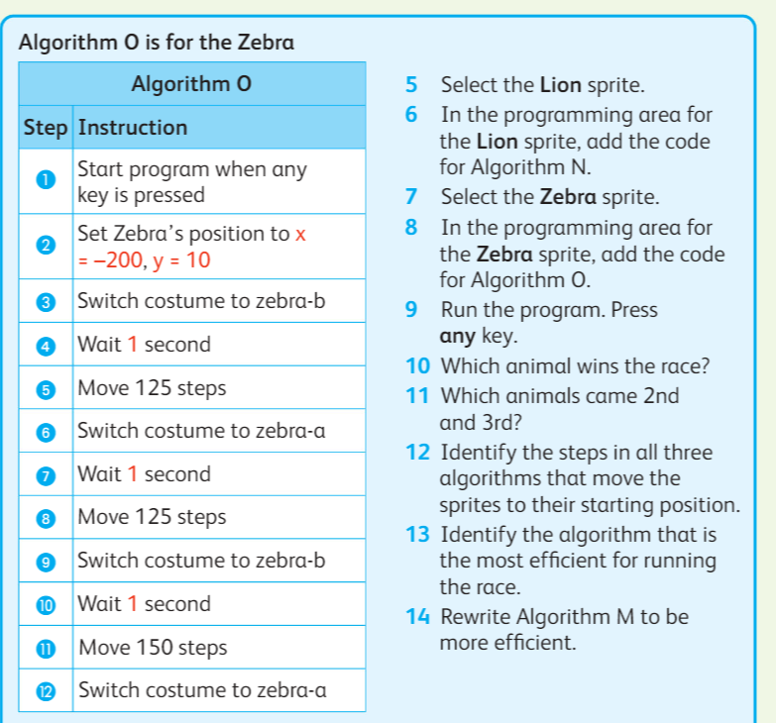
Main Activity

