Slide 1
Shape and Data
Draw and describe 2-D shapes and polygons
Objectives
Day 1
Describe and recognise regular and irregular 2-D shapes.
Day 2
Describe and visualise common 2-D shapes.
Day 3
Make, recognise and describe 2-D shapes.
Notes:
Before teaching, be aware that:
On Day 2 you can also use shapes hidden behind a box for further practice with children selecting (without revealing) shapes to try out.
On Day 3 children will need mini-whiteboards and pens.

Slide 2
Shape and Data
Draw and describe 2-D shapes and polygons
Starters
Day 1
2-D shape (pre-requisite skills)
Day 2
Recognise 2-D shapes (pre-requisite skills)
Day 3
Pattern (simmering skills)
Notes:
Choose starters that suit your class by dragging and dropping the relevant slide or slides below to the start of the teaching for each day.

Slide 3
Shape and Data
Draw and describe 2-D shapes and polygons
Objectives
Day 3
Make, recognise and describe 2-D shapes.

Slide 4
Day 3: Make, recognise and describe 2-D shapes.
Close your eyes. Imagine two squares sitting right next to one another with one of each of their sides touching the other. What shape do they make?
Who drew this shape?
Open your eyes and draw it on your whiteboards.
This one’s just the same, can you see why?

Slide 5
Day 3: Make, recognise and describe 2-D shapes.
Now add another square. You can add it on any side but it must line up with one of the squares already there.
Draw the shapes on your whiteboards. Is there more than one new shape?
Who drew these shapes?
How many sides does each of the new shapes have?
You might have drawn them another way around; that’s fine!

Slide 6
Day 3: Make, recognise and describe 2-D shapes.
Draw the shapes on your whiteboards. How many different shapes can you make joining 4 squares?
Now add one more square. Remember it must line up with one of the existing squares.
Who found all these shapes?

Slide 7
Day 3: Make, recognise and describe 2-D shapes.
We can also make new shapes by joining squares and triangles.
We’re going to add another square. What might the new shape look like? Talk to a partner and draw it on your whiteboard.
Who found all these shapes? How many sides does each one have?
Notes:
Today would be a great day to use a problem-solving investigation – Cut and Paste – as the group activity, which you can find in this unit’s IN-DEPTH INVESTIGATION box on Hamilton’s website.
Alternatively, children can now go on to do differentiated GROUP ACTIVITIES. You can find Hamilton’s group activities in this unit’s TEACHING AND GROUP ACTIVITIES download.
WT/ARE/GD: Put squares, rectangles and triangles together to make new shapes to describe and name OR Describe 2-D shapes in a feely bag through the number of sides and right angles they have.

Slide 8
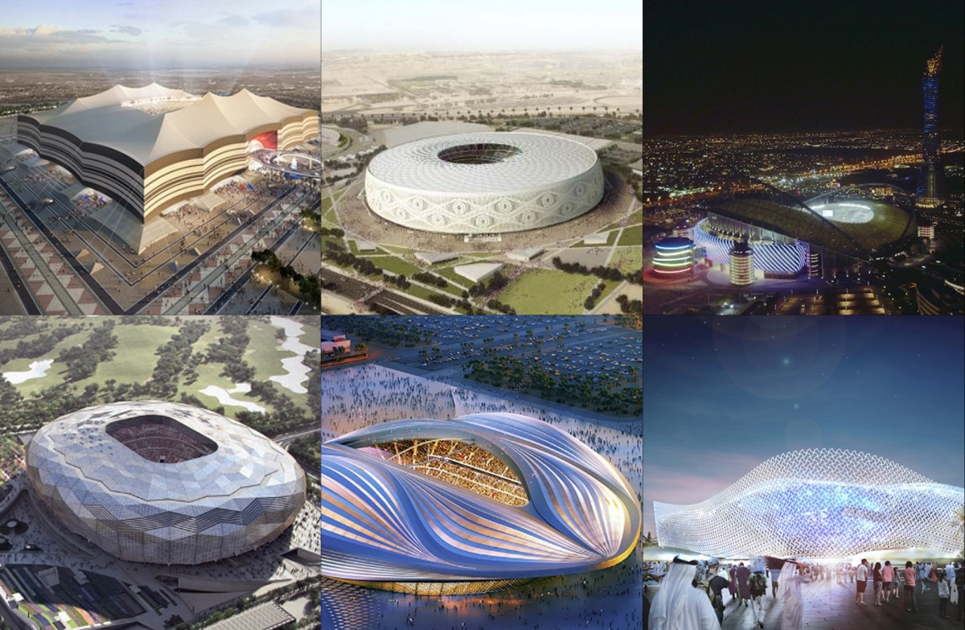
QNID
.
Can you tell how many sides and corners the stadiums have?

Slide 9
Task 1 – Pair/Group Work
Pass the bag around and feel the hidden shape.
Take turns saying one thing about the shape (e.g., sides, corners).
Guess if it could be a square and explain why or why not.
Draw what you think the shape is on your whiteboard.
Reveal the shape and see if you guessed right.
Try again with a new shape!
Task 2 – Pair/Group Work
Use 2 or 3 squares, rectangles, or triangles to make a new shape.
Draw around your shape and write its name or the number of sides if it’s new to you.
Talk with your partner about the shape's sides and corners.
Count the right angles and decide if the shape is symmetrical.

Slide 10
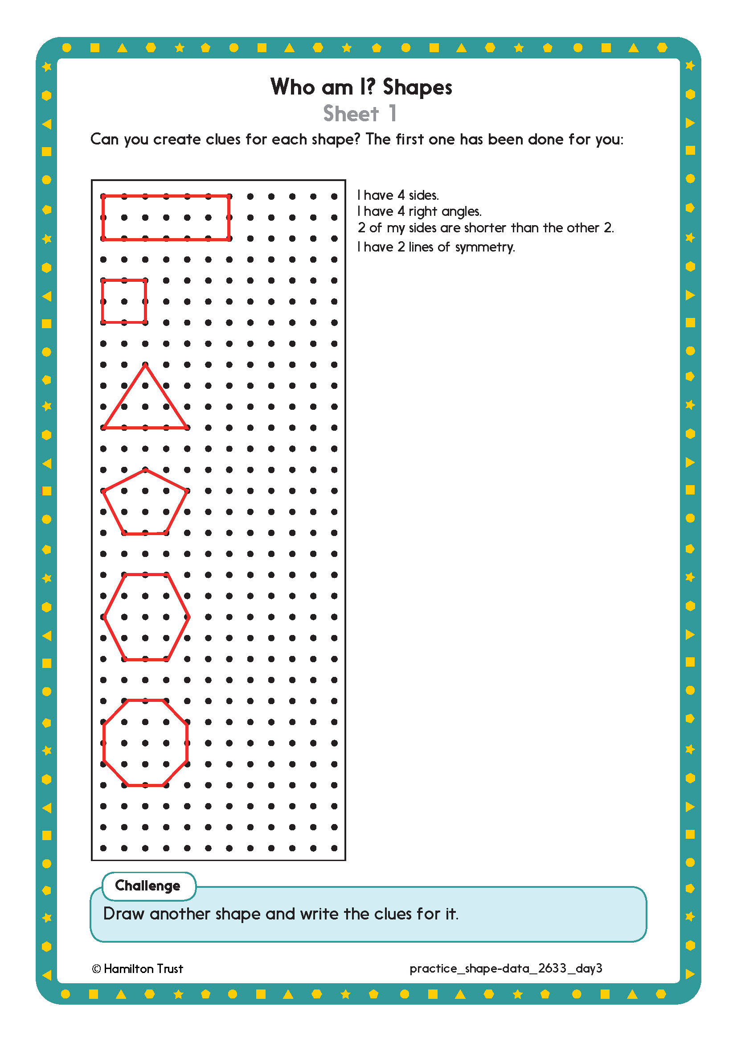
Task 3 – Independent Work
Challenge
Notes:
The Practice Sheet on this slide is suitable for most children.
Differentiated PRACTICE WORKSHEETS are available on Hamilton’s website in this unit’s PROCEDURAL FLUENCY box.
WT/ARE: Who am I? Shapes Sheet 1.
GD: Who am I? Shapes Sheet 2.

Slide 11
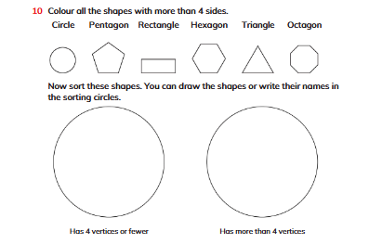
Plenary
Learner’s Book Exercise 2.2 no 10 on page 45

Slide 12
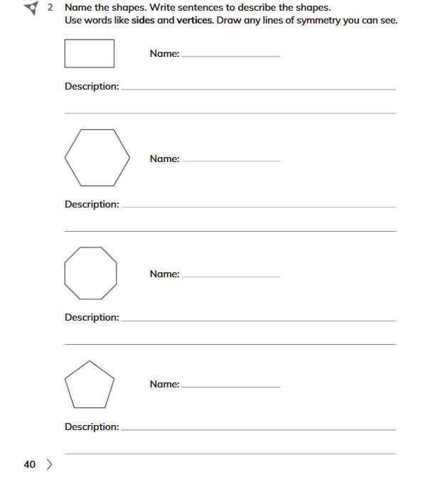
Homework
Workbook Exercise 2.2 no. 2 on page 40
Notes:
The Practice Sheet on this slide is suitable for most children.
Differentiated PRACTICE WORKSHEETS are available on Hamilton’s website in this unit’s PROCEDURAL FLUENCY box.
WT: Weight Sheet 1.
ARE/GD: Weight Sheet 2.

