Slide 1
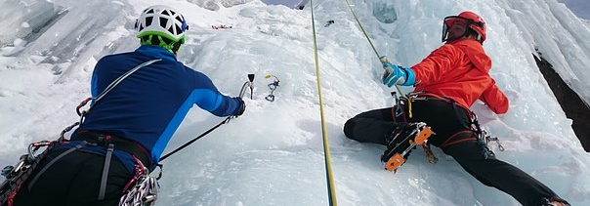
Extending sentences with conjunctions Sport

Slide 2
Clauses
Clauses are groups of words with an active verb; they make sense.
Eliza loves running.
A noun or pronoun does the verb.
She wants to run the Four Deserts race.
She takes lots of equipment.
Then she runs the whole race.
These are all clauses because they have an active verb and they make sense.

Slide 3
We can write sentence with one clause,
but if we want to extend it we can use a conjunction.
Eliza loves running
when she races ultramarathons.
She wants to run the Four Deserts race
if she can get a place.
She takes lots of equipment
wherever she races.
She runs the whole race
whereas many competitors walk large sections.
These sentences have been extended. They now have two clauses.
The conjunctions joined each pair of clauses to make one longer sentence each time.

Slide 4
Can you spot the conjunctions in these sentences?
ANSWERS
Eliza feels nervous before she starts the race.
Eliza usually runs ultramarathons although she also likes shorter mud obstacle races.
Eliza uses special gels wherever she races.
Eliza runs in specialist running trainers because they support her feet and ankles.
Tip – look for two clauses and a word which joins them.

Slide 5
Conjunctions
Which conjunction?
or
Conjunctions can extend sentences in different ways.
Can you choose the best conjunction to extend these sentences?
Riders wear helmets________ this will protect their heads.
before
because
Because signals extension by adding a cause or reason.

Slide 6
Conjunctions
Which conjunction?
or
Conjunctions can extend sentences in different ways.
Can you choose the best conjunction to extend these sentences?
Climbers must stretch________ they start to climb.
before
because
Before signals extension by adding information about time.

Slide 7
Conjunctions
Which conjunction?
or
Conjunctions can extend sentences in different ways.
Can you choose the best conjunction to extend these sentences?
A team is disqualified_______ someone is left behind when sledging.
if
although
If signals extension by adding a condition.

Slide 8
Conjunctions
Which conjunction?
or
Conjunctions can extend sentences in different ways.
Can you choose the best conjunction to extend these sentences?
Some skaters complete for speed_________ some win points with technique and choreography.
if
although
Although signals extension by adding a contrast.

Slide 9
Conjunctions
Which conjunction?
or
Conjunctions can extend sentences in different ways.
Can you choose the best conjunction to extend these sentences?
Winter sports are popular_________ there is regular snowfall each year.
although
where
Where signals extension by adding information about place.

Slide 10
Conjunctions
Conjunctions can extend sentences by joining extra clauses.
They can signal that the information is to do with different things.
time
when
before
after
until
place
where
wherever
cause
because
so
condition
if
unless
contrast
although
whereas
Knowing this helps us to decide which to use when extending a sentence.

Slide 11
when
before
after
until
where
wherever
because
so
although
whereas
if
unless
Conjunctions
Try extending this sentence with your partner.
Which conjunction will you use?
Judges watch carefully…
Judges watch carefully when a skater is performing.
Judges watch carefully before they give a score.
Judges watch carefully where the competition takes place.
Judges watch carefully so they can give a fair score.
Judges watch carefully although they can also view reruns.
IDEAS

Slide 12
when
before
after
until
where
wherever
because
so
although
whereas
if
unless
Conjunctions
Try extending this one in three different ways.
Use different conjunctions each time.
Snowboarders’ boots are fixed to their boards…
Snowboarders’ boots are fixed to their boards until they are ready to stop.
Snowboarders’ boots are fixed to their boards because this keeps them safe.
Snowboarders’ boots are fixed to their boards whereas skateboarders rely on gravity to keep them stuck to their boards.
Snowboarders’ boots are fixed to their boards if they are doing stunts.
IDEAS

Slide 13
This is a Hamilton Trust Presentation. For more fantastic resources visit our website https://www.hamilton-trust.org.uk/ .

