Slide 1

NARRATIVE WRITING
(Elements)

Slide 2
MAJOR ELEMENTS
Setting
Plot
Conflict
Characters
Theme

Slide 3
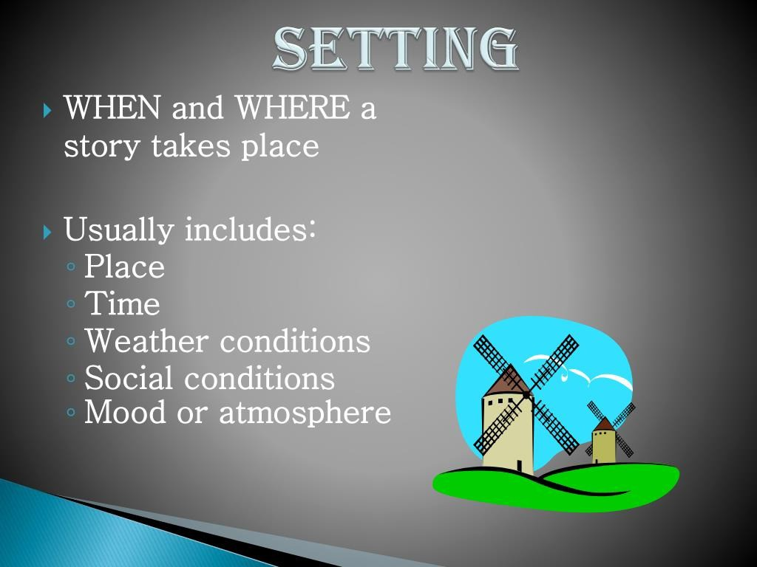

Slide 4

PLOT
The sequence of events in a story;
Has a beginning, middle, and end.
Short stories usually have one plot so it can be read in one sitting.

Slide 5
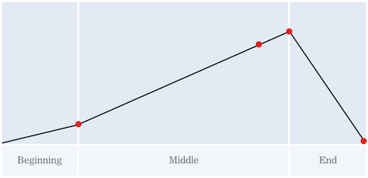
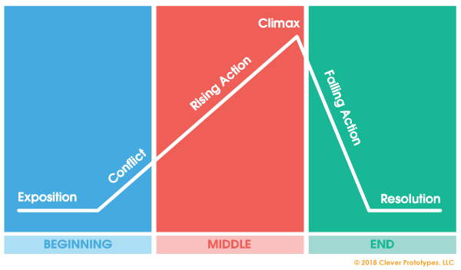
What is meant by the structure of a narrative ?

Slide 6

Exposition
Rising Action
Beginning
of Story
C. Climax
Middle
of Story
Falling Action
Resolution
End
of Story

Slide 7
A. EXPOSITION
Occurs at the beginning of a story
Characters are introduced
We learn about the setting
We are introduced to the main conflict (Main Conflict).

Slide 8
This Part of the story begins to develop the conflict(s). A building of suspense occurs.
B. RISING ACTION

Slide 9
This is the turning point of the story. Usually the main character comes face to face with a conflict.
C. CLIMAX
The Main character will create some change in the story.

Slide 10
D. FALLING ACTION
All loose ends of the plot are tied up
The conflict(s) and climax are taken care of.

Slide 11
E. RESOLUTION
The story comes to a reasonable ending.

Slide 12

CONFLICT
Is the opposition of forces - it is any goal or problem that the main character is faced with.
There are usually (but not always) multiple conf licts, but only one mai•n one.

Slide 13
THEME
Is the author’s main idea or moral
Usually is what the main character learns about life form overcoming the conflict
Author may use figurative language to emphasize his or her theme like Simile, Irony, Metaphor & Hyperbole.

Slide 14
EXAMPLES OF THEME
Some simple examples of common themes in literature, TV and film are :-
Don’t judge a book by its cover
Things are not always as the appear to be
People are afraid of change
Believe in yourself

