Slide 1
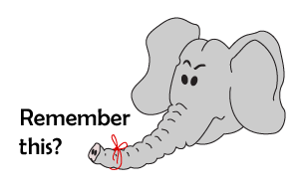
Addition and Subtraction
Number bonds to 10
Starter
Number to 100
Notes:
Simmering skills – to use this starter, drag this slide to the start of Day 4
Count to 100 with the children. Divide the class – Left-hand side is the Lions, Right-hand side is the TigeRs. Count all together to 10, and then, for each subsequent decade, point to either the Lions or the Tigers. Do not do turn and turn about, but sometimes point to the same team twice! Repeat this. How good are the lions and Tigers at counting?

Slide 2
Addition and Subtraction
Number bonds to 10
Objectives
Addition and subtraction of number bonds to 10.

Slide 3
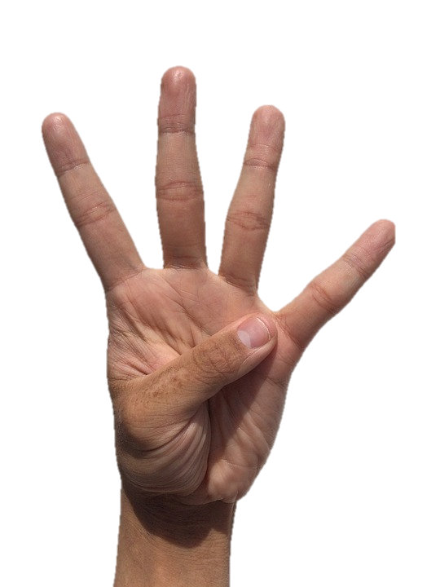
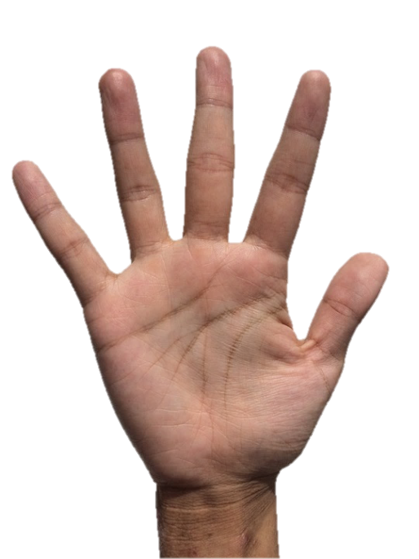
Day 4: Addition and subtraction of number bonds to 10.
How many fingers are standing up?
4
Notes:
Ask children how many fingers are needed to make 10 again? Confirm that you would need 6.
Remind children that these 2 numbers are special because they are partners that when added together make 10.
Explain that these partners can help us work out subtraction number sentences as well as the addition ones.

Slide 4
Day 4: Addition and subtraction of number bonds to 10.
Ask children to hold up 10 fingers and then put 6 fingers down again.
10 – 6
= 4
Talk to your partner.
What is the answer to this number sentence?
Notes:
Feedback and explain that if we had 10 fingers to begin, then took away 6, the answer is 4 because that is how many fingers are still standing!

Slide 5
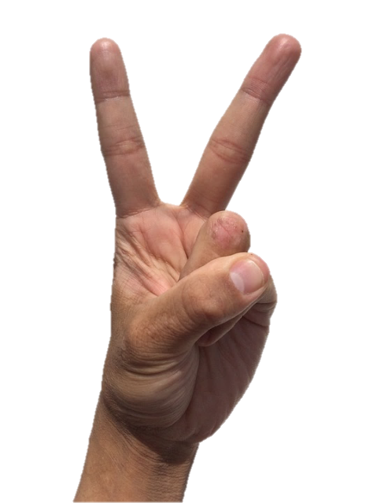
Day 4: Addition and subtraction of number bonds to 10.
How many fingers are standing up?
2
Notes:
Ask children how many fingers are needed to make 10 again? Confirm you would need 8.

Slide 6
Day 4: Addition and subtraction of number bonds to 10.
Ask children to hold up 10 fingers and then put 8 fingers down again.
10 – 8
= 2
Talk to your partner.
What is the answer to this number sentence?
Notes:
Feedback and explain that if we had 10 fingers to begin, then took away 8, the answer is 2 because that is how many fingers are still standing!
What would happen if we added the 8 back onto the 2? Confirm that this would make 10.
Repeat again with another number.
Children can now go on to do differentiated GROUP ACTIVITIES. You can find Hamilton’s group activities in this unit’s TEACHING AND GROUP ACTIVITIES download.
WT: Ladybird spot number bonds to 10 and then subtraction problems using number bonds to help
ARE/GD: Use number bonds to 10 to work out subtraction number sentences.

Slide 7
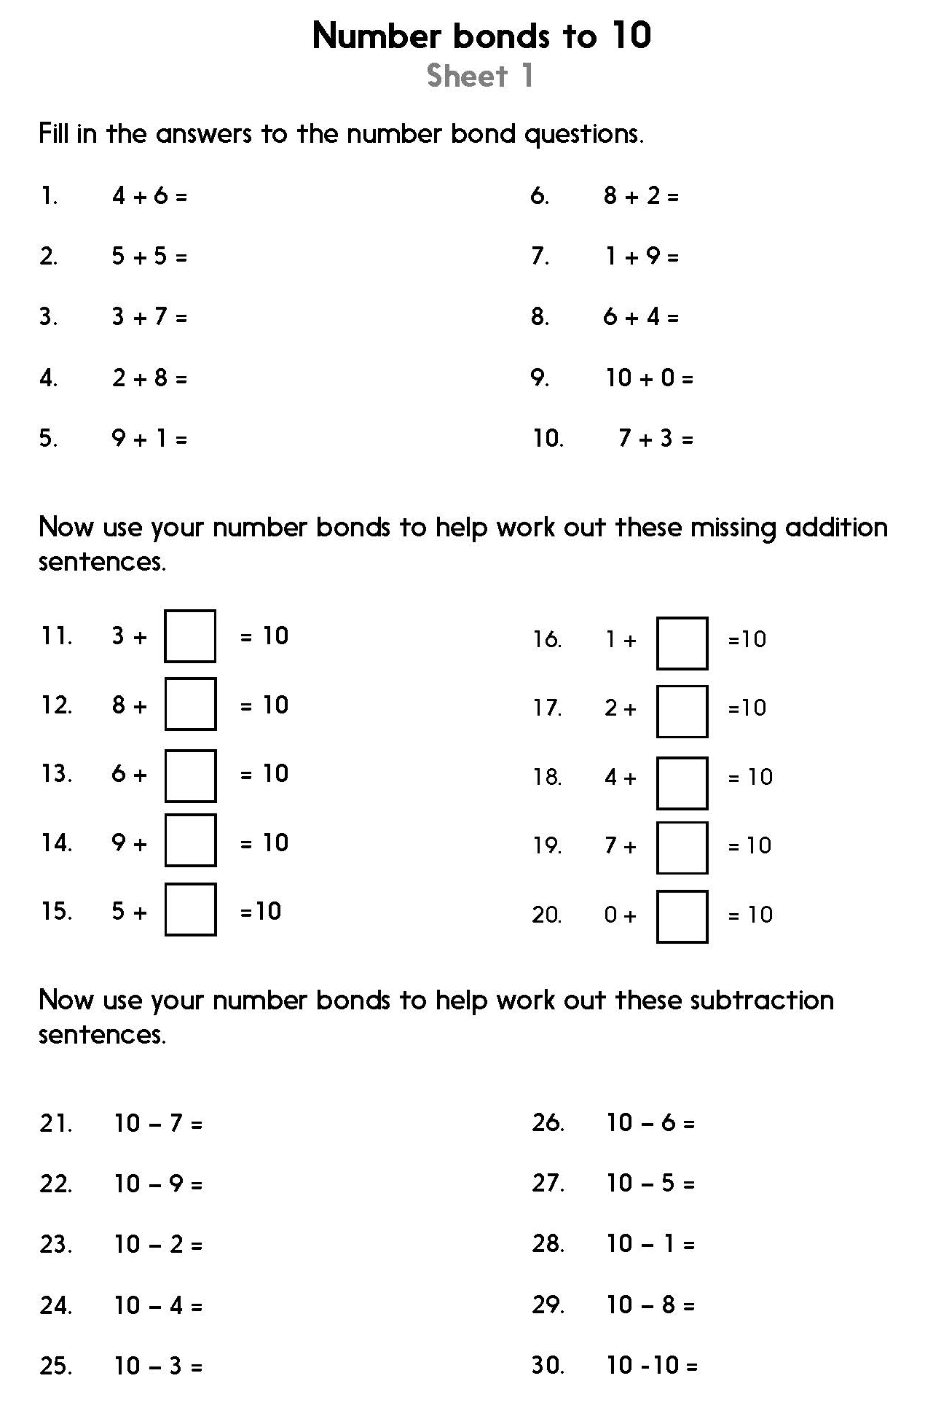
Notes:
The Practice Sheet on this slide is suitable for most children.
Differentiated PRACTICE WORKSHEETS are available on Hamilton’s website in this unit’s PROCEDURAL FLUENCY box.
WT/ARE/GD: Number bonds to 10 Sheet 1

