Slide 1
More Addition and Subtraction
Add/subtract single digit numbers using facts and patterns
Objectives
Day 1
Add a 1-digit number to a 2-digit number, bridging 10.
Day 2
Add a 1-digit number to a 2-digit number, bridging 10.
Day 3
Subtract a 1-digit number from a 2-digit number, bridging 10.
Notes:
Before teaching, be aware that:
On Days 1 and 3 ideally you will need a real 100-bead bar. Alternatively use the slides.

Slide 2
More Addition and Subtraction
Add/subtract single digit numbers using facts and patterns
Starters
Day 1
Complements to multiples of 10 (pre-requisite skills)
Day 2
Place value (simmering skills)
Day 3
Subtraction facts for 10 (pre-requisite skills)
Notes:
Choose starters that suit your class by dragging and dropping the relevant slide or slides below to the start of the teaching for each day.

Slide 3
More Addition and Subtraction
Add/subtract single digit numbers using facts and patterns
Starter
Complements to multiples of 10
Notes:
Pre-requisite skills – to use this starter, drag this slide to the start of Day 1
Children choose numbers from 1-9 to write in a 3x2 grid. What do we add to 35 to make 40? Ring the number if you have it. Repeat with similar questions.
If necessary, children use bead strings to help. First to ring all numbers wins.

Slide 4
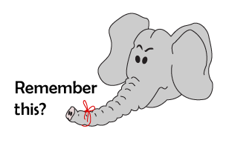
More Addition and Subtraction
Add/subtract single digit numbers using facts and patterns
Starter
Place value
Notes:
Simmering skills – to use this starter, drag this slide to the start of Day 2
What is 20 + 4? Children show place value cards. 24 - 4? 24 - 20? Ask other PV questions. Keep a brisk pace.

Slide 5
More Addition and Subtraction
Add/subtract single digit numbers using facts and patterns
Starter
Subtraction facts for 10
Notes:
Pre-requisite skills – to use this starter, drag this slide to the start of Day 3
Show 10 pegs on a hanger. Children close their eyes whilst you remove 4. How many have gone? Children hold up 4 fingers. Repeat.

Slide 6
More Addition and Subtraction
Add/subtract single digit numbers using facts and patterns
Objectives
Day 1
Add a 1 number to a 2-digit number, bridging 10.

Slide 7
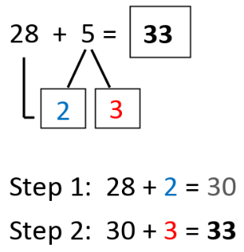
Day 1: Add a 1-digit number to a 2-digit number, bridging 10.
We are going to add 5 beads.
What do you notice?
What is the next multiple of 10 after 28?
Did you see the 2 beads being added to make 30? How many were added then?
We are going to add 5 beads.
What happened this time?
38 + 2 + 3 = 43
Notes:
Point out that 2 of the 5 beads completed a whole 10 and there are 3 more.
Explain that we call this strategy ‘Target the 10s’ or ‘T10’ for short, as we’re trying to land on a multiple of 10 to help us add the single-digit number. Show the steps in the addition.

Slide 8
Day 1: Add a 1-digit number to a 2-digit number, bridging 10.
How many beads do we need to make 50?
We are going to calculate 46 + 7.
+4
+3
46
53
How many more do we need to add?
What is the answer?
46 + 4 + 3 = 53

Slide 9
Day 1: Add a 1-digit number to a 2-digit number, bridging 10.
What is the next multiple of 10?
57 + 7
57 + 3 = 60
60 + 4 = 64
How many do we add to reach 60?
How many more do we need to add?
So where will we end up?

Slide 10
Day 1: Add a 1-digit number to a 2-digit number, bridging 10.
What is the next multiple of 10?
45 + 8
45 + 5 = 50
50 + 3 = 53
How many do we add to reach 50?
How many more do we need to add?
So where will we end up?
You really need to know your number facts to use this strategy!
Notes:
If any children require further examples, repeat with 67 + 5 and 38 + 7.
Children can now go on to do differentiated GROUP ACTIVITIES. You can find Hamilton’s group activities in this unit’s TEACHING AND GROUP ACTIVITIES download.
WT/ARE/GD: Children develop understanding of bridging 10 when adding a 1-digit number to a 2-digit number using beaded lines or landmarked lines.

Slide 11
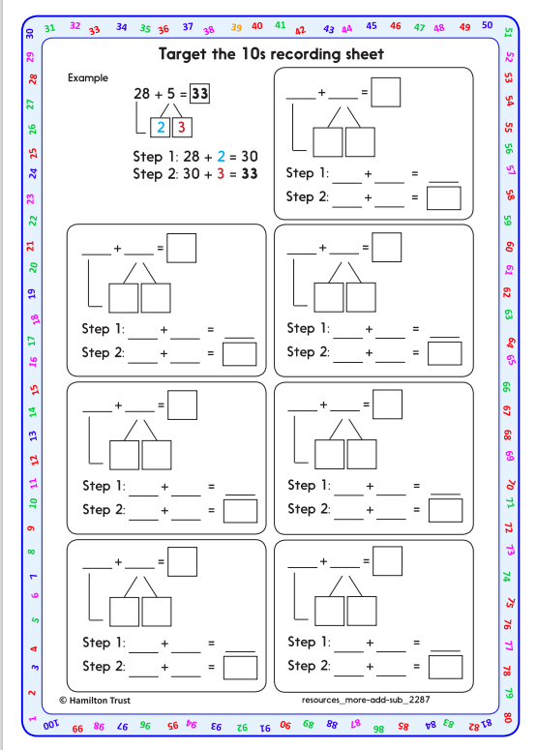
Task 1 – Pair/Group Work
Work in pairs. Spread out the calculation cards face down.
Turn over a card each. Using a beaded line to solve the calculation, draw hops on the line to show the ‘T10’ strategy.
Record your working using the ‘Target the 10s recording sheet’
Now swap cards and discuss each one, checking each other’s work.

Slide 12
Task 2 – Independent Work
Challenge
Notes:
The Practice Sheet on this slide is suitable for most children.
Differentiated PRACTICE WORKSHEETS are available on Hamilton’s website in this unit’s PROCEDURAL FLUENCY box.
WT/ARE/GD: Train journey Sheet 1 – add single-digit numbers to keep a running total of the number of passengers on a train.
Working towards ARE / Working at ARE only do the first 3 stops in each row.
Greater Depth must do all stops and the challenge.

Slide 13
Plenary
Work in pairs to find one single digit and one double digit number. Apply your knowledge of bridging and display your answer on sticky notes. Peer check with other pairs.

Slide 14
Homework

