Slide 2
Aim
I can talk about ways in which the Internet is useful.
Success Criteria
I can identify how we use the Internet.
I can talk about what we can use the Internet for.
I can explain how the Internet helps us.
I understand the importance of using the Internet safely and responsibly.
This resource is fully in line with the Learning Outcomes and Core Themes outlined in the PSHE Association’s Programme of Study.

Slide 3
The Big Questions

Slide 4
How can it help us?
What do we use the Internet for?

Slide 5
Reconnecting

Slide 6
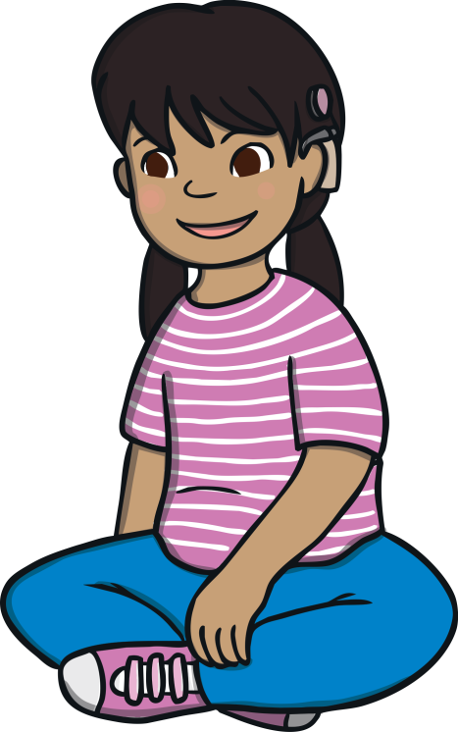
Where Is the Internet?
Today, we will be thinking about the Internet.
We are now going to play a game of True or False. Think about whether it is true or false that the devices we are about to see can use the Internet.
What do we mean when we talk about the Internet? Think quietly and be ready to share your answers.
The Internet is a system that enables computers and other devices to send each other information. We can then get this information and use it to help us.
We can access the Internet on lots of the electronic items we use everyday.
Ready?
If you think it is true, stand up.
If you think it is false, sit down.

Slide 7
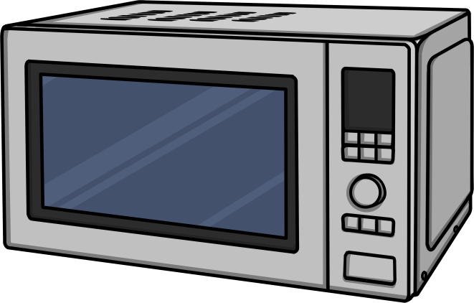
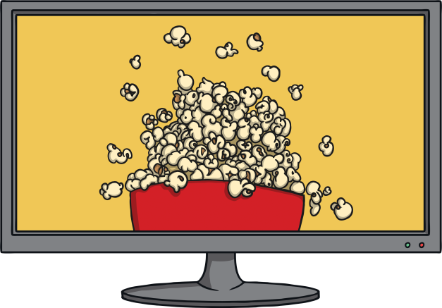
Where Is the Internet?
A microwave can use the Internet.
True or false?
False, microwaves do not use the Internet.
A television can use the Internet.
True or false?
True, televisions can be connected to the Internet. By doing this, we can get more channels, watch programmes that we have missed and stream videos.

Slide 8
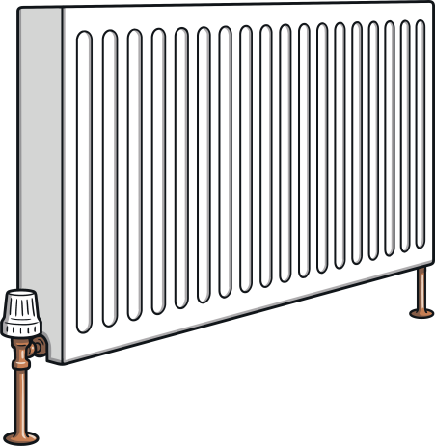
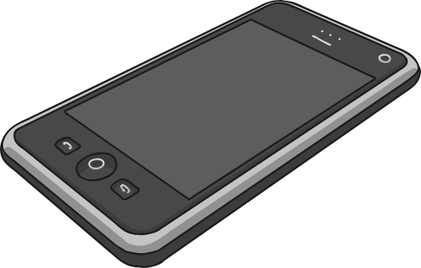
Where Is the Internet?
Central heating systems can use the Internet.
True or false?
True, heating systems can be controlled by the Internet. This means we can switch our heating on or off when we’re out of the house!
A mobile phone can use the Internet.
True or false?
True, mobile phones can be connected to the Internet. This helps us to send messages, play games and look at different websites.

Slide 9
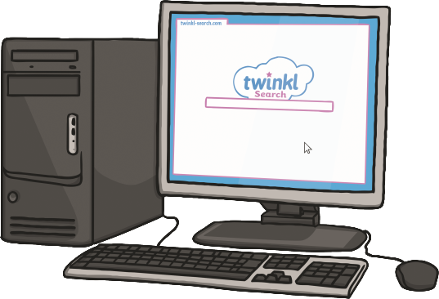
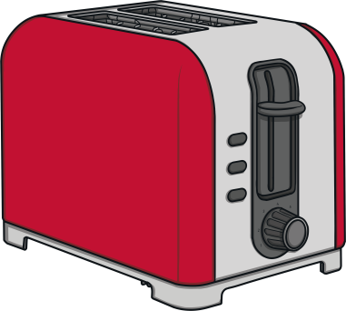
Where Is the Internet?
A computer can use the Internet.
True or false?
True, computers can access the Internet. This means they can be used to send messages and visit websites.
A toaster can use the Internet.
True or false?
False, toasters cannot access the Internet.
Wow! There are a lot of things we use everyday that can access the
Internet. Now, let’s think about what this means.

Slide 10
Exploring

Slide 11
What’s It For?
There are lots of ways we can access the Internet.
When we go online, it is called ‘accessing
the Internet’. The things we
use to access the
Internet are called ‘devices’.
In your groups, look at the picture you have been given. It is a picture of a device that can access the Internet.
Talk together about what the device is, what we use it for and how the device can help us.

Slide 12
What’s It For?
What a lot of fantastic discussion.
Now, let’s hear about the ways you think your device can be helpful when it accesses the Internet or goes online.
When the picture that your group was looking at appears, please share your ideas.

Slide 13
What’s It For?
These devices help us to:
communicate with others
access personal accounts (e.g. banking)
order shopping
find directions
send messages
find information
control home comfort systems (heating, lights)
track personal fitness

Slide 14
Many Ways to Help
There are a lot of devices we can use and many tasks the Internet can be helpful for.
We are going to listen to a story about the Chaudhury family and how they use the Internet during a normal day.
As you listen, look at your Many Ways to Help Bingo Board. If you see a device that someone uses in the story to help them, cross it off.
Make sure you cross off the devices in the order they appear on your card. Let’s listen carefully.
What a lot of different ways the Internet was used by the Chaudhury family! Which devices did you hear mentioned? How do you think these devices helped the Chaudhury family?

