Slide 1
More Addition and Subtraction
Add/subtract 11, 12, 21, 22, etc. to/from 2-digit numbers
Objectives
Day 1
Add 11, 12, 13, 21, 22 and 23.
Day 2
Add 11, 12, 13, 21, 22, 23, 31, 32, and 33.
Day 3
Add and subtract 11 and 21.
Notes:
Before teaching, be aware that:
On Day 1 children will need mini-whiteboards and pens.
On Day 2 children will need 100-bead strings, and an A3 copy of beaded lines (see resources) for each pair.
On Day 3 children will need mini-whiteboards and pens.

Slide 2
More Addition and Subtraction
Add/subtract 11, 12, 21, 22, etc. to/from 2-digit numbers
Starters
Day 1
Add/ subtract 20 (pre-requisite skills)
Day 2
2 more/less than 2-digit numbers (simmering skills)
Day 3
Add 3 to 2-digit numbers (simmering skills)
Notes:
Choose starters that suit your class by dragging and dropping the relevant slide or slides below to the start of the teaching for each day.

Slide 3
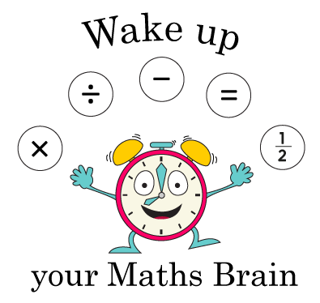
More Addition and Subtraction
Add/subtract 11, 12, 21, 22, etc. to/from 2-digit numbers
Starter
Add/ subtract 20
Notes:
Pre-requisite skills – to use this starter, drag this slide to the start of Day 1
Give a 2-digit number to a child, and show it to class, e.g. 45. She makes 2 big jumps to the right (as children see it); tell children that this is to represent adding 20 (as if on a number line). Write a number sentence on your whiteboards (45 + 20 = 65). Repeat asking other children to add/subtract 20 from 2-digit numbers.

Slide 4
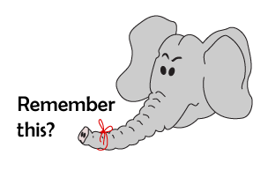
More Addition and Subtraction
Add/subtract 11, 12, 21, 22, etc. to/from 2-digit numbers
Starter
2 more/less than 2-digit numbers
Notes:
Simmering skills – to use this starter, drag this slide to the start of Day 2
Put children in pairs. Show 36 using place value cards. 1 child in each pair shows the number that is 2 more than this number using place value cards and the other child shows the number that is 2 less. Repeat for 5 more numbers. Repeat for another 6 numbers, this time children swap roles. What do they notice about their pairs of numbers? (There is always a difference of 4)

Slide 5
More Addition and Subtraction
Add/subtract 11, 12, 21, 22, etc. to/from 2-digit numbers
Starter
Add 3 to 2-digit numbers
Notes:
Simmering skills – to use this starter, drag this slide to the start of Day 3
Write 35, 45, 65 and 95 in a 2x2 grid on the board. Children draw a blank grid. They add 3 to each number on the board and write the answers in their grid as quickly as they can. Repeat for 62, 32, 82 and 92, then 37, 47, 87 and 67.

Slide 6
More Addition and Subtraction
Add/subtract 11, 12, 21, 22, etc. to/from 2-digit numbers
Objectives
Day 1
Add 11, 12, 13, 21, 22 and 23.

Slide 7
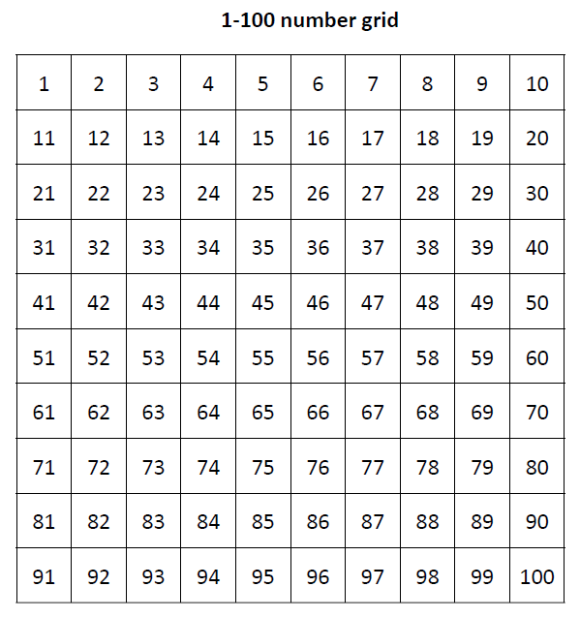
Day 1: Add 11, 12, 13, 21, 22 and 23.
What is 63 add 10?
And 2 more?
How much have we added altogether?
We can use Spider to add 10, then count on 2 to add 12 altogether.
This is much quicker than counting on in 1s from 63.

Slide 8
Day 1: Add 11, 12, 13, 21, 22 and 23.
Talk me through how to find 46 + 12.
How much quicker is it to add 10 and then add on 2 more than counting on in 1s?!

Slide 9
Day 1: Add 11, 12, 13, 21, 22 and 23.
We can also use Spider to help us add 21 and 22.
45 + 21 = 66
45 + 21

Slide 10
Day 1: Add 11, 12, 13, 21, 22 and 23.
We can also use Spider to help us add 21 and 22.
45 + 22 = 67
45 + 22

Slide 11
Day 1: Add 11, 12, 13, 21, 22 and 23.
Write an addition on your whiteboard to show what Spider has done.
36 + 13 = 49

Slide 12
Day 1: Add 11, 12, 13, 21, 22 and 23.
Write an addition on your whiteboard to show what Spider has done.
36 + 23 = 59

Slide 13
Day 1: Add 11, 12, 13, 21, 22 and 23.
Write an addition on your whiteboard to show what Spider has done.
53 + 12 = 65
Notes:
Model the start of the whole class investigation.
Today would be a great day to use a problem-solving investigation – Countdown! – as the group activity, which you can find in this unit’s MASTERY box on Hamilton’s website.
Alternatively, children can now go on to do the investigation in the GROUP ACTIVITIES. You can find Hamilton’s group activities in this unit’s PLANNING download.
WT/ARE/GD: Create, describe and begin to explain patterns created by repeated addition.
WT: Alternative activity - Play a game to practise and discuss adding 11 or 21.

Slide 14
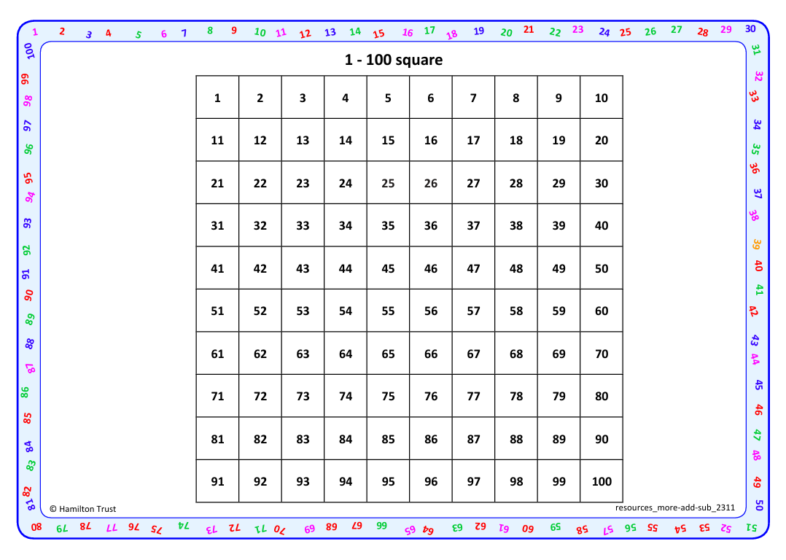
Working in pairs, place a counter on 1 on a 1-100 grid, then add 11 (by moving down and across), ringing the number they land on.
Then add 11 again.
Then carry on until they reach 100, ringing the numbers in this ‘chain’: 12, 23, 34 etc. Do you notice anything interesting, e.g. the 1s digit is always 1 more than the 10s digit..?
Repeat, this time starting at 2 and repeatedly adding 11. How far can you go? What happens when you reach 79? Is there a similar/different pattern?
Then start on 1 and repeatedly add 12. What happens to the pattern this time? Can you begin to explain the patterns you observe?
Repeat, adding 13.
Then 21, 22, 23.
Task 1 – Pair/Group Work

Slide 15
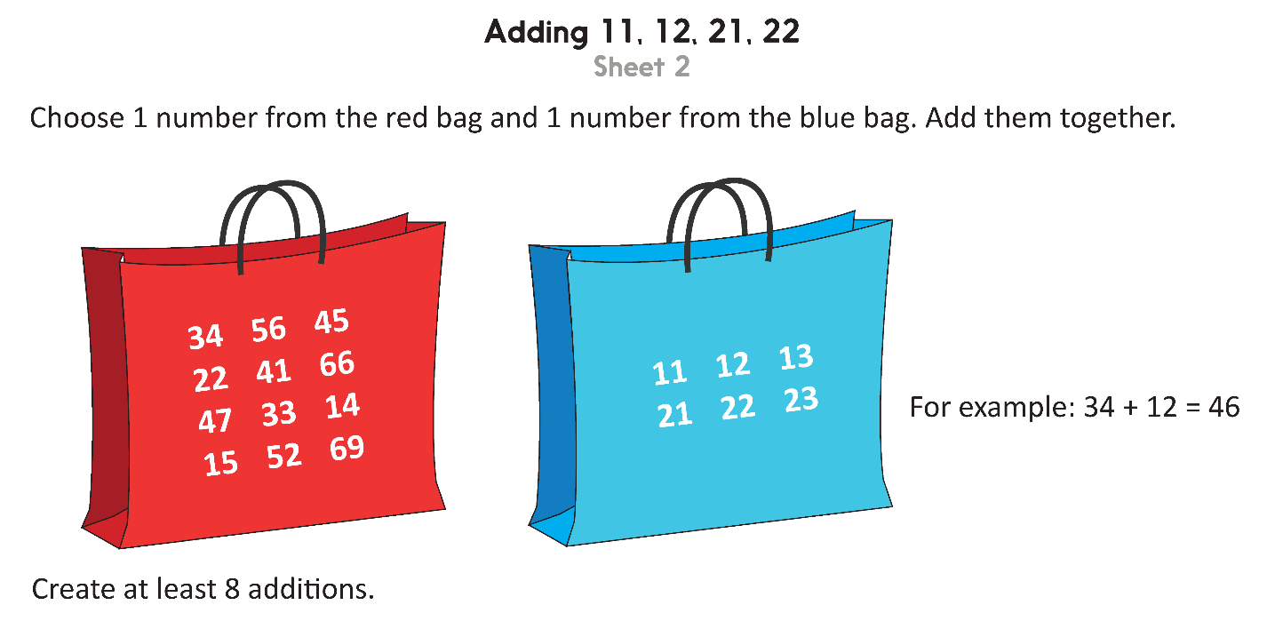
Task 2 – Independent Work
Challenge
Notes:
The Practice Sheet on this slide is suitable for most children.
Differentiated PRACTICE WORKSHEETS are available on Hamilton’s website in this unit’s WORKSHEETS box.
WT: Adding 10, 11, 20, 21 Sheet 1 – add 10s, then related 2-digit numbers.
ARE/GD: Adding 11, 12, 21 and 22 Sheet 2 – as above.

Slide 16
Plenary
Solve Ex 10.1, Q1,2,3 on page 152 and 153 in workbook

Slide 17
Homework
Solve Homework Worksheet

