Slide 1
Data Collection
Grade 6

Slide 2
Survey or Census?
We use a census for the population (all the people in the group).
We use a survey for a sample (some of the people in the group).
We should select people at random when we choose a sample in order to reduce bias (unfairness).
Population
Sample

Slide 3
How to select a Random Sample
Examples:
Names out of a hat
Assigning numbers to people and selecting every 5th number for example
Using a random name generator on the computer
Drawing straws
Rolling a dice and select everyone who rolls a 6
There are many other examples you could use, but the idea is that you do not know who you are picking until those people are selected.

Slide 4
Categorical Data
Categorical Data – This means data which can be placed into categories (can be described using words).
Examples - Eye colour, favourite food, brand of cereal you eat, places you go to shop, which football team you support, where you were born.

Slide 5
Organisation of Categorical Data
We can organise categorical data into the following ways:
A dot plot
A tally and frequency table (the frequency is the number of items in that category).
Example:
Top Shop
Favourite Shop | Tally | Frequency
Top Shop | IIII II | 7
New Look | III | 3
Primark | IIII | 4
New Look
Primark
Frequency
We use this organisation in order to find the mode: the group with the highest frequency (most occurring).

Slide 6
Graphing Categorical Data
We can display categorical data using:
Bar charts
Pie charts
Example:
Titles needed!

Slide 7
Numerical Data
Numerical Data – This means data which is in number form (can be quantified).
Examples - Shoe size, height, number of siblings, annual income, number of pens in your pencil case.

Slide 8
Organising Numerical Data
We can organise numerical data in the following ways:
Stem-and-leaf plot
Tally and frequency table
Example: The following data represents marks out of 50 on a test:
32, 48, 19, 23, 29, 10, 41, 45, 37, 33, 31, 32, 20
Unordered Stem Plot: Ordered Stem Plot:
1 9, 0 1 0, 9
2 3, 9, 0 2 0, 3, 9
3 2, 7, 3, 1, 2 3 1, 2, 2, 3, 7
4 8, 1, 5 4 1, 5, 8
Key:
1 9 means 1 tens, 9 units

Slide 9
Graphing Numerical Data
We can display numerical data using:
Column graphs
Example: The number of siblings students have is as follows:
Number | Frequency
0 | 3
1 | 7
2 | 9
3 | 4
4 or more | 2

Slide 10
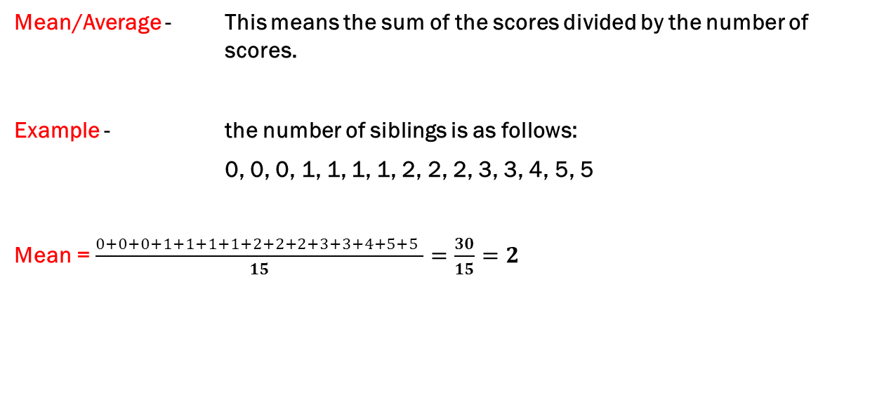
Mean or Average
Mean/Average - This means the sum of the scores divided by the number of scores.
Example - the number of siblings is as follows:
0, 0, 0, 1, 1, 1, 1, 2, 2, 2, 3, 3, 4, 5, 5
Mean = $\frac{0+0+0+1+1+1+1+2+2+2+3+3+4+5+5 }{15}=\frac{30}{15}=2$

