Slide 1
More Addition and Subtraction
Add/subtract 11, 12, 21, 22, etc. to/from 2-digit numbers
Objectives
Day 2
Add 11, 12, 13, 21, 22, 23, 31, 32, and 33.

Slide 2
Day 2: Add 11, 12, 13, 21, 22, 23, 31, 32, and 33.
Show me 40 on your bead strings.
Now slide 2 more beads across.
Slide 10 more beads across.
40 + 12 = 52
+10
+2
52

Slide 3
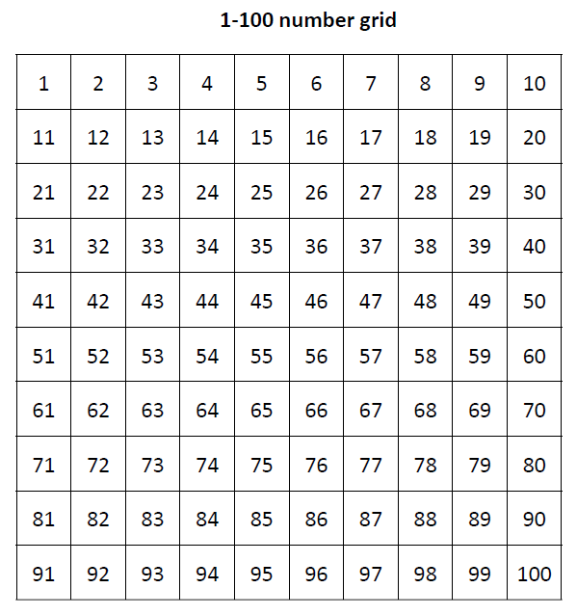
Day 2: Add 11, 12, 13, 21, 22, 23, 31, 32, and 33.
Which do you find easier – showing this on the beaded line or the number grid?
The important thing is to have a clear picture of what’s happening in our heads!
Notes:
Discuss the advantages of both and say that each child can use whichever works best for them!

Slide 4
Day 2: Add 11, 12, 13, 21, 22, 23, 31, 32, and 33
+10
+10
+1
35
56
35 + 21 = 56
35 + 21

Slide 5
Day 2: Add 11, 12, 13, 21, 22, 23, 31, 32, and 33
+10
+10
+2
46
68
46 + 22 = 68
46 + 22

Slide 6
Day 2: Add 11, 12, 13, 21, 22, 23, 31, 32, and 33.
+10
+10
+10
+1
65
96
65 + 31 = 96
65 + 31

Slide 7
Day 2: Add 11, 12, 13, 21, 22, 23, 31, 32, and 33.
We’re going to calculate 36 + 33. Label 36 on your beaded line.
First person
Draw 3 jumps of 10, counting in 10s as you do so.
Second person
Draw the small hop of 3 and label where you land.
36 + 33= 69
Notes:
Give each pair an A3 copy of beaded lines and say that they are going to add 33 to 36.

Slide 8
Day 2: Add 11, 12, 13, 21, 22, 23, 31, 32, and 33.
We’re going to calculate 47 + 33. Label 36 on your beaded line.
First person
Draw 3 jumps of 10, counting in 10s as you do so.
Second person
Draw the small hop of 3 and label where you land.
See how we landed on a multiple of 10 this time.
47 + 33= 80
Notes:
Today would be a great day to use a problem-solving investigation – Count Down to Zero – as the group activity, which you can find in this unit’s MASTERY box on Hamilton’s website.
Alternatively, children can now go on to do differentiated GROUP ACTIVITIES. You can find Hamilton’s group activities in this unit’s PLANNING download.
WT/ARE/GD: Play a game to practise adding 11, 12, 13, 21, 22, 23, 31, 32, and 33.

Slide 9
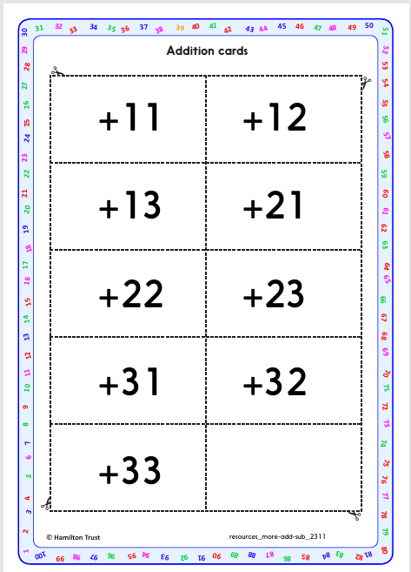
Task 1 – Pair/Group Work
You are playing a game called Biscuit 77 (because if they land on 77, you get to have a biscuit to eat!).
Work in pairs. Spread out the Addition cards face down.
Each child places their counter on a number between 1 and 20 on the grid.
Take turns to turn over an Addition card and move your counter to add the number shown. Partner. You watch carefully to check that they add correctly.
After 3 turns each, see whose counter is closest to the ‘Biscuit’ number 77. Is 67 closer to 77 than 74..? The person closest scores a point.

Slide 10
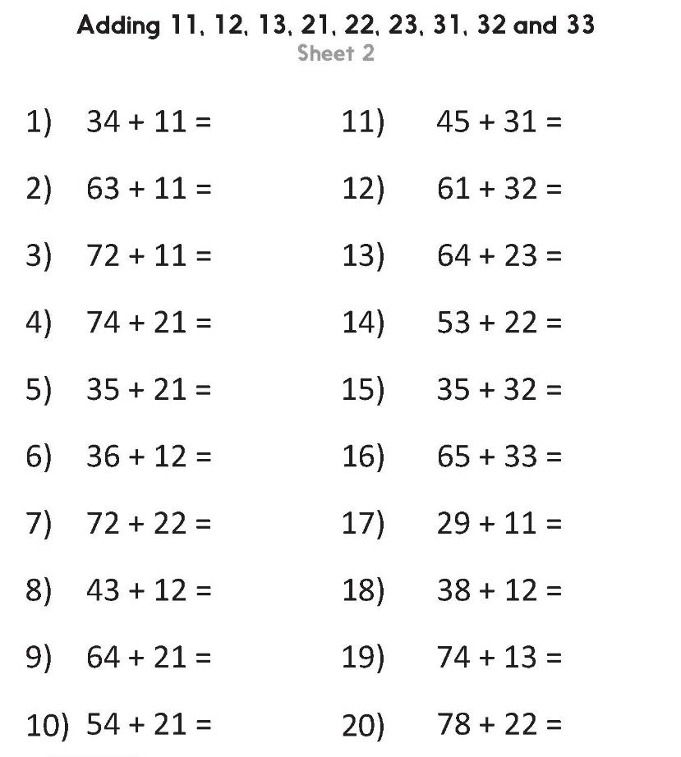
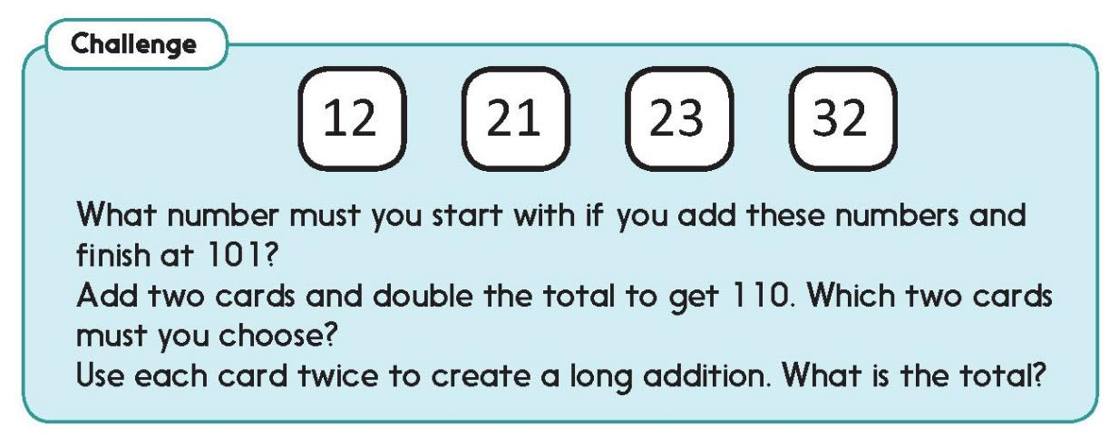
Task 2 – Independent Work
Challenge
Notes:
The Practice Sheet on this slide is suitable for most children.
Differentiated PRACTICE WORKSHEETS are available on Hamilton’s website in this unit’s WORKSHEETS box.
WT: Reach100 Sheet 1- add 10, 21, 30, 12, 22, 11 and 31 on a bead string to reach 100.
ARE: Adding 11, 12, 13, 21, 22, 23, 31, 32 and 33 Sheet 2 – children do all questions.
GD: Adding 11, 12, 13, 21, 22, 23, 31, 32 and 33 Sheet 2 – children do even numbered questions only.

Slide 11
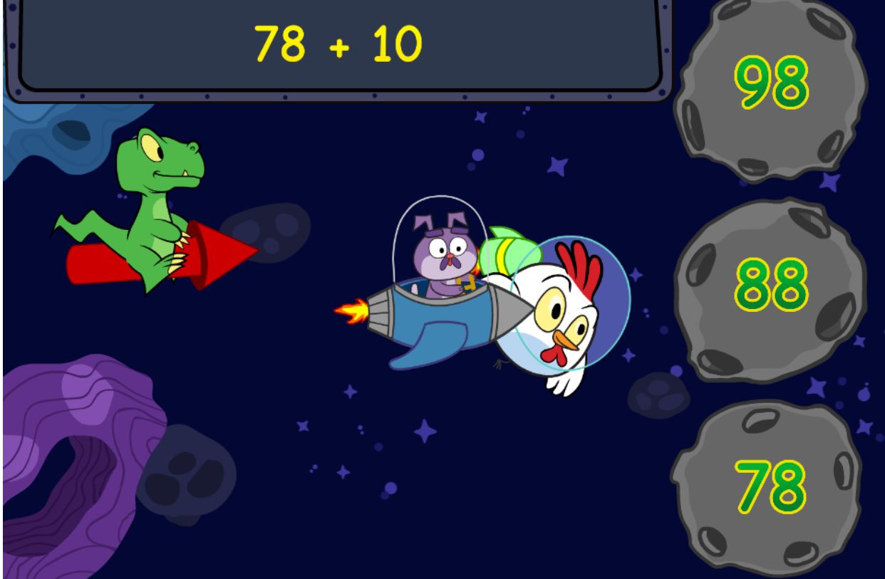
Plenary
Interactive game:
https://www.mindlygames.com/game/two-digit-addition-and%20adding-10-more-space-race

