Slide 1
Protein sYNTHESIS

Slide 2
STARTER activity
Chromosomes
Gene
Homologous chromosome
Alleles

Slide 3
Our genetic make-up
BODY
CELL (nucleus)
CHROMOSOME
DNA (deoxyribonucleic acid)

Slide 4
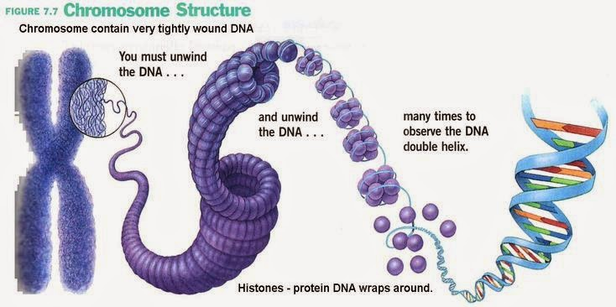
Structure of Chromosomes
http://biology4alevel.blogspot.qa/2014/09/29-dna-structure.html

Slide 5
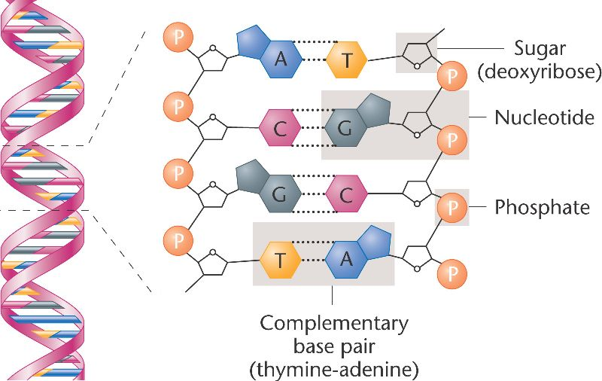
James watson and francis crick: Double helix structure of dna
http://bio3400.nicerweb.com/Locked/media/ch01/DNA_double_helix.html

Slide 6
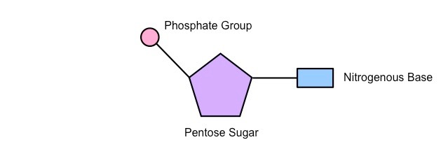
Nucleotide
Contains a sugar molecule (deoxyribose), a phosphate group and a nitrogen-containing group called a base
http://ib.bioninja.com.au/standard-level/topic-2-molecular-biology/26-structure-of-dna-and-rna/nucleotides.html

Slide 7
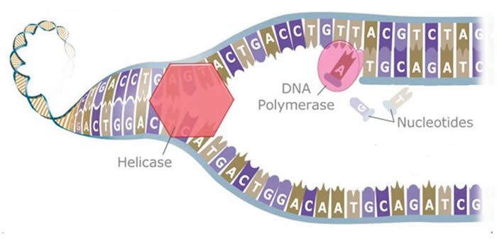
Dna replication
Making exact copy of each DNA molecules in the nucleus
http://lifeofplant.blogspot.com/2011/04/dna-replication.html

Slide 8
Genetic code
Only one strands code for the manufacture of proteins in a cell called the template strand
Proteins are made of chains of amino acids

Slide 9
Difference between dna and rna
DNA | RNA
Double helix | Single strand
deoxyribose | Ribose-extra oxygen atom
Thymine | Uracil

Slide 10
Ribonucleic acid (RNA)
Responsible for protein synthesis that takes place in the cytoplasm
Three types of RNA:
Messenger RNA (mRNA)- a molecule that carries a copy of the information on DNA to a ribosome, to be used to synthesize a protein
Transfer RNA (tRNA) – carries amino acids to the ribosome to make the protein
3) Ribosomal RNA (rRNA)- made of RNA and protein

Slide 11
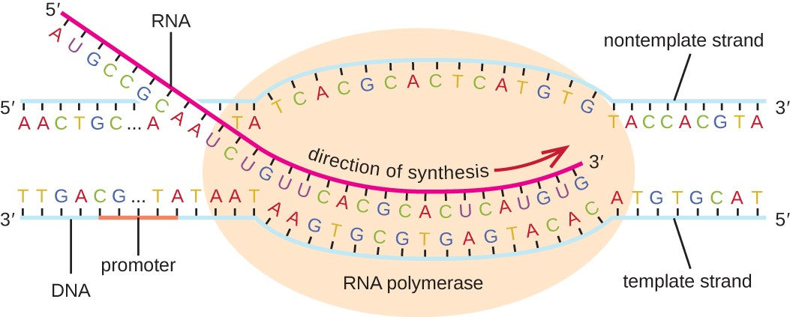
Two stages of protein synthesis
Transcription- happens in the nucleus
https://courses.lumenlearning.com/microbiology/chapter/rna-transcription/

Slide 12
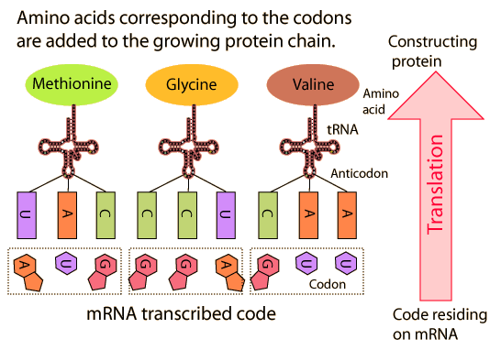
B. Translation- converting a code in the mRNA into a protein takes place at the ribosome
http://hyperphysics.phy-astr.gsu.edu/hbase/Organic/translation.html

Slide 13
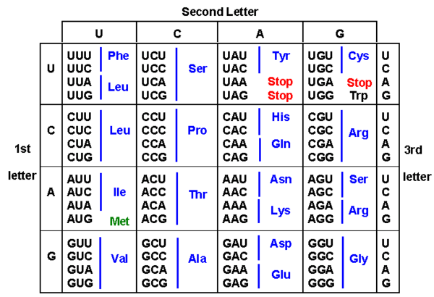
Codon table
https://socratic.org/questions/how-can-there-be-64-codon-combinations-but-only-20-possible-amino-acids

Slide 14
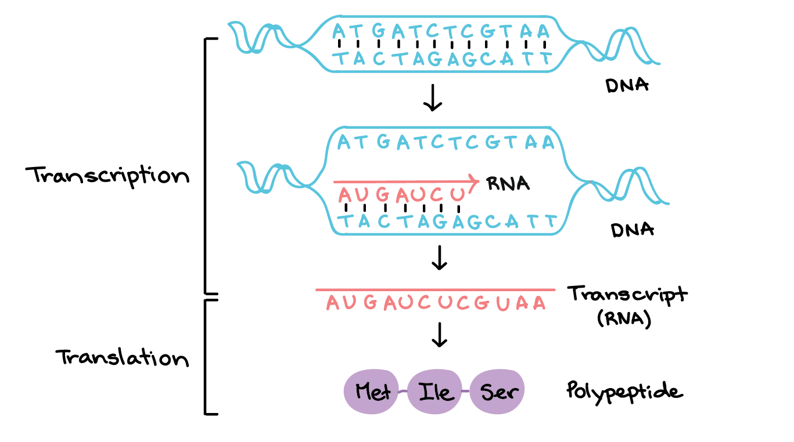
overview
https://www.khanacademy.org/science/biology/gene-expression-central-dogma/transcription-of-dna-into-rna/a/overview-of-transcription

Slide 15
SUMMARY OF PROTEIN SYNTHESIS
In the nucleus, the order of bases in the template strand of the DNA forms the genetic code. The code is converted into the sequence of bases in the mRNA.
In the cytoplasm, the sequence of mRNA bases passes through the ribosome and is used to determine the position of amino acids in a protein.

Slide 16
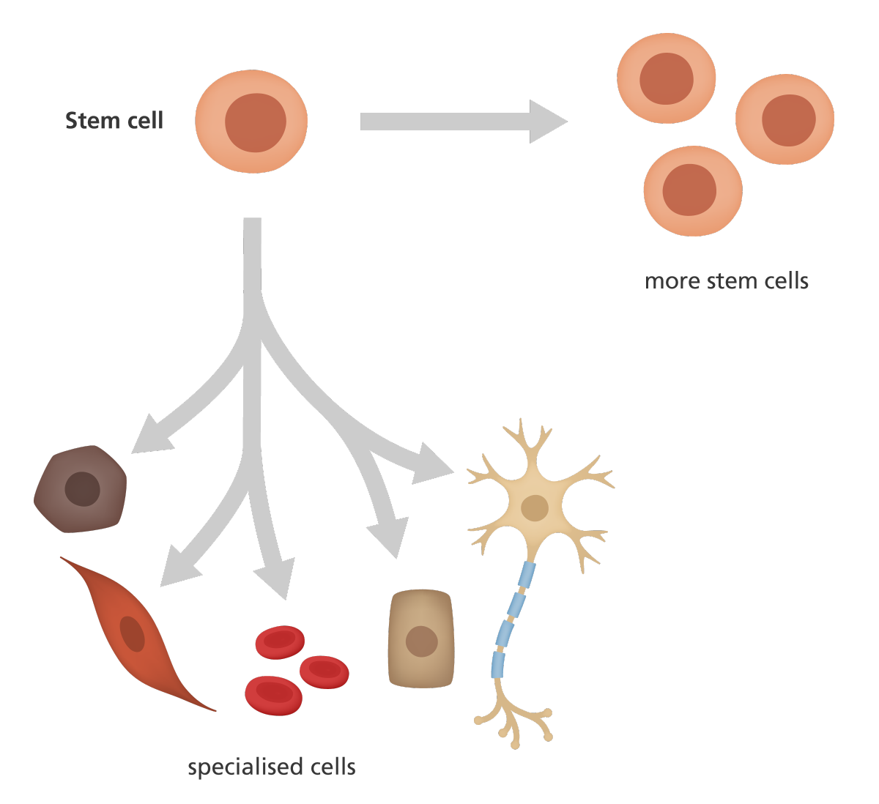
STEM CELLS
Unspecialized cells that are able to divide by mitosis to produce different types of specialized cell

Slide 17
Sources:
-Edexcel IGCSE Biology (Pearson)
-Cambridge IGCSE Biology Coursebook 2nd ed.
-Biology for Cambridge IGCSE Coursebook 4th ed.
-Images from Google

