Slide 1
Servers

Slide 2
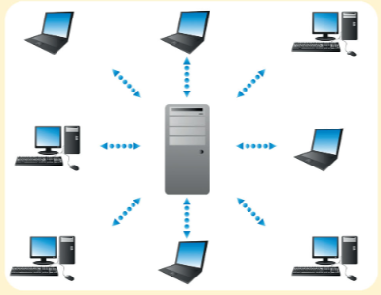
Servers
A server stores, finds and sends files and data to other computers on its network. A server also allows other computers to share resources and communicate with one another.

Slide 3
Types of Servers:
File Servers: Store files for everyone on the network. Application servers: allows programs to be run over a network. Web Servers: hold and share web pages Print Servers: Forward documents from clients to be printed. Mail Servers: Handle email between users.

Slide 5
Clients
A client is a computer that requests services from the server. The server checks each request and then sends the response

Slide 6
Client Server networks
Client server network are used in schools and businesses where many computers need access to the same information or devices

Slide 7
Example 1

Slide 8
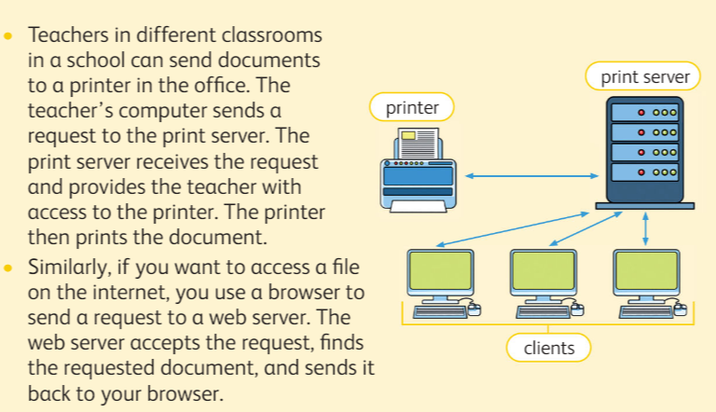
Example 2 &3

Slide 9
Internet

Slide 10
Services on the internet

