Slide 1
More Addition and Subtraction
Add/subtract multiples of 10 to/from 2-digit numbers
Objectives
Day 1
Add and subtract 20, 30, 40, 50 to/from 2-digit numbers using the 1-100 grid.
Day 2
Add and subtract 20, 30, 40, 50 to/from 2-digit numbers using the beaded line.
Notes:
Before teaching, be aware that:
On Day 1 children will need mini-whiteboards and pens.
On Day 2 children will need 100-bead strings.

Slide 2
More Addition and Subtraction
Add/subtract multiples of 10 to/from 2-digit numbers
Starters
Day 1
Count on and back in 10s, with 100 grid (pre-requisite skills)
Day 2
Count on and back in 10s, using a bead bar (pre-requisite skills)
Notes:
Choose starters that suit your class by dragging and dropping the relevant slide or slides below to the start of the teaching for each day.

Slide 3
More Addition and Subtraction
Add/subtract multiples of 10 to/from 2-digit numbers
Starter
Count on and back in 10s
Notes:
Pre-requisite skills – to use this starter, drag this slide to the start of Day 1
Place Spider on 2 on a 1-100 grid and move down the grid as you count on in 10s to 92, and then back again. Repeat, this time with Spider starting on 5. Children close their eyes and imagine Spider moving up and down the grid.

Slide 4
More Addition and Subtraction
Add/subtract multiples of 10 to/from 2-digit numbers
Starter
Count on and back in 10s
Notes:
Pre-requisite skills – to use this starter, drag this slide to the start of Day 2
Children count on in 10s from 3 to 93 and then back again as you move groups of 10 beads across the 0-100 bead bar (or use a 10s catcher). Repeat starting at 8.

Slide 5
More Addition and Subtraction
Add/subtract multiples of 10 to/from 2-digit numbers
Objectives
Day 1
Add and subtract 20, 30, 40, 50 to/from 2-digit numbers using the 1-100 grid.

Slide 6
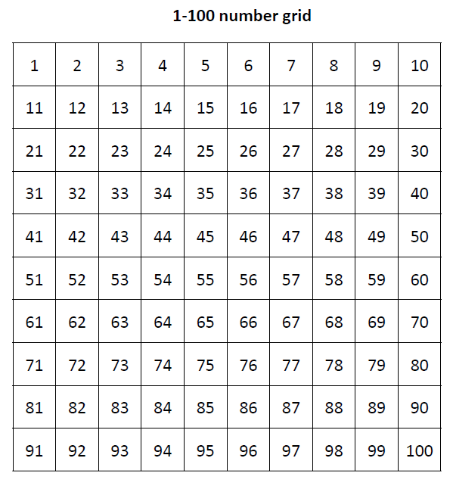
Day 1: Add and subtract 20, 30, 40, 50 to/from 2-digit numbers using the 1-100 grid.
What has spider done? How much has been added?
43 + 20 = 63
Spider doesn’t have to count in 1s!

Slide 7
Day 1: Add and subtract 20, 30, 40, 50 to/from 2-digit numbers using the 1-100 grid.
What has spider done? How much has been added?
26 + 30 = 56

Slide 8
Day 1: Add and subtract 20, 30, 40, 50 to/from 2-digit numbers using the 1-100 grid.
What has spider done? How much has been added?
52 + 40 = 92

Slide 9
Day 1: Add and subtract 20, 30, 40, 50 to/from 2-digit numbers using the 1-100 grid.
What has spider done? How much has been added?
Put up one finger for each 10 Spider adds.
Count in 10s on your fingers from 47.
47 + 50 = 97
Notes:
If you have a 1-100 grid and plastic spider, ask a child to come and make Spider show 64 + 30 without telling the rest of the class the addition. Can children guess which addition Spider is doing?

Slide 10
Day 1: Add and subtract 20, 30, 40, 50 to/from 2-digit numbers using the 1-100 grid.
What has Spider done this time?
How much has been subtracted?
43 – 20 = 23

Slide 11
Day 1: Add and subtract 20, 30, 40, 50 to/from 2-digit numbers using the 1-100 grid.
What has Spider done?
How much has been subtracted?
64 – 30 = 34

Slide 12
Day 1: Add and subtract 20, 30, 40, 50 to/from 2-digit numbers using the 1-100 grid.
What has Spider done?
How much has been subtracted?
84 – 30 = 54

Slide 13
Day 1: Add and subtract 20, 30, 40, 50 to/from 2-digit numbers using the 1-100 grid.
What has Spider done?
How much has been subtracted?
78 – 40 = 38

Slide 14
Day 1: Add and subtract 20, 30, 40, 50 to/from 2-digit numbers using the 1-100 grid.
Write a number sentence to show what Spider has done.
63 + 30 = 93

Slide 15
Day 1: Add and subtract 20, 30, 40, 50 to/from 2-digit numbers using the 1-100 grid.
Write a number sentence to show what Spider has done.
84 – 40 = 44
Notes:
Model the group activity game play is you are using that activity with the whole class.
Children can now go on to do differentiated GROUP ACTIVITIES. You can find Hamilton’s group activities in this unit’s TEACHING AND GROUP ACTIVITIES download.
WT/ARE/GD: Play a game using Spider on the 1-100 grid to rehearse adding and subtracting multiples of 10.

Slide 16
QNID
Qatar’s initiative to promote sustainability.
Plastic bottles recycling machines in
Al-Meera

Slide 17
Hamid put 20 bottles into the recycling machine, which already contained 36 bottles. How many bottles are in the machine now?
A worker then came and took away 10 bottles. How mant are left?

Slide 18
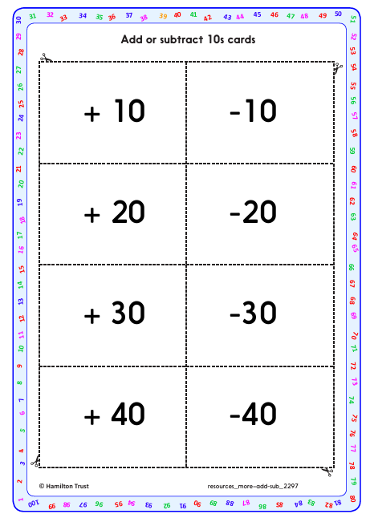
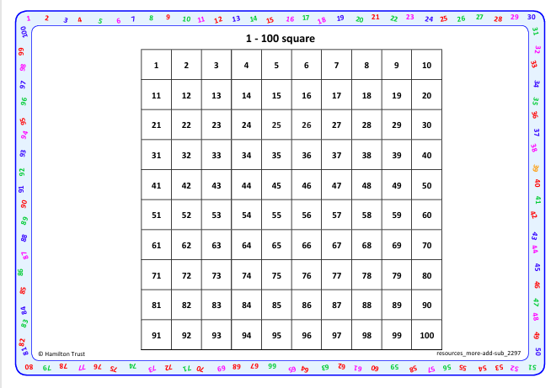
Task 1 – Pair/Group Work
Using the 1-100 grid and addition and subtraction cards, play the game with provided instructions.

Slide 19
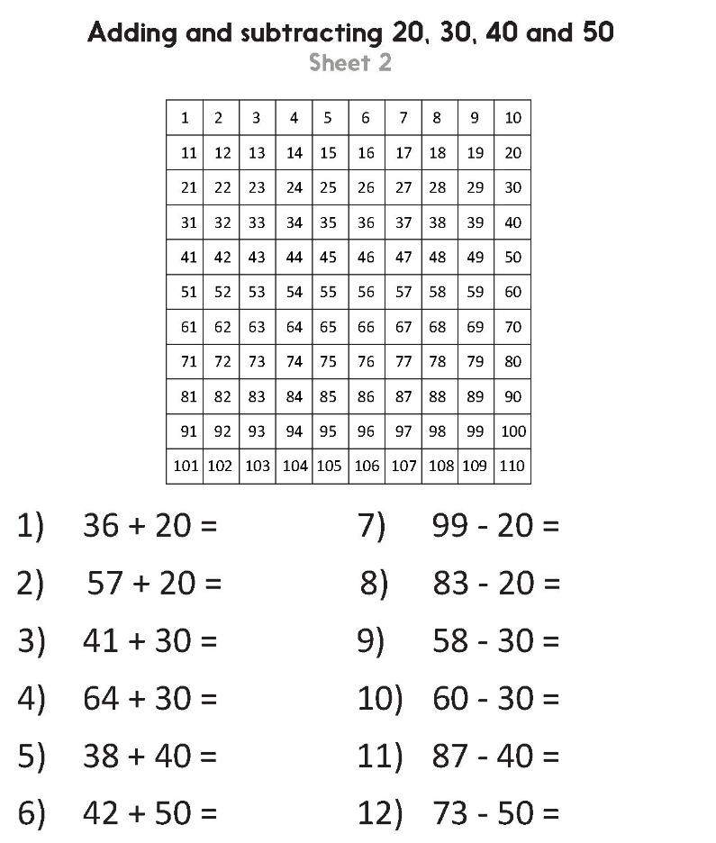
Task 2 – Independent Work
Challenge
Notes:
The Practice Sheet on this slide is suitable for most children.
Differentiated PRACTICE WORKSHEETS are available on Hamilton’s website in this unit’s PROCEDURAL FLUENCY box.
WT: What’s the calculation? Sheet 1 – write possible Spider calculations given jumps on a 1-100 grid.
ARE/GD: Adding and subtracting 20, 30, 40 and 50 – Sheet 2 – adding/subtracting 10s on 1-100 grid.

Slide 20
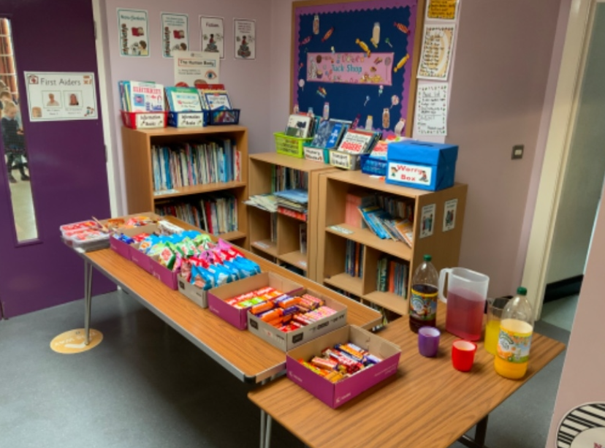
Plenary
Get one drink and one snack from the tuc shop and find your total.

Slide 21
Homework
Homework Worksheet

