Slide 1
Unit 5: Be a computer scientist

Slide 2
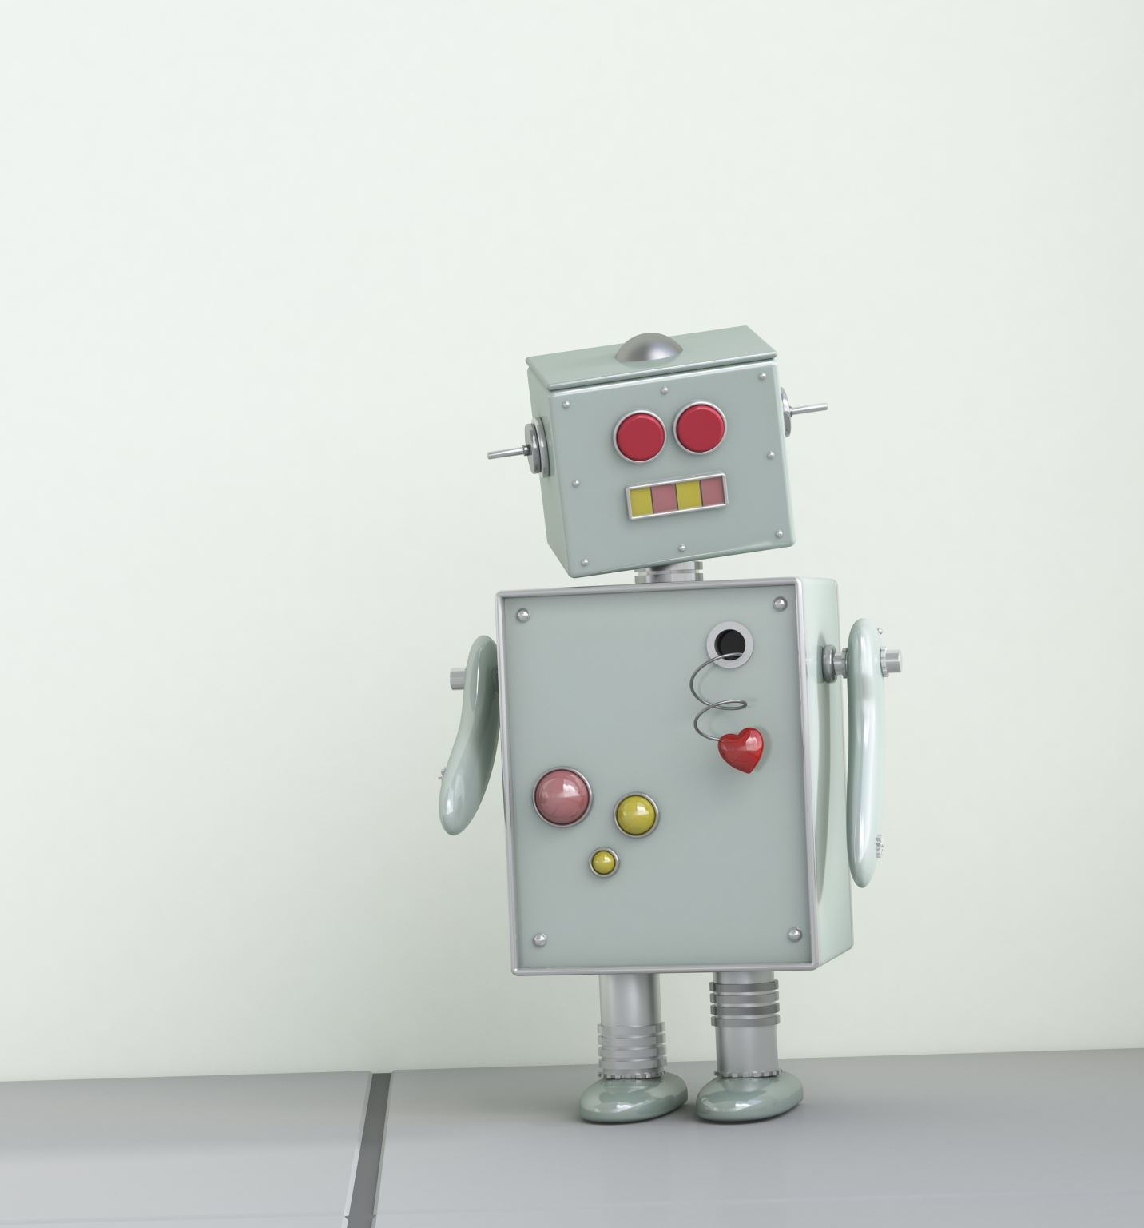
Hook activity (10 mins)
Answer the following questions
Look at EV3 robots
Can you identify the parts of robot
Name a few activities that you would want a robot to do for you?
Name a few tasks robots cannot perform.

Slide 3
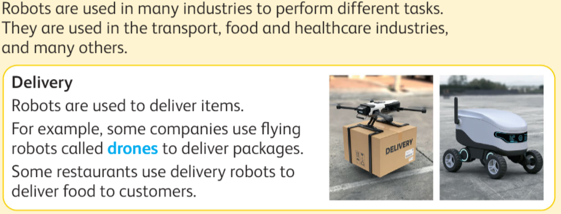

Slide 5
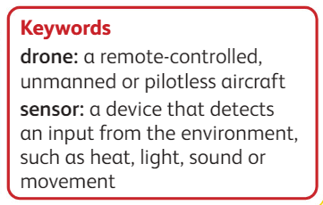

Slide 6
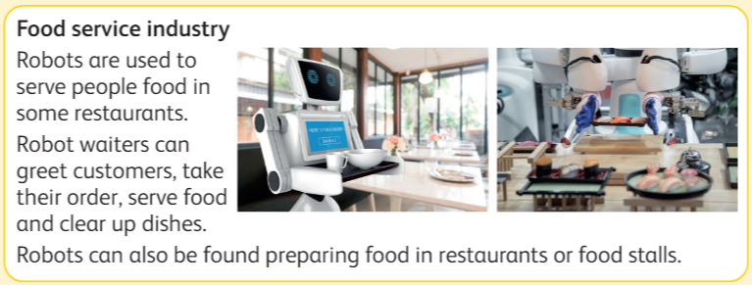

Slide 7
