Slide 1
Negotiation
Planning a negotiation
Conducting the negotiation
Measuring success

Slide 2
UNIT 5
Negotiation
Negotiation is all about trying to find a solution that everyone is happy with . The process of negotiation will involve :
Resolving disputes
Agreeing on courses of action
Bargaining for individual or collective advantage
Reaching outcomes to satisfy the interests of those involved .
There are three main stages in a negotiation .
Planning
Conducting the negotiation
Measuring success

Slide 3
Planning involves two main stages :
Setting Objectives
Thinking ahead is important to a successful negotiation .
Ask yourself the following questions :
What do you want to achieve from the negotiation ?
What do you think the other side wants ?
What and how are you going to say it ?
Who are you going to be negotiating with ?
What will you do if you cannot get your first choice ? What are you prepared to accept , offer or give up to reach a compromise agreement ?
Will you insist on getting exactly what you want or are you willing to collaborate with the other team ?
Have you listed the consequences for both sides if your proposal is not accepted ?
At what point you think you will walk away from the negotiation and why ?

Slide 4
2.Choosing evidence to use:
Any information used must be accurate , well presented and include all the relevant facts .
For example , if you are asking for finance the other party is likely to want to see a business plan or cash flow forecasts to check if you are able to repay the money .
Benefits and weaknesses of a proposal
Write down advantages and disadvantages for both sides of accepting your proposal . Try to identify what they may want in return for an agreement and any reasons why they may or may not accept your proposal .
You must provide evidence to support each point made .
For example , market research data can show potential demand and financial projections can support pricing and costing decisions .

Slide 5
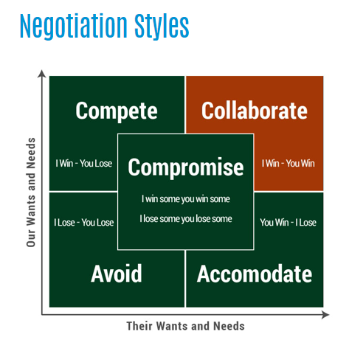

Slide 6
Arguments and counter arguments for the proposal
Identify key details that you think the other side may disagree with .
Think about why they may be opposing the proposal and you can be ready with a suitable response .
Template for Plan for Negotiation is in GC.
Skills required for negotiation :
Persuasion
Listening
Why are the above skills important for negotiation ?

Slide 7
Conducting the negotiation:
Setting the tone :
When and Where
Get to know the other side
Language
Be confident and calm
Page 83,84 and 85 of the book .
Measuring success:
The purpose of this stage is to identify what went well and to consider how you could improve next time .
There are may ways to look at success .
Did I achieve my objective ?

Slide 8
The following questions might be helpful to you when you are measuring the success of negotiation .
Outcome :
Did you get what you wanted ?
Was the other side happy with the outcome ?
How do you know or why do you think this ?
If the negotiation was unsuccessful , why do you think this ?
Process :
How well do you think when planning and conducting the negotiation ?
Had you anticipated their counter arguments?
Did you manage to set the right tone ?
Did you use simple and clear language ?
Did you ask the right questions ?
Did you listen carefully to the points and arguments
Would you change your negotiation strategy next time ?
Which enterprise skills did you use ?

Slide 9
Milo plans to open a market stall selling burgers and hot dogs . Milo knew there would be many other stalls selling food there .Being able to set competitive prices would be more important for Milo’s enterprise .
Milo has arranged a meeting with a local supplier . He knows he will have to spend time preparing for the negotiation so he can agree a suitable price for the ingredients he needs .
Define “negotiation “.
Identify three questions Milo should consider when planning for the negotiation .
Explain two ways that Milo could help ensure a successful outcome for his negotiation .
Milo prepared to negotiate with the supplier . Using examples from your enterprise project , discuss how you tried to ensure a successful outcome for our negotiation .

