Slide 1
Cybersecurity Awareness
Year 8
Computer Science

Slide 2
Topic
Phishing Emails/Scams
Ransomware
Social Engineering
How to protect yourself

Slide 3
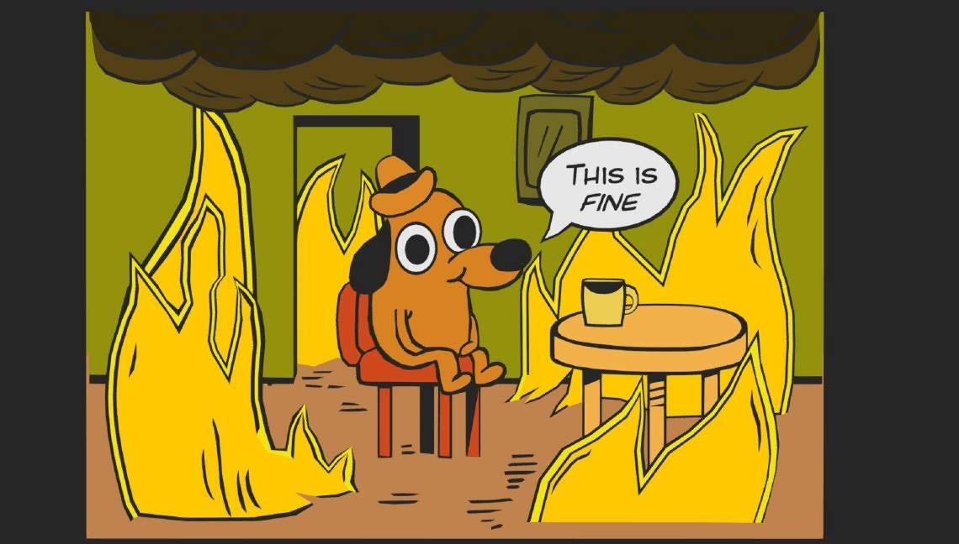
Current state of Cybersecurity
Phishing attacks are still
number 1
Ransomware attacks are
on the rise
Social Engineering is the leading attack vector for scams

Slide 4
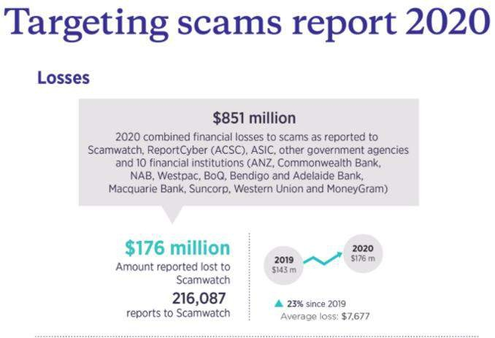
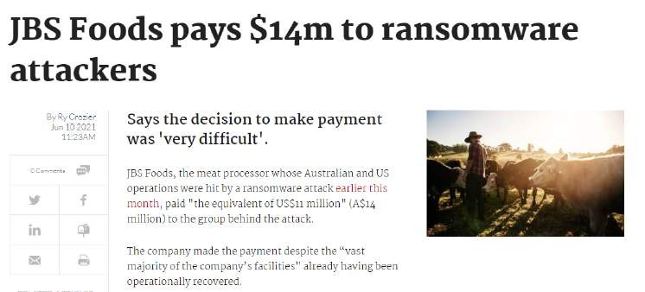
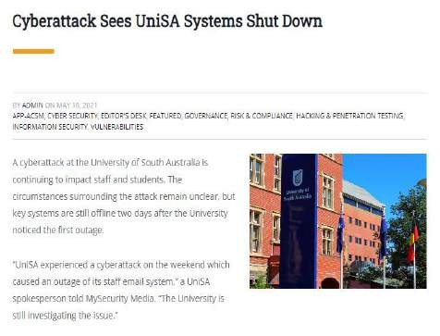
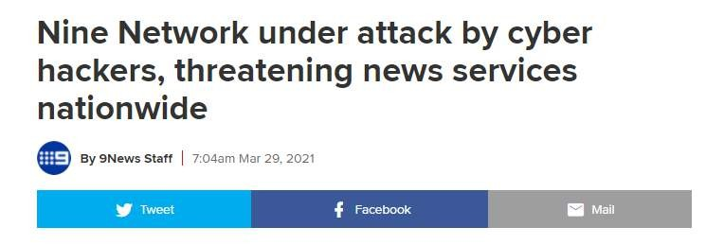
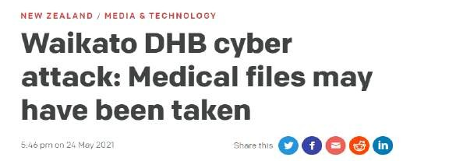
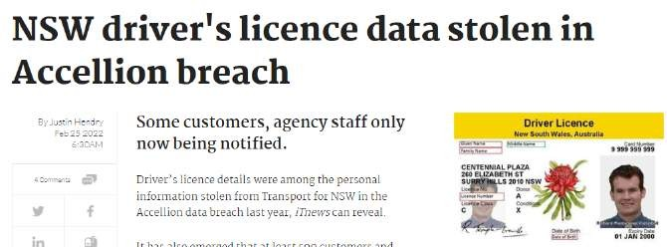
Cost of Cybersecurity Attacks

Slide 5
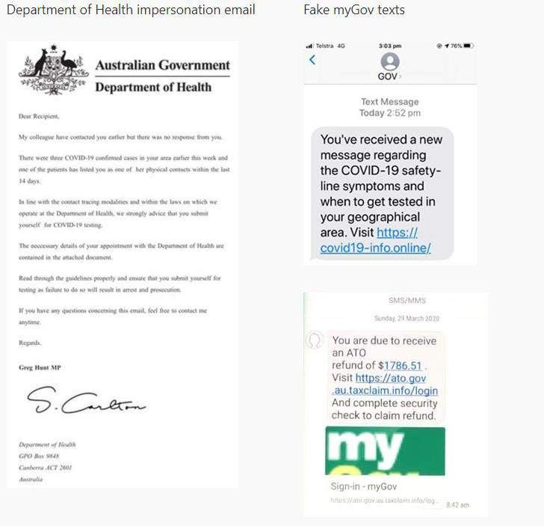
Phishing Attacks
Phishing emails
e.g. COVID 19 vaccines
Vishing
e.g. Computer technician call to fix a virus on your machine
Smishing
e.g. ATO text messages to claim a tax refund

Slide 6
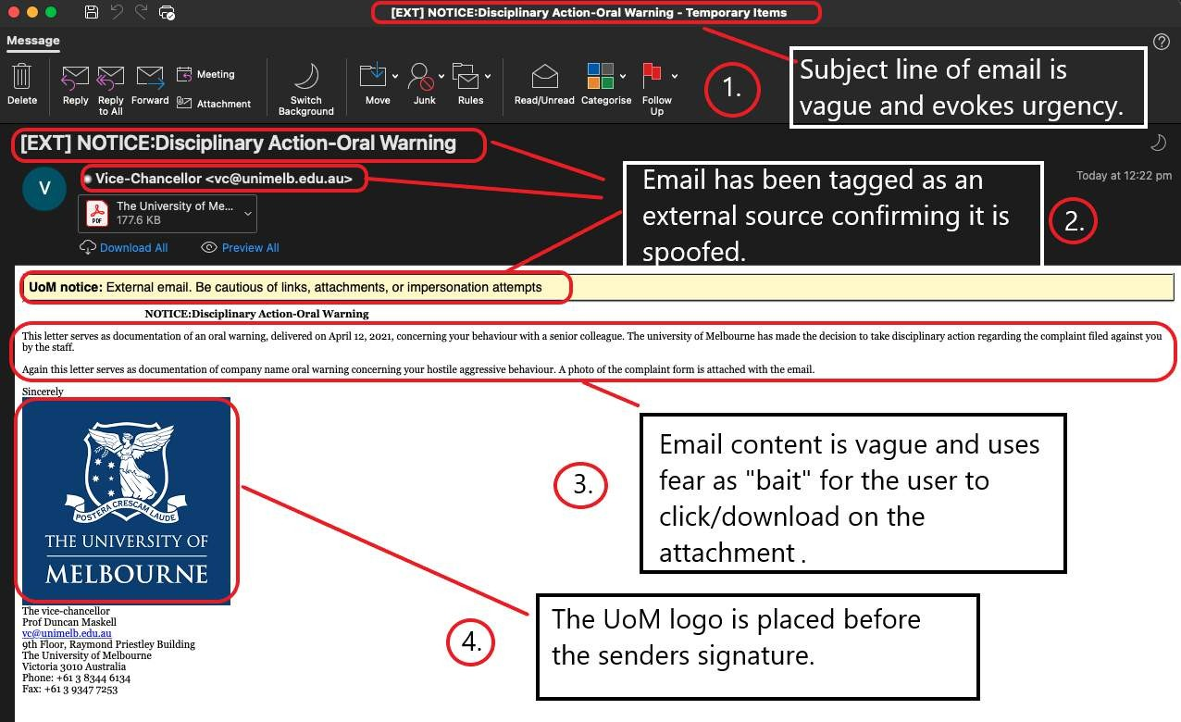
Phishing Examples

Slide 7
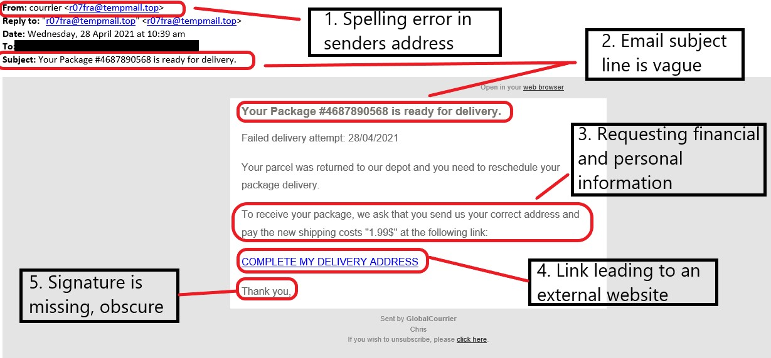
Phishing Examples

Slide 8
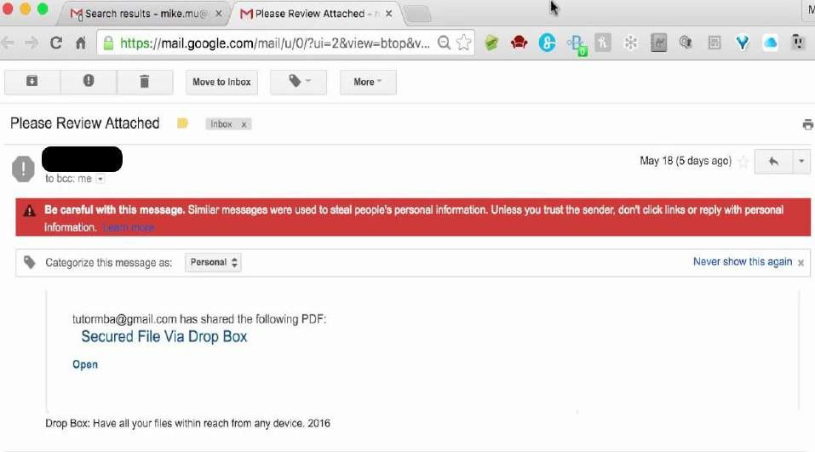
Ransomware
Type of malware that encrypts data specifically
asking for payment in order to restore access.
How?
Protect Yourself
Email attachments
Regular backups
Website
downloads
Updates
Email links
Verify emails
Website links
Don’t PAY!

Slide 9
Why is Cyber awareness so important?
Everything is CONNECTED!
Personal documents
Identity
Finances
Digital footprint
9

Slide 10
How can I protect myself?

Slide 11
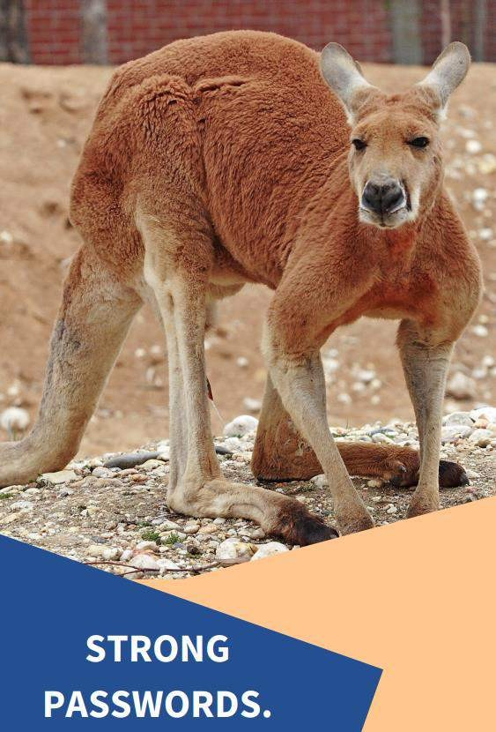
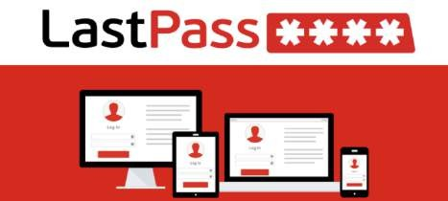
Passwords
Long and strong. Passphrases
Enable 2FA where possible
Change default passwords
Don’t reuse passwords across accounts
Use a Password manager (LastPass is FREE)

Slide 12
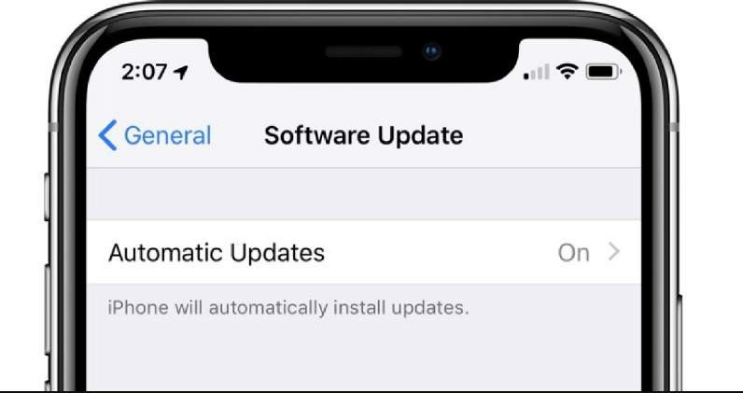
Updates
Ensure all devices are on their latest updates.
Turn on AUTOMATIC UPDATES
Make time for updates
Spring clean your apps regularly

Slide 13
Be aware of Scams
Phishing - email
Vishing – phone call
Smishing – text messages
Look out for:
Urgency
Asking for personal/financial information
Unsolicited
Contain links and downloadable files
Bad grammar
Too good to be true

Slide 14
Search Yourself (Digital Footprint)
Privacy controls
Be mindful of what you share
Review app privacy collection

Slide 15
Creating a Cyber secure home checklist
Are my devices secure?
Using VPN to access University systems?
Beware of using FREE Wi-Fi
Do I have anti virus installed?
Am I backing up my important files? Cloud & Local
Are my devices up to date?
Enable two-factor authentication (2FA) where possible
STOP. THINK BEFORE YOU CLICK.

Slide 16
How can you help?
Report suspicious emails : spam-report@unimelb.edu.au
Got a question? Service Now ticket
Yammer & Slack
Sign up for free cyber alerts (Australian Cyber Security Centre)
GET IN TOUCH!

Slide 17
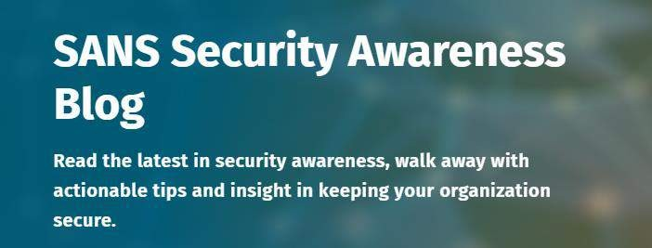
Helpful Websites
Scamwatch
Stay Smart Online
SANS Security Awareness Blog

Slide 18
Thank you!

