Slide 1
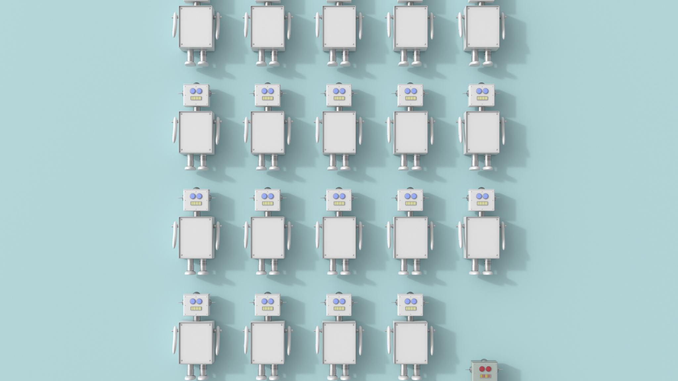
Unit 7: Computers and Robots
Yr 3 Wk 3 Day 2

Slide 2
Learning Objective
By the end of the lesson, learners will be able to identify the different types of files that can be stored on a computer's hard drive.

Slide 3
Key vocabulary
Text files: it contains text or numbers or both

Slide 4
Hook Activity - Group
Each group will brainstorm and list some devices in the home with the computer inside in the A4 sheet.

Slide 5
Main Activity– Pair Work (20 mins)
Learner will work in pair to sort the following devices that Siri or Alexa can assist or cannot be assisted (Sorting Activity worksheet attached).
After the allotted time, have each pair share their answer with the class.

Slide 6
Discussion time

Slide 7
Main Activity (Individual activity – 20 mins):
Learner will do Practice question 1 in the book pg 109:
Extension task:
Early finisher will write different types of file in their notebook.
Such as

Slide 8
Exit Ticket (10 mins)
The teacher will display the following question on the board. What is the primary storage location for files on a computer? a. RAM b. Hard drive c. External drive d. USB flash drive How are files organized on a computer similar to paper documents? a. In binders b. In folders c. In drawers d. On shelves Where can different folders be located on a computer's hard drive? a. Only in one specific location b. Randomly scattered c. In different places d. Exclusively on the desktop Why do files on a computer have individual names? a. To make them more interesting b. To easily find and identify them c. To differentiate them from folders d. As a security measure What are the various types of files mentioned in the text? a. Only text and audio b. Text, audio, image, video, games c. Text, image, and games d. Audio, video, and games only Mark as Quiz 2. Students will write their answers in sticky notes or can use plickers. www.plickers.com/shomaila/CS-Term-2-Unit-7--Computers-and-robots-30476

