Slide 1
Unit 5-Digital Content Streaming digital content
Year 6 Week 11 Day1

Slide 2
Learning objective
By the end of the lesson you will be able to identify and understand that a range of digital content is stored on servers, including streaming and messaging services after having a class discussion and completing the task.

Slide 3
Key Vocabulary
Digital content, Streaming, Podcast, Audio book

Slide 4
Big Question
Why do we need streaming?
What makes good streaming content?
What are the different ranges of digital content you have made use of in your day to day life?

Slide 5
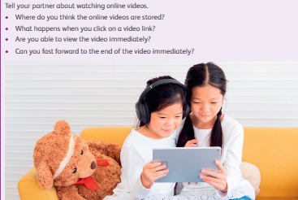
Hook Activity – Group (10 mins)
5 mins- Discuss with your peer and present your answer your to your classmate.

Slide 6
Hook Activity – Group (10 mins)
5mins-Watch the video about Google data center.

Slide 7
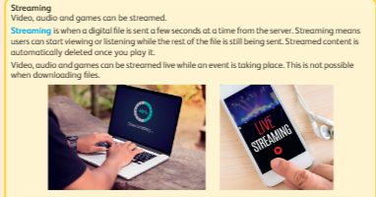
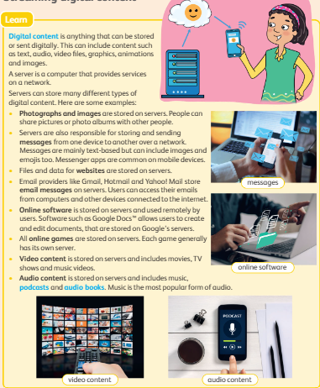
Main Activity Discussion–
Do you remember some of the main types of media files that are stored on computers?
If yes can anyone list?

Slide 8
Main Activity
15 mins-Group Activity ( Sorting the content and service provider)
Complete the Activity sheet 4
20 mins-
Make a Report on different types of digital content and about streaming services available in Qatar with appropriate images.
If computer lab is available, they will make a report using MS Word.

Slide 9
Extension Task
Write down the answers in the barcoded sheet

Slide 10
Plenary
Research about the streaming services which are owned by Qatar and jot it down in the sticky note.

