Slide 1
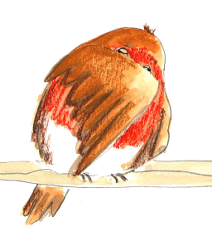
Noun Phrases

Slide 2
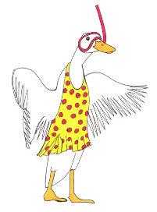
Nouns
Nouns are often names of people, places or things.
Uncle Harry
The garden
A bird
Sometimes they name an idea or feeling.
A dream
happiness
In front of a noun, we often have
a an the
Revision

Slide 3
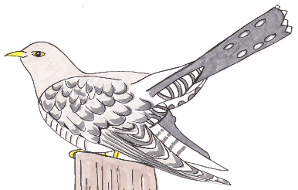
Adjectives
An adjective is a describing word.
It tells you more about a noun.
a white bird
an elegant owl
a dark shape
The cuckoo was hidden.
Its calls were amazing.
Adjectives sometimes come next to ‘their’ nouns…
but sometimes they do not.
Revision

Slide 4
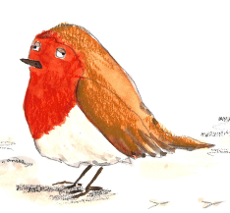
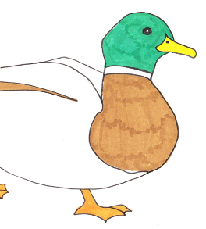
Noun Phrases
A noun phrase adds extra detail to the noun.
red-breasted robin
its cheerful calls
the happy visitor
a complete surprise
It can be made by adding an adjective or two.
Revision

Slide 5
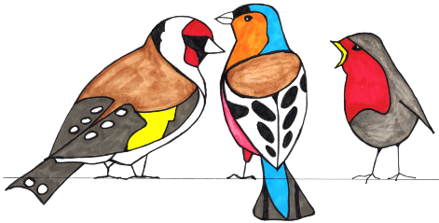
Spotting a Noun Phrase
A noun phrase can be replaced by a pronoun.
The red-breasted robin was on the wall.
The noisy jay flew down beside him.
The beautiful goldfinch then arrived.
The robin gave them a stern warning.
He was on the wall.
It flew down.
She arrived alongside.
The robin gave it to them.
Revision

Slide 6
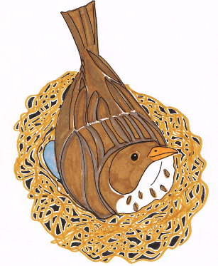
Adding more description using little words…
Can you find the adjectives?
of
by
with
on
under
in
These are called prepositions
The shy bird on her nest…
The brown bird under the eaves of the house …
The little eggs in the nest under the bird are warm.
Notes:
All these slides are based on the teaching outlined in the document ‘Teaching_1_Pronouns’ available from Hamilton.
It is essential to read the teaching before using this powerpoint presentation.

Slide 7
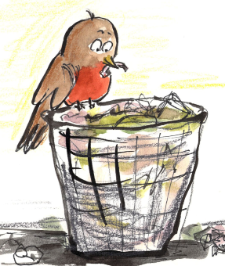
Prepositions help us add description
above
of
over
The hungry bird on the bin…
with
on
without
Behind the bin, a cat prowled…
behind
by
inside
beside
The watchful bird with bright eyes…
from
outside
under
below
The irritated cat without a chance slunk off.

Slide 8
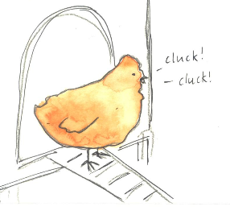
Create your own descriptions
above
Write a noun
of
on
over
with
inside
Add an adjective
chicken
without
outside
by
the careful chicken
beside
behind
Now you have a go…
Add more description
from
under
The careful chicken on the ladder,
below
looked all around for danger.

Slide 9
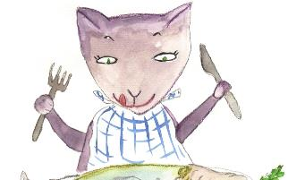
End
Notes:
All these slides are based on the teaching outlined in the document ‘Teaching_1_Pronouns’ available from Hamilton.
It is essential to read the teaching before using this powerpoint presentation.

