Slide 1
CALCULATIONS INVOLVING GAS VOLUMES

Slide 2
LET’S EXERCISE
Find the molar concentration of 14.3g of hydrated sodium carbonate, Na₂CO₃.10H₂O in 500 cm³ of distilled water.
Molar concentration = 0.1 mol/dm3

Slide 3
Number of Moles from a Volume and Concentration
Mole (mol)
Volume (dm³ )
Concentration
(mol/ dm³)

Slide 4
Number of Moles from a Volume and Concentration
Mole (mol)
Volume (cm³ )
concentration
1000

Slide 5
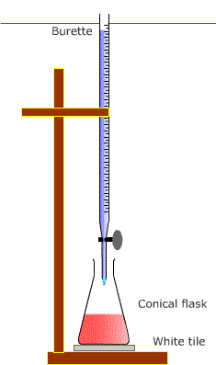
Calculations with Titrations
Titration- a technique that
is used to find out how much
of one solution reacts with a
certain volume of another
solution of known
concentration.
http://alevelchem.com/aqa_a_level_chemistry/unit3.3/331/titration.htm

Slide 6
Calculations with Titrations
1) 25cm³ of 0.100 mol/dm³ sodium hydroxide solution required 23.5ocm³ of dilute HCl acid for neutralisation. Calculate the concentration of the HCl acid.
NaOH(aq) + HCl(aq) NaCl(aq) + H2O(l)
concentration = 0.11 mol/dm³

Slide 7
Calculations with Titrations
2) 25cm³ of sodium hydroxide solution of unknown concentration was titrated with dilute sulfuric acid of concentration 0.050 mol/dm³. 20.0cm³ of the acid was required to neutralise the alkali . Find the concentration of the sodium hydroxide solution in mol/dm³.
2NaOH(aq) + H2SO4(aq)
Na2SO4(aq) + 2H2O(l)
concentration = 0.08mol/dm³

Slide 8
Reverse Calculations with Titrations
2) Calculate the volume of 0.100mol/dm³ NaHCO3 solution needed to neutralise 20cm³ of 0.125mol/dm³ HCl.
NaHCO3(aq) + HCl(aq)
NaCl(aq) + CO2(g) H2O(l)
concentration = 0.025dm³ or 25cm³

Slide 9
Sources: Chemistry for Cambridge IGCSE Coursebook
Edexcel IGCSE Chemistry (Pearson)
Images from Google

