Slide 1
COMPARE
Identify/comment on similarities and/or differences

Slide 2
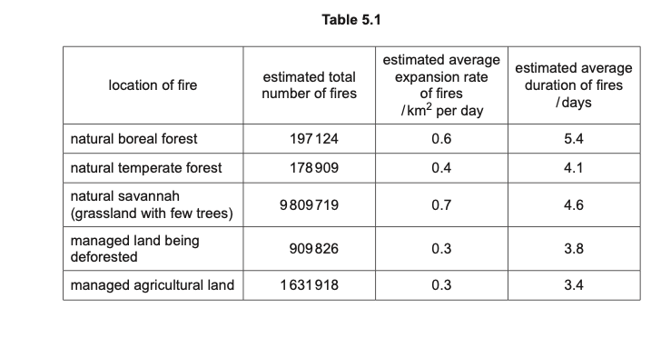
Compare the data for the two managed locations with the data for the three natural locations. [3]

Slide 3
ANSWER
1(total) number of fires in natural ecosystems is higher than (total) number of fires in managed land or idea that the savannah (alone) has more fires than the (total) fires in managed land ;
2 fires on managed land, have a lower expansion rate / spread more slowly (than other fires) ;
3 fires on managed land, have a shorter duration / last less time (than other fires) ;
4 more fires on land being deforested than in natural forest ;
5 comparative data quote (with units at least once) ;
6 AVP;

Slide 4
REVISION TIPS
Compare general trends/summary per row.
Quote at least one data with units

