Slide 1
Shape and Data
Draw and describe 2-D shapes and polygons
Objectives
Day 1
Describe and recognise regular and irregular 2-D shapes.
Day 2
Describe and visualise common 2-D shapes.
Day 3
Make, recognise and describe 2-D shapes.
Notes:
Before teaching, be aware that:
On Day 2 you can also use shapes hidden behind a box for further practice with children selecting (without revealing) shapes to try out.
On Day 3 children will need mini-whiteboards and pens.

Slide 2
Shape and Data
Draw and describe 2-D shapes and polygons
Starters
Day 1
2-D shape (pre-requisite skills)
Day 2
Recognise 2-D shapes (pre-requisite skills)
Day 3
Pattern (simmering skills)
Notes:
Choose starters that suit your class by dragging and dropping the relevant slide or slides below to the start of the teaching for each day.

Slide 3
Shape and Data
Draw and describe 2-D shapes and polygons
Starter
2-D shape
Notes:
Pre-requisite skills – to use this starter, drag this slide to the start of Day 1
Place children in groups of 5, each with a different 2-D shape. Start to draw one of their shapes. Hold up your shape if you think I’m drawing it. Draw a bit more. And now? Continue.

Slide 4
Shape and Data
Draw and describe 2-D shapes and polygons
Starter
Recognise 2-D shapes
Notes:
Pre-requisite skills – to use this starter, drag this slide to the start of Day 2
Place children in five teams: circles, squares, triangles, rectangles, hexagons. Use a puppet to show part of a shape from behind a ‘wall’. Children put up their hands if they think it is their shape. Reveal more, then all of the shape. Give the shape to the team if they guessed it. Repeat.

Slide 5
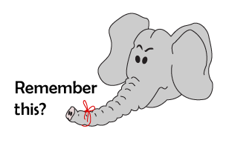
Shape and Data
Draw and describe 2-D shapes and polygons
Starter
Pattern
Notes:
Simmering skills – to use this starter, drag this slide to the start of Day 3
Draw a repeating pattern of 3 shapes. Children draw next 3 shapes on whiteboards. Children then create their own pattern for a partner to continue.

Slide 6
Shape and Data
Draw and describe 2-D shapes and polygons
Objectives
Day 1
Describe and recognise regular and irregular 2-D shapes.

Slide 7
Day 1: Describe and recognise regular and irregular 2-D shapes.
Talk to your partner.
What’s the same about these shapes?
What’s different about them?
All the sides of the shapes are straight but the number of sides is different!

Slide 8
Day 1: Describe and recognise regular and irregular 2-D shapes.
What’s the same about these two shapes?
They each have 5 sides and are pentagons. ‘Pent’ means 5 (it comes from Greek penta).

Slide 9
Day 1: Describe and recognise regular and irregular 2-D shapes.
What’s the same about these two shapes?
They each have 6 sides and are hexagons.
‘Hex’ means 6.

Slide 10
Day 1: Describe and recognise regular and irregular 2-D shapes.
How many sides does this shape have?
It has 8 sides. It is called an octagon. ‘Oct’ means 8. Can you think of any other words beginning ‘oct-’?
Notes:
NB: October used to be the 8th month (of ten) on the Roman calendar.

Slide 11
Day 1: Describe and recognise regular and irregular 2-D shapes.
Talk to your partner.
How have the shapes been sorted this time?
All the shapes on the left are symmetrical.

Slide 12
Day 1: Describe and recognise regular and irregular 2-D shapes.
We can use a mirror to check if shapes are symmetrical.
Where would you put the mirror on the other shapes to check?
Notes:
Children can now go on to do differentiated GROUP ACTIVITIES. You can find Hamilton’s group activities in this unit’s TEACHING AND GROUP ACTIVITIES download.
WT/ARE/GD: Sort shapes into hexagons, pentagons and octagons OR Make a variety of shapes using skipping ropes.

Slide 13
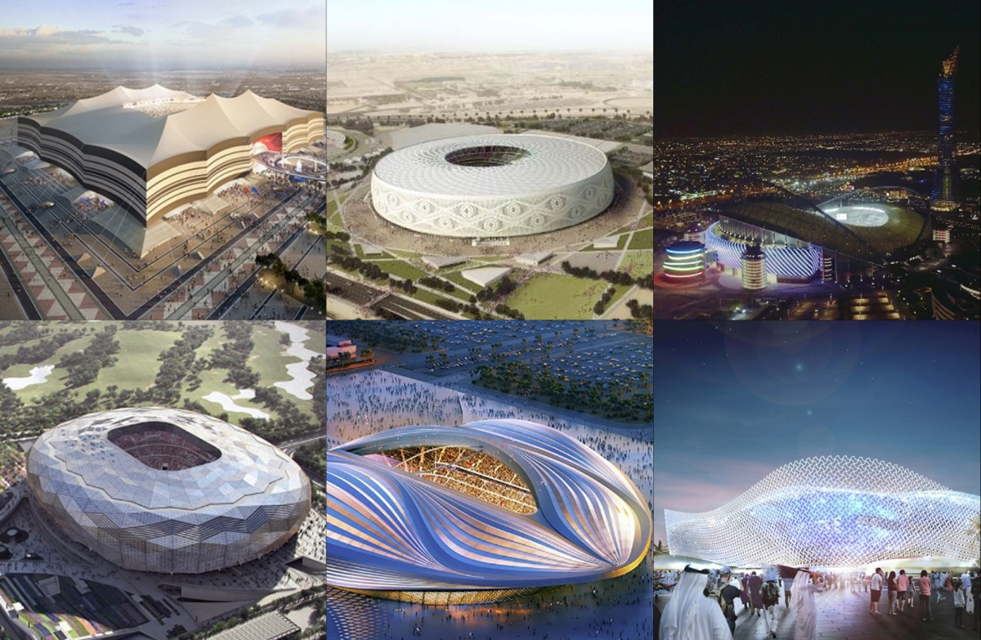
QNID
Look at the stadiums built for FIFA. Are they symmetrical? Symmetrical means having two halves the same where one is the mirror image of the other.

Slide 14
Task 1 – Pair/Group Work
· Get into small groups (3–8 friends).
· Use a skipping rope to make a 4-sided shape.
· Turn it into a square, then a rectangle.
· Make a triangle, then try a different kind of triangle.
· After each shape, draw it in your notebook and write how many friends or hands held the rope.
· Try to make new shapes using more people or hands, up to 8.
· Name each shape you make and have fun!

Slide 15
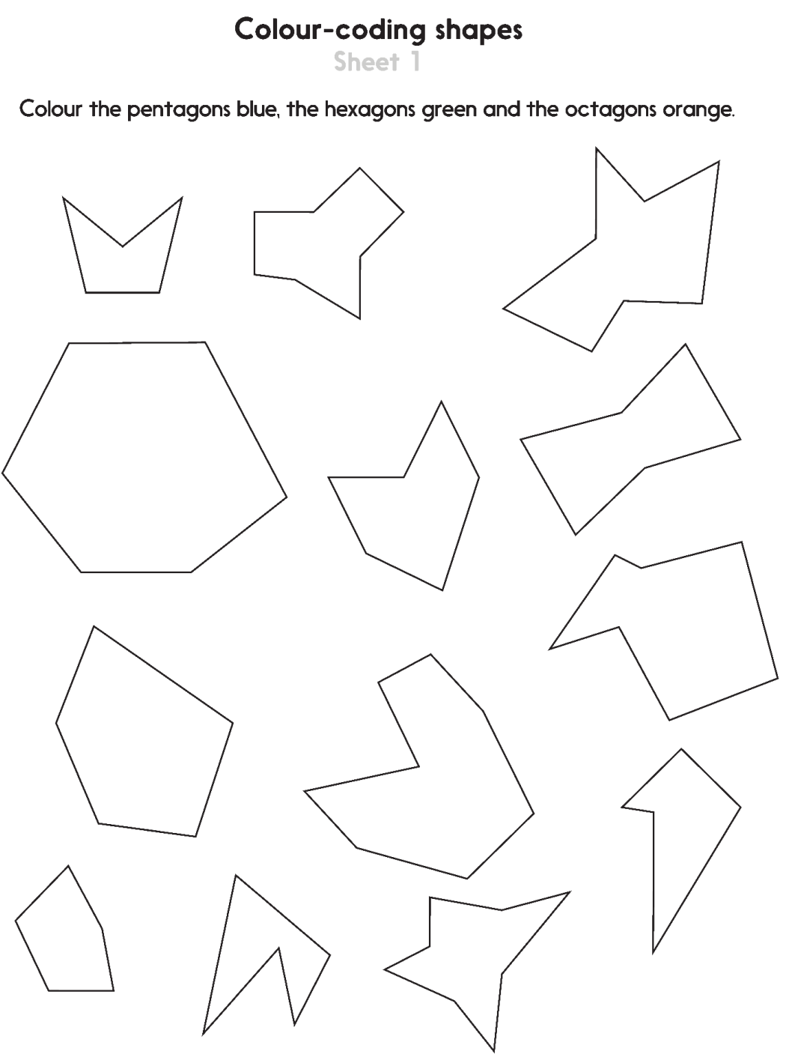
Task 2 – Independent Work
Challenge
Notes:
The Practice Sheet on this slide is suitable for most children.
Differentiated PRACTICE WORKSHEETS are available on Hamilton’s website in this unit’s PROCEDURAL FLUENCY box.
WT: Colour coding shapes Sheet 1.
ARE: Colour coding shapes Sheet 1.
GD: Colour coding shapes Sheet 1 plus Challenge.

Slide 16
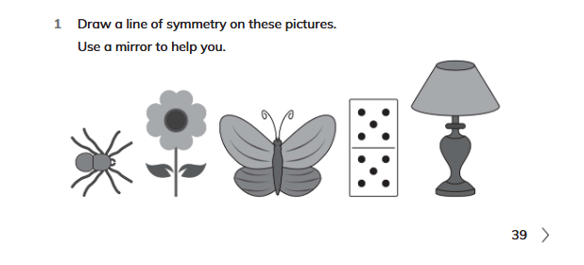
Plenary
Workbook Exercise 2.2 no. 1 on page 39

Slide 17
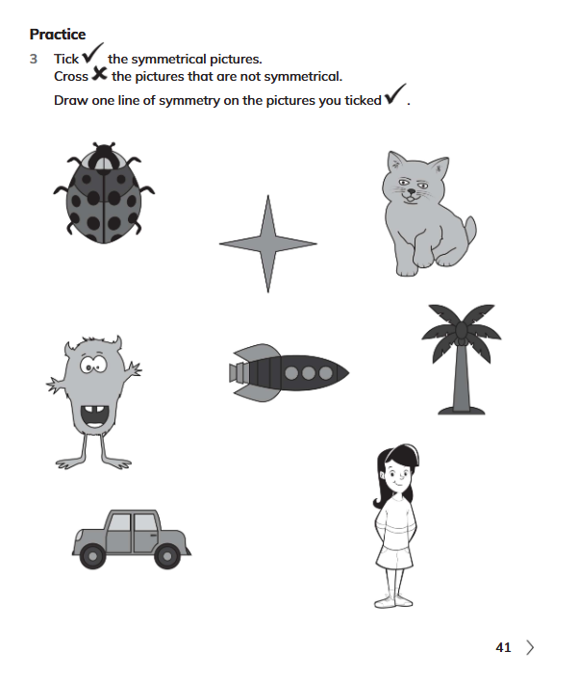
Homework
Workbook Exercise 2.2 Practice nos. 3 on page 41
Notes:
The Practice Sheet on this slide is suitable for most children.
Differentiated PRACTICE WORKSHEETS are available on Hamilton’s website in this unit’s PROCEDURAL FLUENCY box.
WT: Weight Sheet 1.
ARE/GD: Weight Sheet 2.

