Slide 1
Science - Year 3
Plants – Block 3P
Artful Flowers, Fruits and Seeds
Session 6
Quiz PowerPoint
© Original resource copyright Hamilton Trust, who give permission for it to be adapted as wished by individual users.
We refer you to our warning, at the foot of the block overview, about links to other websites.

Slide 2
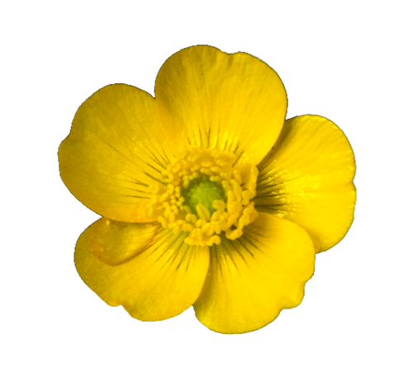
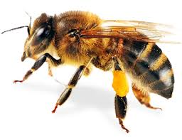
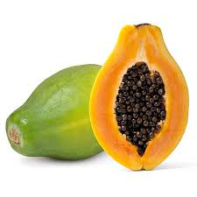
Quiz on Flowers, Fruits and Seeds

Slide 3
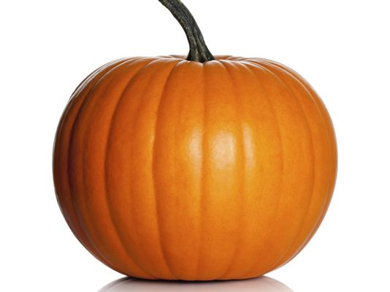
On each slide there is a question and some possible answers. Each answer has a letter. Choose the letter that is above the right answer and write it on your sheet.
Some are quite easy, others are a bit harder. If you’re not sure, give it your best guess.

Slide 4
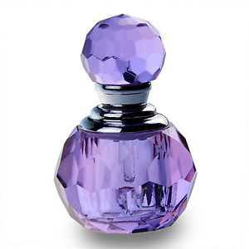
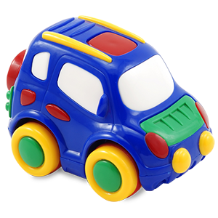
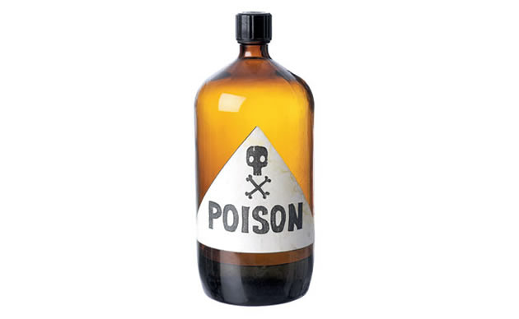
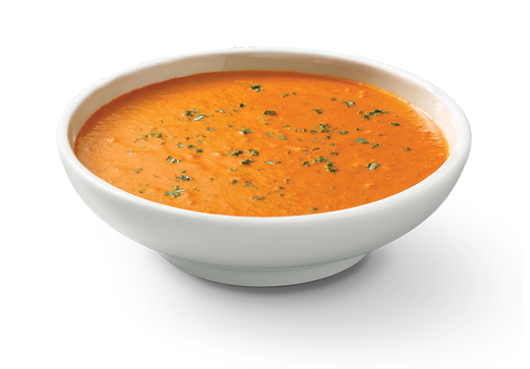
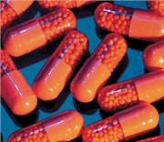
1. Plants can be used for making …
A
Perfume
B
Plastics
C
Poison
D
Medicine
E
Food
Which one is not true?

Slide 5
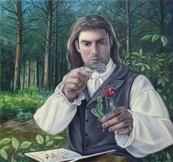
2. A person who studies plants is called a ?
A
Geologist
B
Botanist
C
Chemist

Slide 6
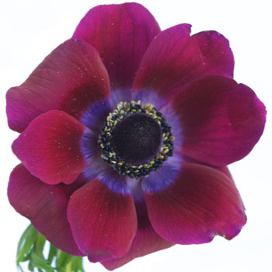
3. Most plants produce flowers. These are important because they …
C
A
B
Are bright and colourful
Enable plants to reproduce
Are attractive to humans

Slide 7
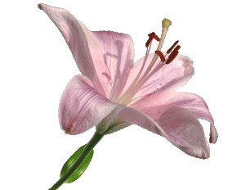
4. The reproductive parts in the centre of this flower are …
A
B
C
Stalks and heads
Stems and petals
Male and female

Slide 8
5. The male parts are called the
A
B
C
Stigmas
Ovaries
Stamens

Slide 9
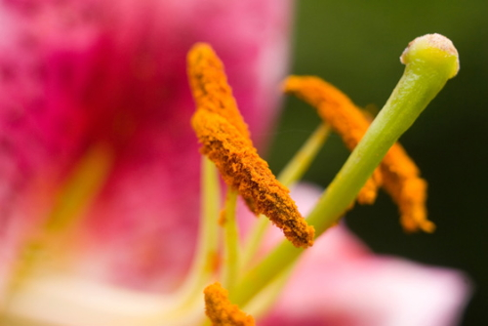
6. It is the job of the stamens to make …
A
B
C
Pollen
Ovules
Petals

Slide 10
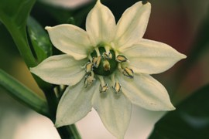
7. The female part of the flower is made of 3 parts, …
3 of these are true.
Which one is not true?
A
The stigma
B
The Anther
C
The style
D
The Ovary

Slide 11
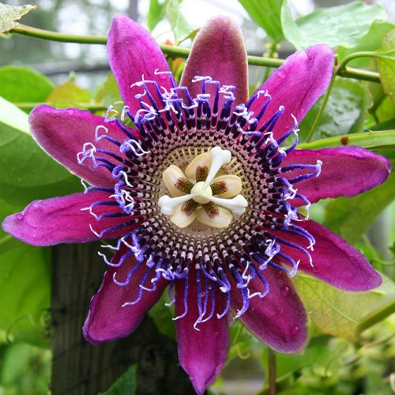
Together the female parts are called the …
A
The sepal
B
The bud
C
The carpel

Slide 12
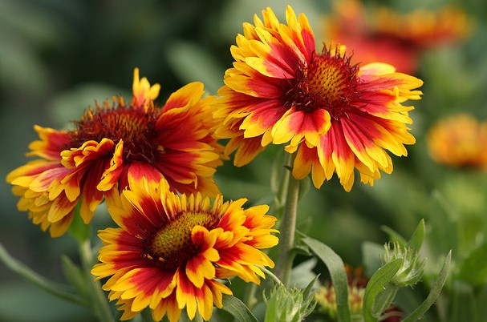
9. Bees visit flowers to collect a sugary food called …
A
Nectar
B
Pollen
C
Syrup

Slide 13
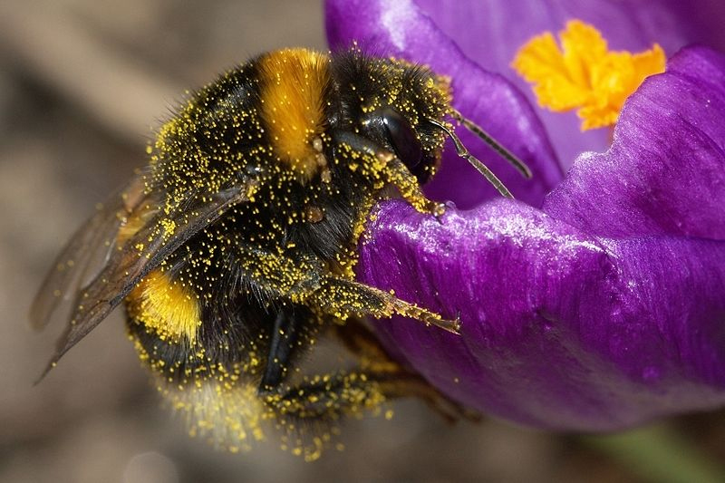
10. Bees fly from one flower to another, collecting nectar. Pollen from the stamens of one flower can attach to the stigma of another flower. This is called …
A
B
C
Infestation
Pollination
Investigation

Slide 14
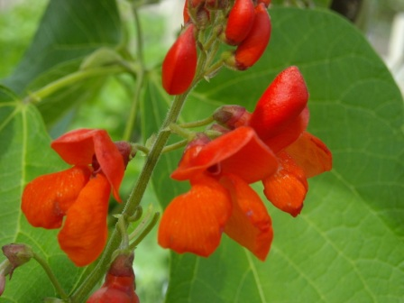
11. After pollination, the flower will …
A
Shrivel and die
B
Make new petals
C
Bloom

Slide 15
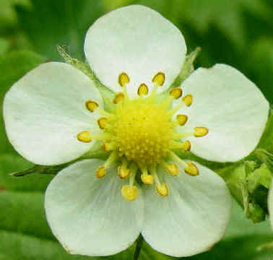
12. The pollen grains make a tube and travel down to the ovary where they join with the…
A
Anthers
B
Ovules
C
Sepals

Slide 16
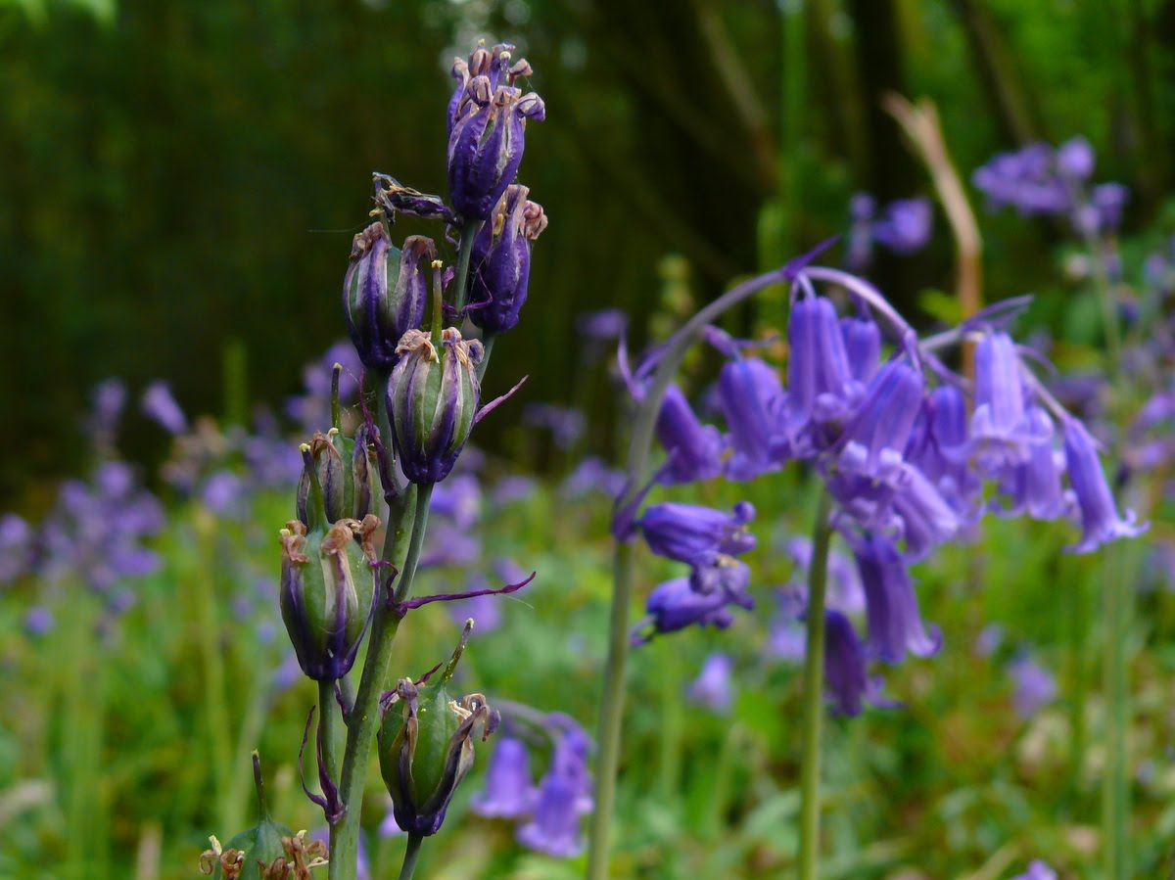
13. The ovules have now been …
A
Fertilised
B
Pasteurised
C
Sterilised

Slide 17
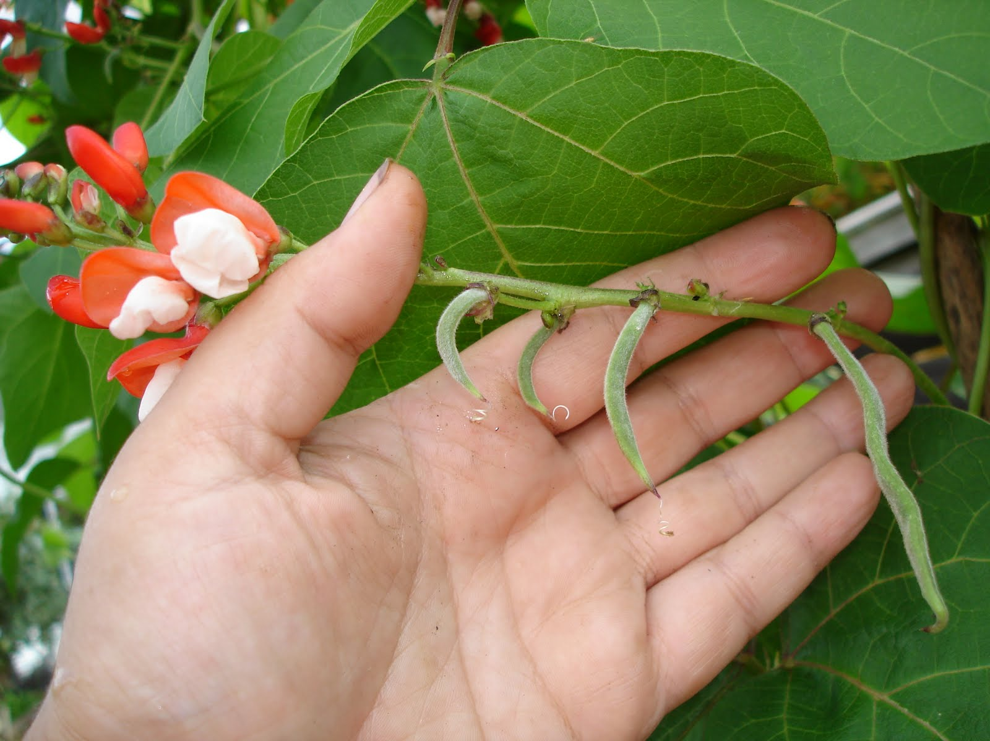
14. After fertilisation, the ovary grows into a …
A
seed
B
pip
C
fruit

Slide 18
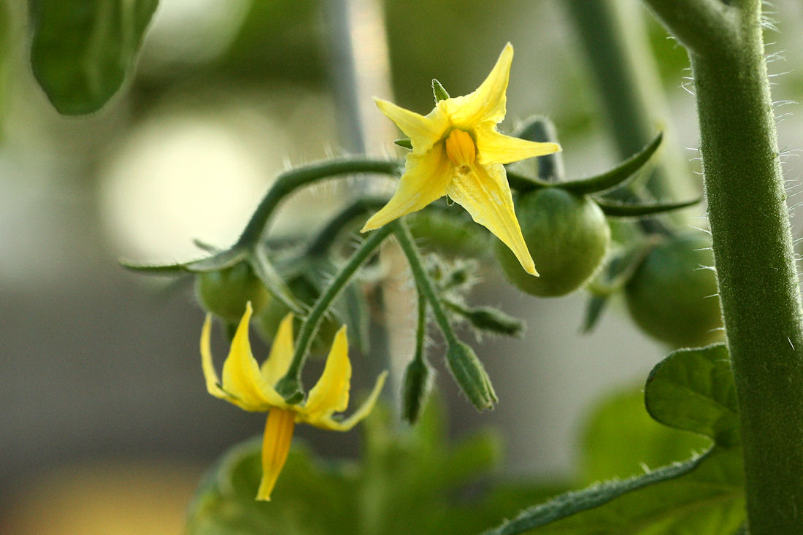
15. Inside the fruit, the fertilised ovules turn into …
A
B
C
seeds
blossoms
pods

Slide 19
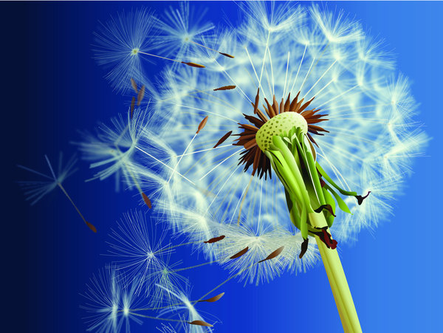
16. Plants need to spread their seeds so they can find new places to grow. This is called…
A
pollination
B
fertilisation
C
dispersal

Slide 20
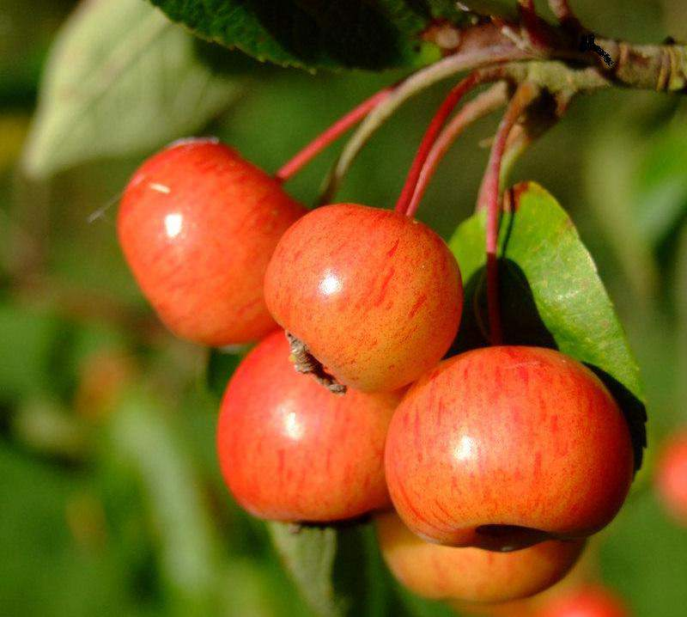
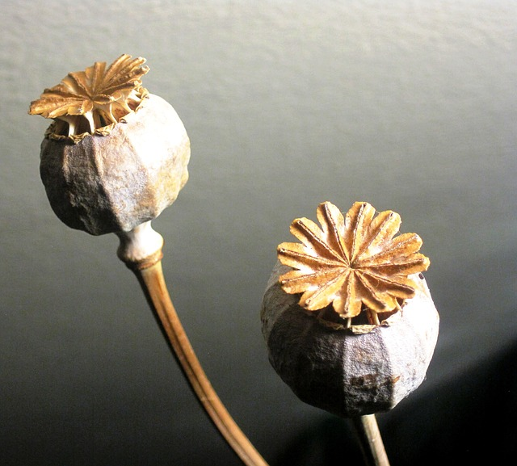
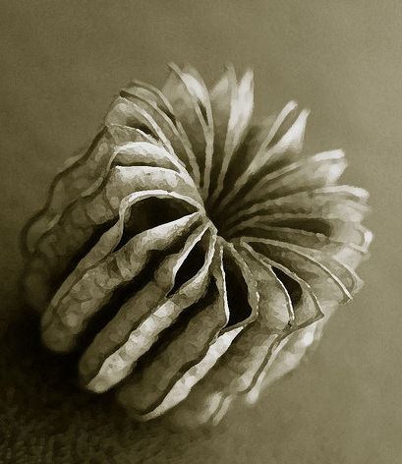
17. There are lots of ways that seeds can be dispersed. Which one of these is not a method of seed dispersal?
A
By wind
B
By animals
C
By electricity
D
By water

Slide 21
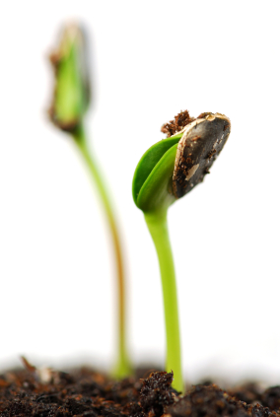
18. When a seed lands in a suitable place, it will grow. When a seed begins to grow, it is called …
A
germination
B
radiation
C
evaporation

Slide 22
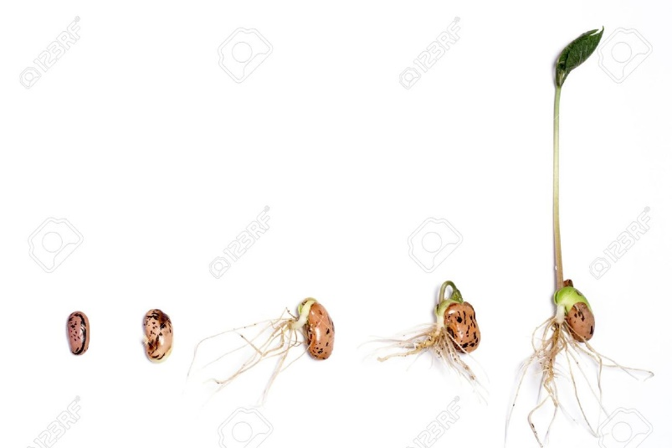
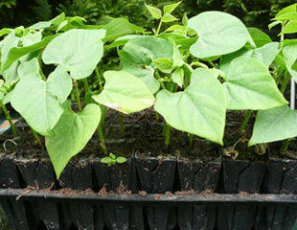
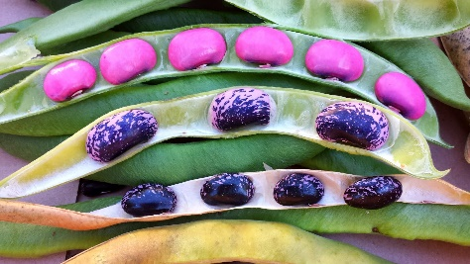
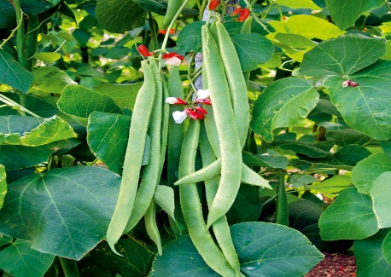
19. A new plant will grow from the seed. In time this plant will produce a flower and then a fruit. Inside the fruit new seeds will form. Some of those seeds will find new places to grow and it will all begin again! This is the plant’s …
A
Life cycle
B
Rotation
C
Circle

Slide 23
Science - Year 3
Plants – Block 3P
Artful Flowers, Fruits and Seeds
Session 6
Quiz Answers PowerPoint
© Original resource copyright Hamilton Trust, who give permission for it to be adapted as wished by individual users.
We refer you to our warning, at the foot of the block overview, about links to other websites.

Slide 24
Answers to Quiz on Flowers, Fruits and Seeds

Slide 25
1. Plants can be used for making …
A
Perfume
B
Plastics
C
Poison
D
Medicine
E
Food
Which one is not true?

Slide 26
2. A person who studies plants is called a ?
A
Geologist
B
Botanist
C
Chemist

Slide 27
3. Most plants produce flowers. These are important because they …
C
A
B
Are bright and colourful
Enable plants to reproduce
Are attractive to humans

Slide 28
4. The reproductive parts in the centre of this flower are …
A
B
C
Stalks and heads
Stems and petals
Male and female

Slide 29
5. The male parts are called the
A
B
C
Stigmas
Ovaries
Stamens

Slide 30
6. It is the job of the stamens to make …
A
B
C
Pollen
Ovules
Petals

Slide 31
7. The female part of the flower is made up of 3 parts, …
3 of these are true.
Which one is not true?
A
The stigma
B
The Anther
C
The style
D
The Ovary

Slide 32
Together the female parts are called the …
A
The sepal
B
The bud
C
The carpel

Slide 33
9. Bees visit flowers to collect a sugary food called …
A
Nectar
B
Pollen
C
Syrup

Slide 34
10. Bees fly from one flower to another, collecting nectar. Pollen from the stamens of one flower can attach to the stigma of another flower. This is called …
A
B
C
Infestation
Pollination
Investigation

Slide 35
11. After pollination, the flower will …
A
Shrivel and die
B
Make new petals
C
Bloom

Slide 36
12. The pollen grains make a tube and travel down to the ovary where they join with the…
A
Anthers
B
Ovules
C
Sepals

Slide 37
13. The ovules have now been …
A
Fertilised
B
Pasteurised
C
Sterilised

Slide 38
14. After fertilisation, the ovary grows into a …
A
seed
B
pip
C
fruit

Slide 39
15. Inside the fruit, the fertilised ovules turn into …
A
B
C
seeds
blossoms
pods

Slide 40
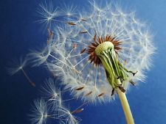
16. Plants need to spread their seeds so they can find new places to grow. This is called…
A
pollination
B
fertilisation
C
dispersal

Slide 41
17. There are lots of ways that seeds can be dispersed. Which one of these is not a method of seed dispersal?
A
By wind
B
By animals
C
By electricity
D
By water

Slide 42
18. When a seed lands in a suitable place, it will grow. When a seed begins to grow, it is called …
A
germination
B
radiation
C
evaporation

Slide 43
19. A new plant will grow from the seed. In time this plant will produce a flower and then a fruit. Inside the fruit new seeds will form. Some of those seeds will find new places to grow and it will all begin again! This is the plant’s …
A
Life cycle
B
Rotation
C
Circle

