Slide 1
Science - Year 3
Plants – Block 3P
Roots and Shoots
Session 6
Quiz PowerPoint
© Original resource copyright Hamilton Trust, who give permission for it to be adapted as wished by individual users.
We refer you to our warning, at the foot of the block overview, about links to other websites.

Slide 2
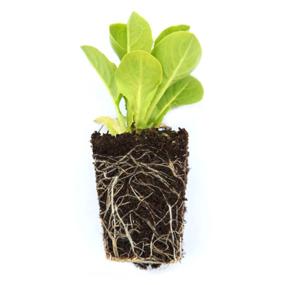
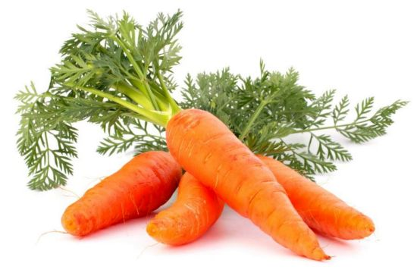
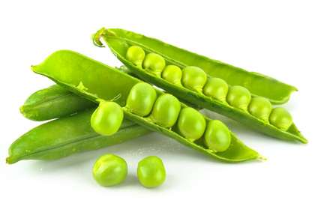
Quiz on Plants

Slide 3
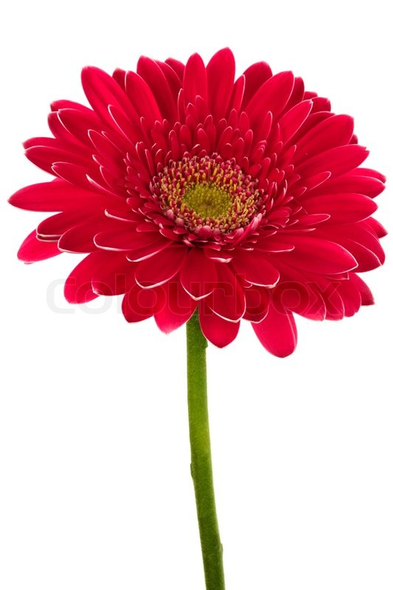
On each slide there is a question and some possible answers. Each answer has a letter. Choose the letter that is above the right answer and write it on your sheet.
Some are quite easy, others are a bit harder. If you’re not sure, give it your best guess.

Slide 4
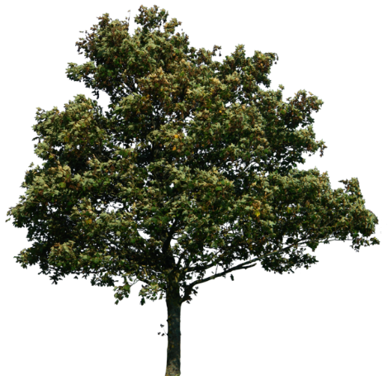
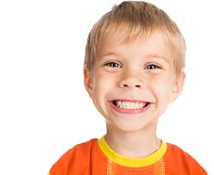
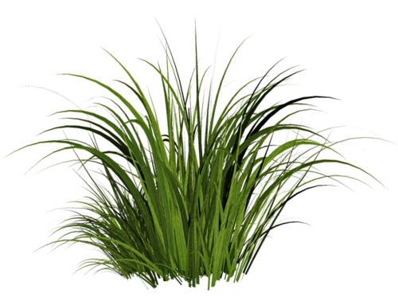
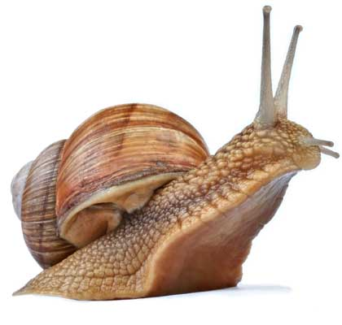
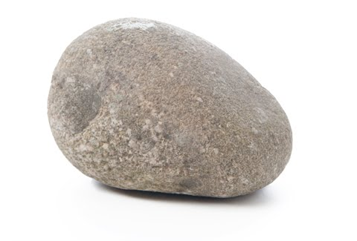
1. Which one is not a living thing?
A
B
C
D
E

Slide 5
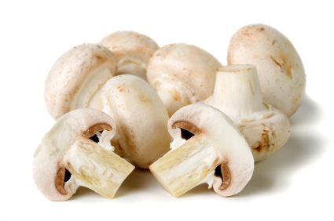
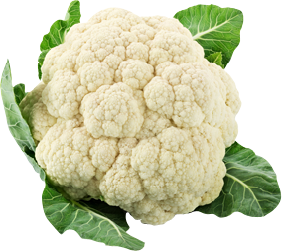
2. Which one is not a plant?
A
B
C
D
E

Slide 6
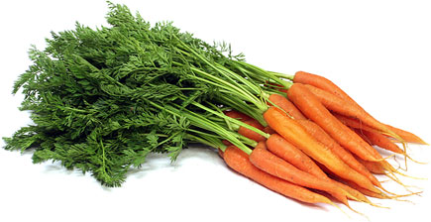
3. Which one of these is not true
A
B
C
D
The root holds the plant upright in the soil
The root takes up water from the soil
The root makes food for the plant
The root can store food for the plant

Slide 7
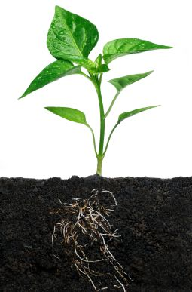
4. Which one is not true?
A
B
C
The stem transports water from the roots to the leaves
The stem of a plant cannot be eaten
The stem contains long tubes called xylem

Slide 8
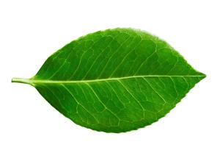
5. Which one is not true
A
B
C
D
The leaves always grow in pairs
The leaves make food for the plant
The leaves have tiny holes on their underside that allow gases in and out
The leaves use energy from sunlight

Slide 9
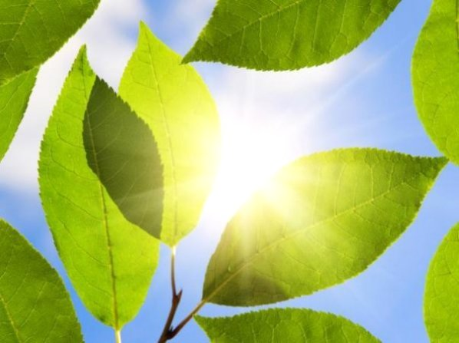
6.Which of these is not needed by a plant to make its food?
A
B
C
D
Water
A gas called carbon dioxide
Sugar
Sunlight

Slide 10
7. Leaves contain a green chemical that traps the sunlight. It is called …
A
oxygen
B
xylem
C
chlorophyll

Slide 11
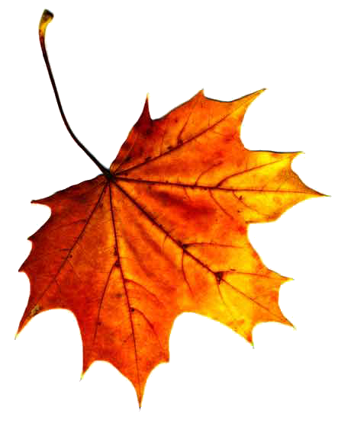
In winter, the leaves of many plants turn brown. This is because
A
The plant cannot get enough water
B
The green chlorophyll breaks down
C
The wind damages them

Slide 12
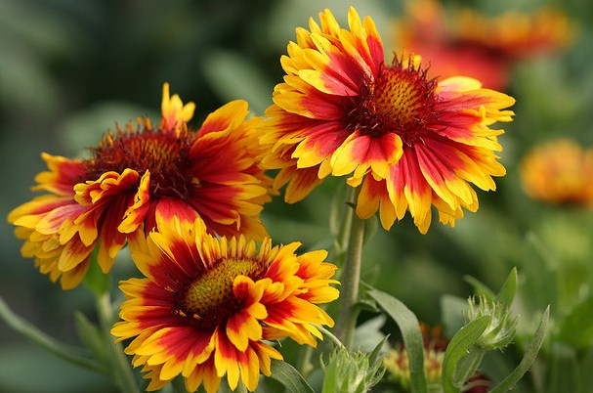
9. Plants make flowers to …
A
Make themselves look nice
B
Warn off predators
C
Reproduce

Slide 13
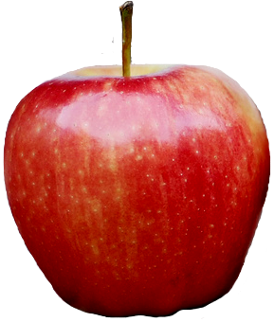
10. The plant makes a fruit to
A
B
C
Hold its seeds
Feed animals
Look attractive

Slide 14
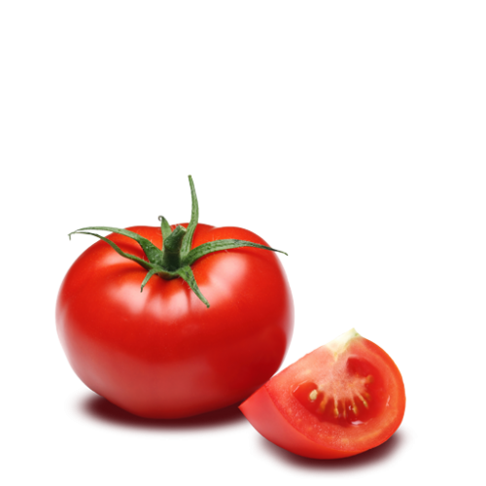
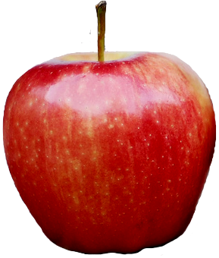
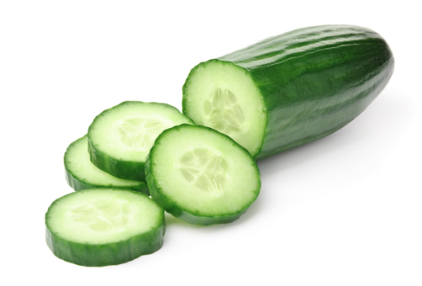
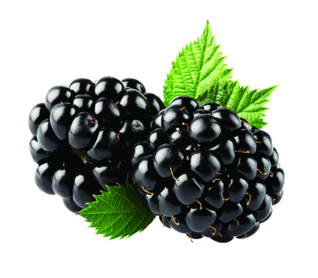
11. Which of these is not a fruit?
A
B
C
D
E

Slide 15
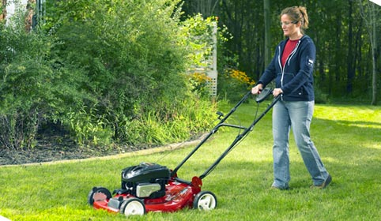
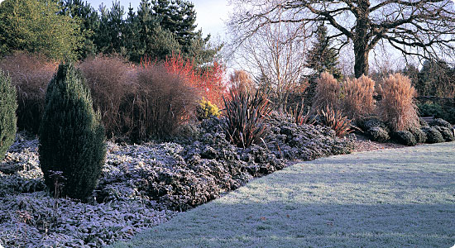
12. When it is cold, plants grow
A
Very slowly
B
Very fast
C
Just the same

Slide 16
13. Soil is important for plants.
Which one of these statements is not true?
A
Plants get minerals and nutrients from soil to keep them healthy
B
Plants need soil for their roots to hold onto so they are anchored in the ground
C
Plants need soil to get rid of waste

Slide 17
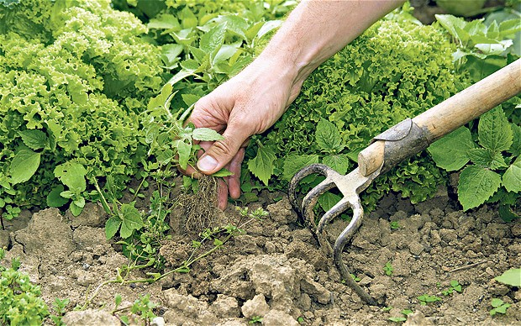
14. To be healthy a plant also needs…
A
A plastic plant pot
B
Other plants nearby
C
Enough space to grow

Slide 18
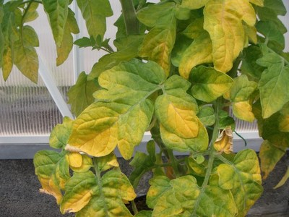
15. Which one is not true?
A plant that has enough water may still be unhealthy if it doesn’t have enough …
A
B
C
D
Space
Attention
Light
Nutrients

